Slide 1
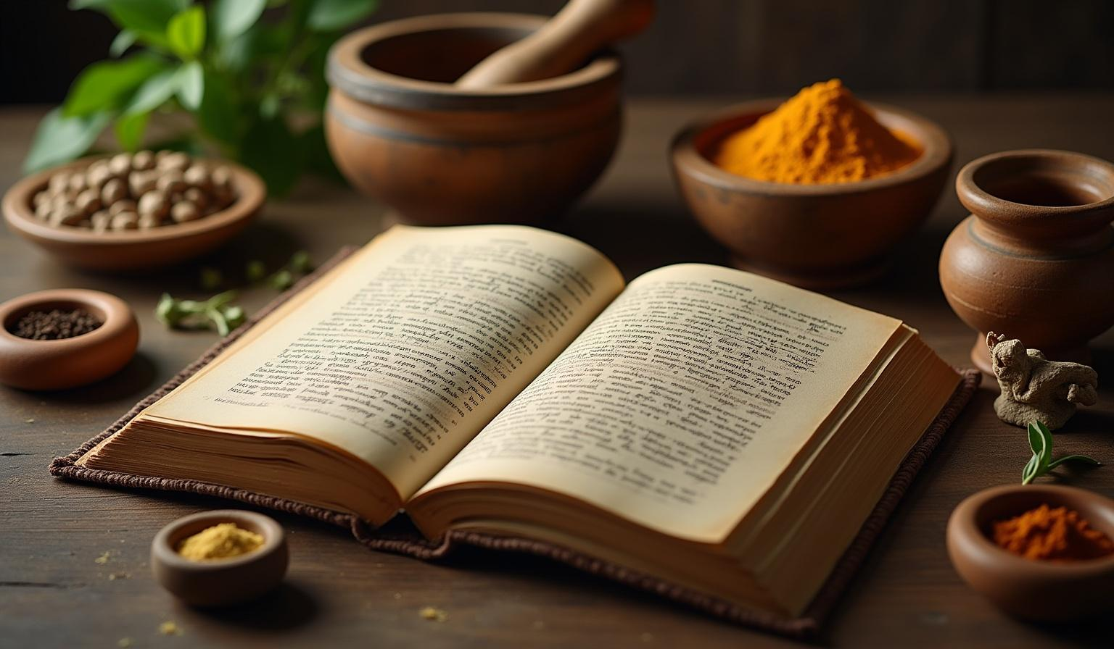
विष चिकित्सा
Management of Poisoning

Slide 2

01
Visha chikitsha upkrama

Slide 3
Introduction
विष चिकित्सा के 24 उपक्रम आचार्य चरक ने च.चि. 23 में विष चिकित्सा के 24 उपक्रमों का वर्णन किया है। ये उपक्रम विज्ञान के इतने विकास के बाद भी उतने ही महत्वपूर्ण, उपयोगी एवं तर्क संगत सिद्ध होते हैं।
मन्त्रारिष्टोत्कर्तन निष्पीडन चूषणानि परिषेकाः।
अवगाह रक्तमोक्षण वमन विरेकोपधानानि ।।
हृदयावरणांजननस्य धूमलेहीषधप्रशमनानि।
प्रतिसारणं प्रतिविषं संज्ञासंस्थापनं लेपः ।।
मृत संजीवनमेव च विंशतिरेते चतुर्भिरधिका।(च. चि. 23/35-37)

Slide 4
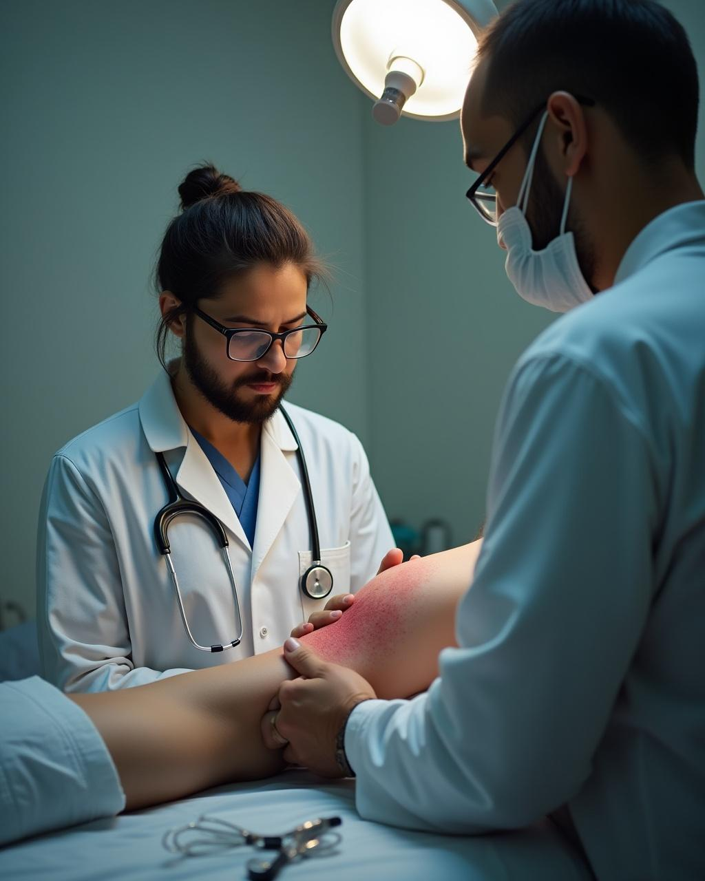
अचार्य चरक द्वारा वर्णित विष चिकित्सा के 24 उपक्रमो को निम्न प्रकार से वर्गीकृत किया जा सकता है-
विष प्रवेश एवं संचरण में बाधक उपक्रम-1. अरिष्टा बन्धन2. निष्पीडन 3. उत्कर्तन 4. चूषण 5. अग्निकर्म6. परिषेक 7. अवगाह
शोधक उपक्रम-8. रक्तमोक्षण9. वमन10. विरेचन11. नस्य
लाक्षणिक उपक्रम- 12. हृदयावरण13. संज्ञास्थापन14. मृत संजीवन
प्रतिरोधक उपक्रम -15. मन्त्र16. औषध17. प्रतिविष
शामक उपक्रम- 18. लेप 19. प्रतिसारण20. अञ्जन 21. प्रधमन 22. धूम 23. लेह24. उपधान

Slide 5
BASIC PRINCIPLE OF POISONING MANAGEMENT (MODERN)
The steps used in poison management is as follow-
Resuscitation (Supportive Care) as per ABCD - if Required
Removal of Unabsorbed Poison
Use of Antidote
Methods of Elimination of Absorbed Poison from Body
Symptomatic Management

Slide 6
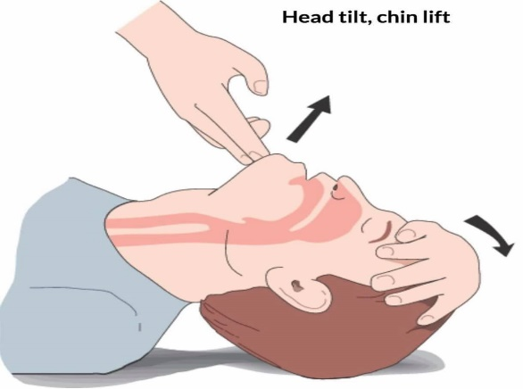
Resuscitation (Supportive Care) as per ABCD - if required
A. Airway Management-
Position of Airway - Head tilt, Chin lift
Suction-if Airway block with salivation or froth Cleaned with a moist cloth or suction machine
Mouth Gag
Plastic/Metallic airway
Endotracheal Tube or Tracheostomy - SOS

Slide 7
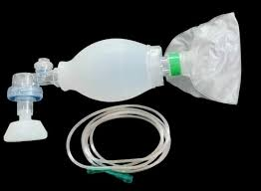
B. Breathing Management-
(a)In field - Mouth to Mouth Respiration
(b)Hospital-1. Oxygen to maintain 100% O, level
2. Manual Ventilation by Ambu Bag
3. Mechanical ventilation by Heart-Lung Machine
Ambu Bag

Slide 8
C. Circulation Management-
a.Hypotension/Dehydration - IV Fluid (Riger Lactate)
b Hypovolumic Shock-Inj. Dopamine Drip with IV Fluid
C Hypertension-Cap. Nefidepine or Inj. Nitroglycerine
D. Drug Management-
Inj. Atropine for excessive secretion & Bradycardia
Inj. Verapamil For Atrial Fibrillation
Inj. Xylocaine-For Ventricular Fibrillation
Inj. Dopamine for Hypovolumic Shock
Inj. Adrenaline Restart the Heart.
Inj. Aminophylline - For Bronchospasm
Inj. Hydrocortisone - For Respiratory Support.
Inj. Sodium bicarbonate - For Metabolic Acidosis.

Slide 9
2. Removal of Unabsorbed Poison
Inhaled Poison:-
Remove the patient from exposure site
Ensure clear airway
Artificial respiration and oxygenation.
2. Injected Poisons:-
(a) Use of tourniquette
(b) Incision and suction.
(c) Ice packs may be applied
3. Contact poisoning through skin, wounds and natural orifices:- Wash the area with water or soap and water.

Slide 10
4. Gastro-Intestinal Decontaminationa
A. Administration of Milk/Water for dilution of Toxin
Contra-Indication - Ingested Phosphorus & Strong Acid Poison
B. Induced Emesis
Definition Induced Emesis-removal of unabsorbed poison from Stomach along with gastric content by means of vomiting induced by emetic is called as Induced Emesis.
Type of induced Mechanical-Posterior pharyngeal wall to be stimulated by FingerChemical-Syp. Epac 30 ml (Adult) & 15 ml (Child)

Slide 11
Contraindication of Induced Emesis-
Corrosive, Petroleum, Mechanical, During Convulsion and Unconsciousness & Unstable Vital
Indication of Induced Emesis –
All Poison except above condition
C. Gastric Lavage (Stomach Wash)
Definition Gastric lavage, also commonly called stomach pumping or gastric irrigation, is the process of cleaning out the contents of the stomach using a tube.
Method of Stomach Wash by-
1.Stomach Wash Tube
2.Ryle's Tube

Slide 12
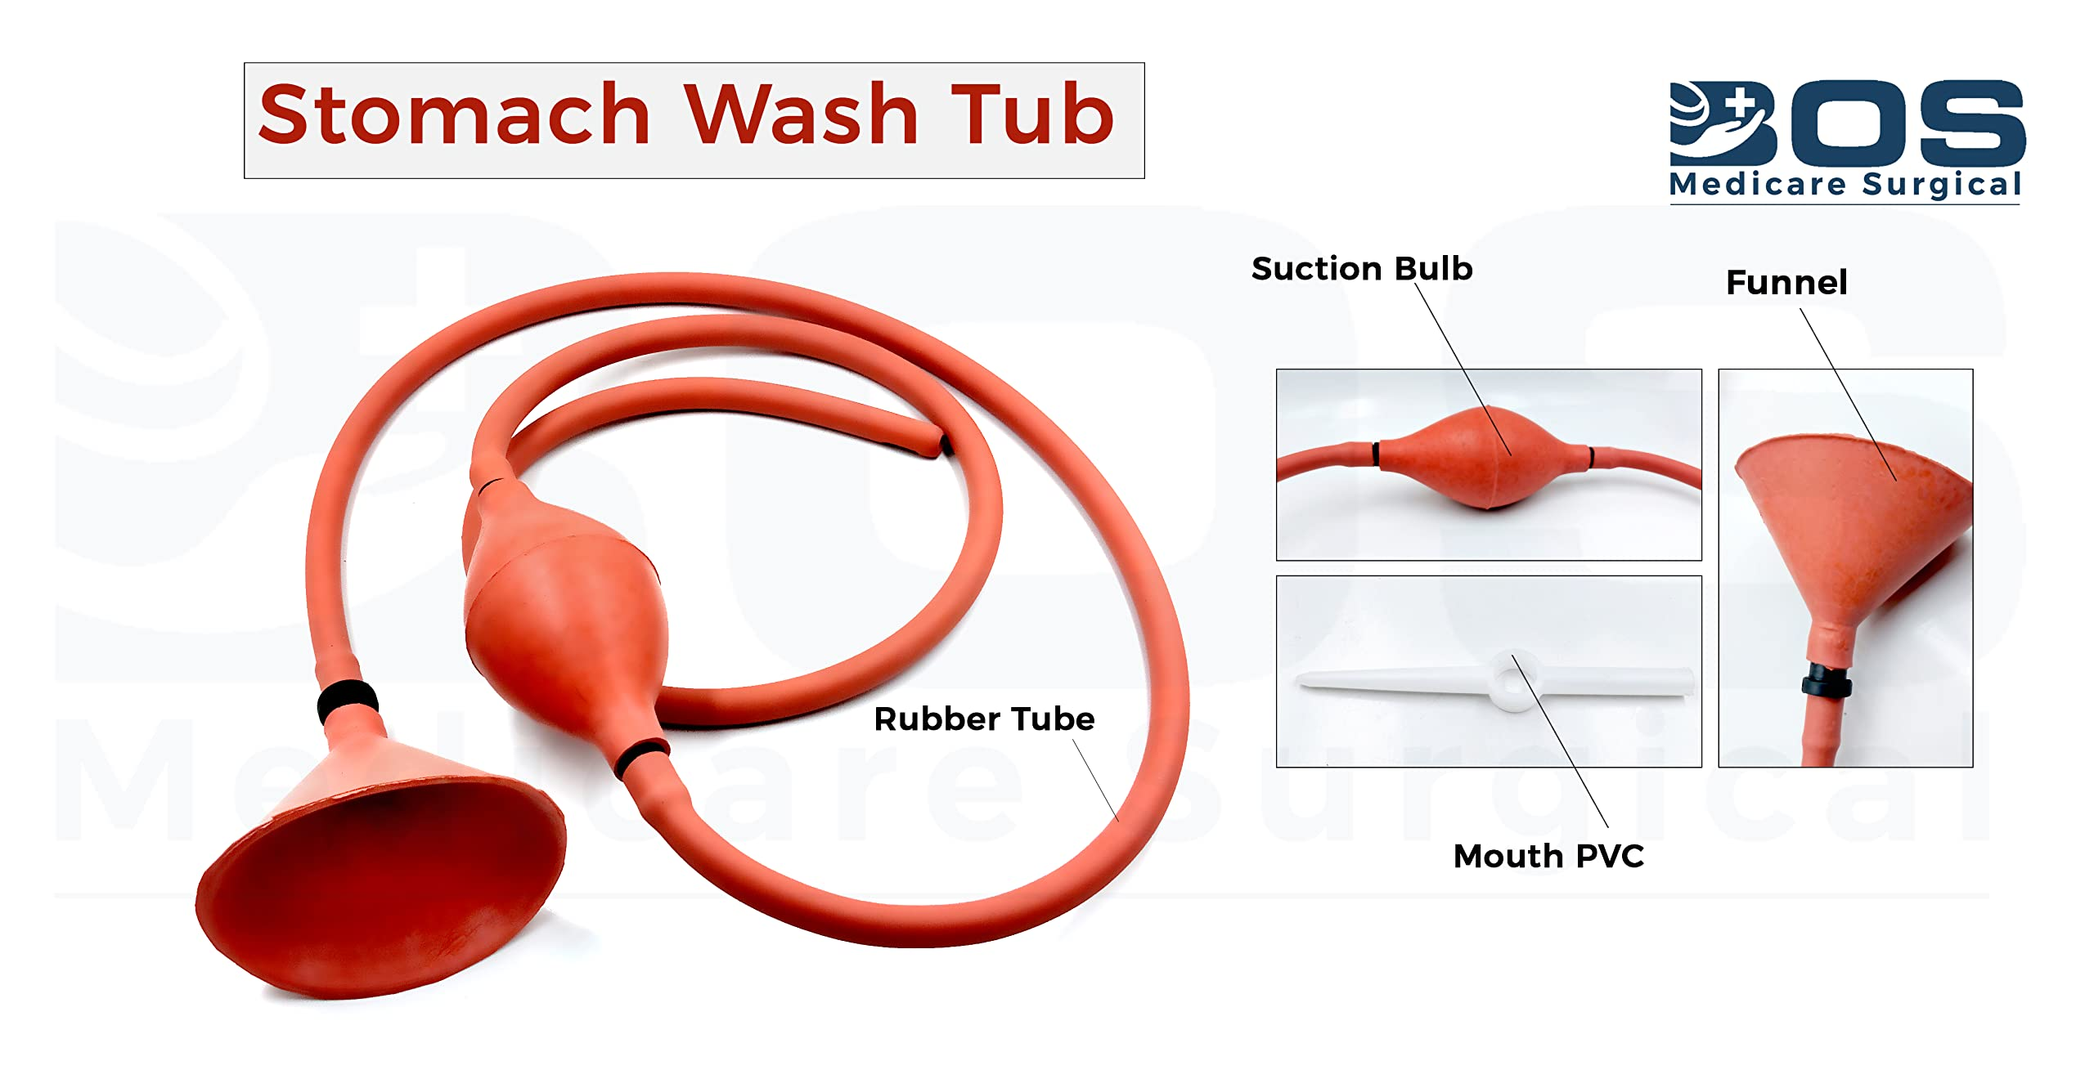
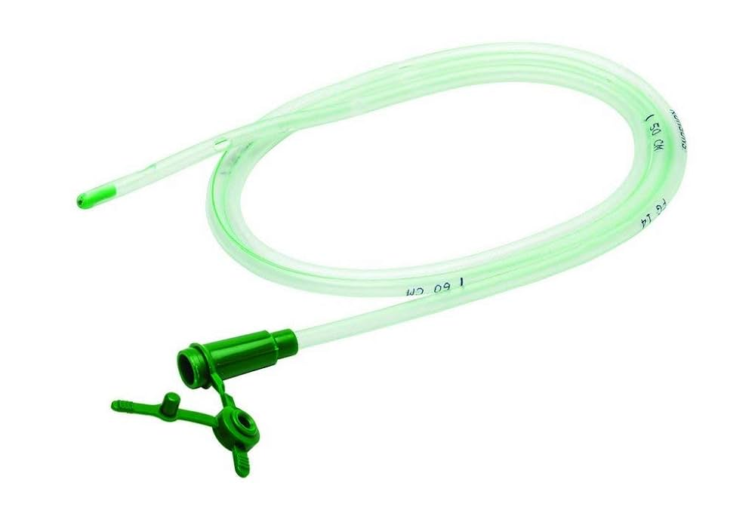
Ryle’s Tube

Slide 13
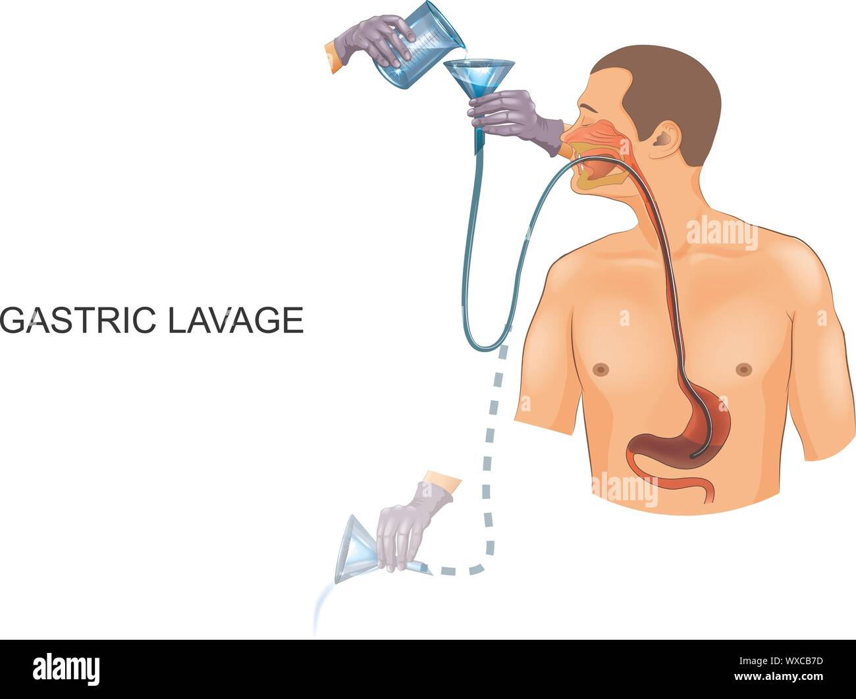

Slide 14
Sr. no. | Feature | Stomach Wash Tube | Ryle’s Tube
1. | Position of the patient | Trendelenburg with head low | Supine with neck extended
2. | Route | From mouth(Orogastric) | Nasal route (Nasogastric)
3. | Also known as | Oro-gastric tube (OGT) | Naso-gastric tube(NGT)
4. | Used in | Opium | All poison
Stomach Wash Tube Ryle's Tube1.Position of

Slide 15
Sr no | Poison | Solution
1. | Most poison(known/unknown) | Water or saline (0.9)
2. | (a) Alkloid-Marpine, Aconte, Strychnine,Phosphorus, Hydrocyanic acid, Cyanides,Barbituric acid and its derivatives,Atropine etc. (b) Organno-phasphurusPoison (OPP) | KMnO4 (1:1000)
3. | Murcury | 5% Sodium Formaldehyde Sulphoxylate
4. | Arsenic | Fe2O3 (Hydrated Ferous Oxide)
5. | Copper Sulphate | 1% Potassium Ferrocynide
6. | Methyl Alcohol | 5% Sodium bi carbonate in warm water
7. | Kerosine | 5% Sodium bi carbonate in warm water
8. | Carbolic Acid | Caster Oil & Warm Water (1 : 2)

Slide 16
Contraindication of Stomach Wash/Gastric Lavage (When not to be used)-
Corrosive Poison, Petroleum Poison, Mechanical Poison and During Convulsion
d. Administration of Activated Charcoal
Action:It is adsorbent & adsorbs the maxicum poison on ti's surface.
Dose:1-2 gm/kg body wt. with 8 ml water.
e. Bowel IrrigationSolution : Electrolyte + Poly ethylene glycol.
Action: It is bowel cleaning agent & causes irrigation of poison through bowel
Dose : 2 lit/hour/orally (Adult) & 0.5 lit./hour/orally (Child)
f. Catheratic Agent
Solution : Syp. Sorbitol 1-2 gm/kg
Action : LuxativePurpose : To avoid Constipation
g. Endoscopic Removal - In case of heavy metallic coin, foreign bodies & Mechanical Irritant.

Slide 17
3. Use of antidote-
Definition:- Antidotes are agents that neutralize the effect of a poison or toxin.
Antidotes mediate its effect-By preventing the absorption of the toxin,
By binding and neutralizing the poison,
By antagonizing its end-organ effect or
By inhibition of conversion of the toxin to more toxic metabolites.
They need to be used because-
1.The poison may not have been completely removed by emesis or gastric lavage or these procedures are contra-indicated.
2.The poison is already absorbed. or
3. The poison has been administered by route other than ingestion.

Slide 18
4. Methods Of Elimination Of Absorbed Poison From Body
Indications :-
Severs poisoning.
Progressive deterioration in spite of full supportive care.
High risk of serious morbidity or mortality.
When normal route of excretion of the toxic compound is impaired.
Poison produce delayed but serious toxic effects.
Patient is having cardiovascular, respiratory or other disease that increase the hazards.

Slide 19
Methods:-
Renal Excretion [Diuresis / Forced Diuresis]- The increased production of urine by kidney is known as Diuresis.
Purging- The elimination of poison in the stools.
Diaphoretics- The poison is excreted through sweat.
Peritoneal Dialysis- During peritoneal dialysis, a cleansing fluid called dialysate passes through a catheter tube into part of the abdomen known as the peritoneal cavity. The dialysate absorbs waste products from blood vessels in the lining of the abdomen, called the peritoneum. Then the fluid is drawn back out of the body and discarded.
Haemodialysis- Hemodialysis is a procedure where a dialysis machine and a specialfilter called an artificial kidney, or a dialyzer, are used to clean your blood. To get your blood into the dialyzer, the doctor needs to make an access, or entrance, into your blood vessels.
Haemoperfusion:- is a process used to remove toxic substances from a patients blood

Slide 20


