Slide 1

Medical Records
Medical Record

Slide 2
Exposure to Medical Records Department
Storage, Maintenance & Disposal of Medical Records

Slide 3
Introduction
• MRD: Essential part of hospital administration
• Functions: Collection, classification, storage, retrieval, disposal
• Importance: Patient care, legal documentation, research, hospital management

Slide 4
Objectives of Exposure
To understand methods of storage of medical records.
To learn about the maintenance and security of medical records.
To observe the disposal procedures of outdated or inactive records.
To appreciate the legal and ethical importance of proper medical record keeping.

Slide 5
Lifecycle of Medical Records:
Creation → Storage → Maintenance → Retention → Disposal

Slide 6
Types of Medical Records
• Inpatient Records
• Outpatient Records
• Emergency Records
• Medico-legal Records

Slide 7
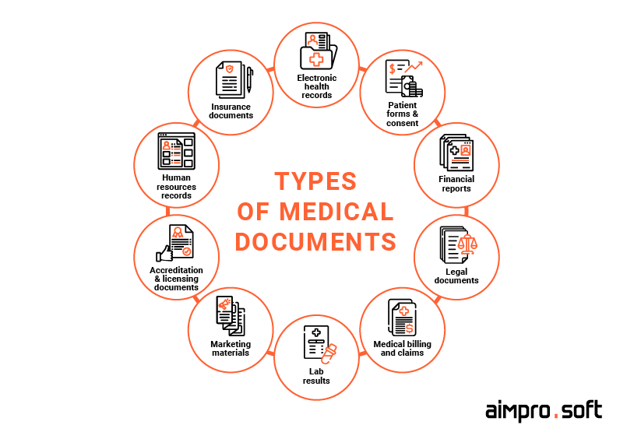

Slide 8


Storage of Records

Slide 9
Storage of Records
• Manual System: Paper files, shelves, racks
• Digital System (EMR/EHR): Hospital Information System
• Filing Methods: Alphabetical, numerical, terminal digit
• Security: Restricted access, fire & pest protection, climate control

Slide 10
Types of Records: Inpatient records, outpatient records, medico-legal records, diagnostic reports.
Systems of Storage:
Alphabetical filing system
Numerical filing system (Unit number system, Serial number system)
Digital storage in Electronic Health Records (EHR) software.
Physical Storage: Compact racks, shelves, fireproof cupboards, dust/moisture protection.
Security Measures: Restricted access, confidentiality protocols, backup servers for digital records.

Slide 11
Retention Period (India)
• Indoor patient: 3 years minimum
General medical records- 3-5 years
• Medico-legal: Indefinite / Court orders
Till Final Judgement + Appeal Period.
• Pediatric: Till patient turns 18 years + buffer period
• Research/teaching: As per institution policy

Slide 12
Maintenance of Records
• Accuracy & completeness
• Confidentiality & restricted access
• Regular updating
• ICD coding (ICD-10/11)
• Preservation (dust, fire, pests, moisture)
• Digitization for easy retrieval

Slide 13
Accuracy: Records must be complete, legible, and updated regularly.
Indexing: For easy retrieval using patient ID or hospital number.
Confidentiality: Only authorized personnel can access.
Retention Period: Varies by law/policy (e.g., 3–5 years for general records, 10 years or more for medico-legal cases).
Digitalization: Scanning old records into electronic format for space and efficiency.
Quality Checks: Ensuring records are free from errors, omissions, or duplications.

Slide 14
Data Entry
Coding
Storage
Retrieval

Slide 15
Legal & Ethical Aspects
Medical records are legal documents and can be used in court.
Improper disposal or leakage of data can lead to litigation and breach of patient confidentiality.
Hospitals must follow National Medical Commission (NMC) and Hospital Accreditation (NABH) guidelines.

Slide 16
Disposal of Records
• Policy-based disposal after retention period
• Methods:
- Shredding (paper)
- Incineration (confidential)
- Secure deletion (electronic)
• Disposal register/log maintained

Slide 17
Observations During Visit
• Filing system used
• Storage facilities (fire/pest control, ventilation)
• Software for electronic records
• Record retrieval process
• Confidentiality measures

Slide 18
Summary
• MRD ensures safe custody & confidentiality of patient information
• Proper storage, maintenance & disposal are essential
• Helps in clinical, legal, research, and administrative purposes

Slide 19
Thank You

