Slide 1
CONTENTS
Introduction
Immediate care of newborn
General care of newborn
Contemporary methods
Conclusion

Slide 2
चरक संहिता | सुशृत संहिता | अष्टाङ्ग हृदय
उल्ब परिमार्जन | उल्ब परिमार्जन | उल्ब परिमार्जन
प्राण प्रत्यागमन | मुखविशोधन | प्राण प्रत्यागमन
स्नान | पिचु धारण | नालछेदन
मुखविशोधन | नालछेदन | स्नान
गर्भोदक वमन | जातकर्म | पिचु धारण
नालछेदन | स्नान | सुवर्ण प्राशन
जातकर्म |  | गर्भोदक वमन
रक्षा कर्म |  | जातकर्म

Slide 3
Immediate care
तद्यथा - अश्मनोः संघट्टनं कर्णयोर्मूले , शीतोदकेनोष्णोदकेन वा मुखपरिषेकः, तथा स क्लेशविहतान् प्राणान्पुनर्लभेत । कृष्णकपालिकाशूर्पेण चैनमभिनिष्पुणीयुर्यद्यचेष्टः स्याद् यावत् प्राणानां प्रत्यागमनम् । ततः प्रत्यागतपाणं प्रकृतिभूतमभिसमीक्ष्य स्नानोदक ग्रहणाभ्यमुपपादयेत् ॥ च. शा.८/७२
अथास्य ताल्वोष्ठकण्ठजिह्वा प्रमार्जनमारभेताग्ङ्गुल्या सुपरिलिखितनखया सुप्रक्षालितोपधान कार्पासपिचुमत्या । प्रथमं प्रमार्जितास्यस्य चास्य शिरस्तालु कार्पासपिचुना स्नेहगर्भेण प्रतिसञ्छादयेत् । ततोऽस्यानन्तरं सैन्धवोपहितेन सर्पिषा कार्यं प्रच्छर्दनम् । च. शा. ८/४३

Slide 4
Striking of stones near the baby’s ears
Sprinkling water over baby’s face
Fanning with broken earthen pot
Proper cleaning of the oral cavity
Oil soaked cotton pad to cover the head
Emesis induced by madhu-saindhava

Slide 5
Acc to Sushrutha,
Ulba shodhana
Pichu dharana
Ashwasana
Jatakarma
Abhyanga – Snana
Acc to Vagbhata,
Ulba shodana
Taila sechana
Ashmanorvadana
Snana
Pichu dharana
Prashana

Slide 6
For the asphyxiated baby
Fanning with branches of specific drugs, or krishna kapalika
Bala taila irrigation
Chanting of hymns /striking stones near the right ear
Alternate sprinkling of hot and cold water

Slide 7
नाल छेदन
नाभिबन्धनात् प्रभृत्यष्टाङ्गुलमभिज्ञानं कृत्वा छेदनावकाशस्य द्वयोरन्तरयोः शनैर्गृह्ईत्वा तीक्ष्णेन रौक्म राजतायसानां छेदनामन्यतमेनार्धधारेण छेदयेत् । तामग्रे सूत्रेणोपनिबध्य कण्ठेऽस्य शिथिलमवसृजेत्। तस्य चेन्नाभिः पच्येत, तां लोध्रमधुकप्रियङ्गु सुरदारुहरिद्राकल्कसिद्धेन तैलेनाभ्यज्यात्, एषामेव तैलौषधानां चूर्णेनावचूर्णयेत् । इति नाडीकल्पनविधिरुक्तः सम्यक् । च.शा.८/४४
Cord cut at a distance of 8 angulas from the umbilicus
The cut cord is tied loosely around the baby’s neck
Application of taila to the stump

Slide 8
General care
Snana
Abhyanga with Bala Taila.
Snana with ksheeri-vriksha kashaya.
Jatakarma
Madhu ghrita prasha
Stanapana
Udaka kumbha sthapana

Slide 9
Feeding of the newborn
स्तनमत ऊर्ध्वमेतेनैव विधिना दक्षिणं पातुं पुरस्तात् प्रयच्छेत् । च.शा.८/४६
After madhu-ghrita prashana, right breast is fed.

Slide 10
Prashana
हरेणुमात्रं मेधयुर्बलार्थमभिमन्त्रितम् | अ. हृ. उ.१
Medhya drugs are given.

Slide 11
रक्षा कर्म
आदानीखदिरकर्कन्धुपीलुपरुषकशाखाभिरस्या गृहं समन्ततः परिवारयेत् ।सर्वतश्च सूतिकागारस्य सर्षपातसीतण्डुलकण्कणिकाःप्रकीरेयुः ।… …कणककण्टकेन्धनवानग्निस्तिन्दुककोष्टेन्धनश्चाग्निः सूतिकागारस्याभ्यन्तरतो नित्यं स्यात्। च.शा.८/४६
Rakshoghna drugs are placed all aorund the place
Fire place is always lit inside the sootikagara.
Fumigation is done.

Slide 12
Resuscitation of a Newborn
Of the 25 million infants born every year in India, 3-5% experience asphyxia at birth. Asphyxia is characterised by progressive hypoxia, hypercapnea, hypoperfusion and acidosis. It may lead to multiorgan dysfunction including hypoxic ischemic encephalopathy (HIE) which might result in long-term neuromotor sequelae.

Slide 13
Being prepared
Preparation for delivery should include-
A radiant heat source ready for use
All resuscitation equipments immediately available and in working order
At least one person skilled in neonatal resuscitation.

Slide 14
Suction equipment
Meconium aspirator
Mechanical suction
Bag and Mask equipment
Neonatal resuscitation bags (self-inflating)
Intubation equipment
Laryngoscope with straight blades
Suction catheters 10,12 or 14 F
Face-masks
Oxygen with tubing
Extra bulbs and batteries
Endo-tracheal tubes 2.5,3.0,3.5 mm ID
Medications
Epinephrine
NS or RL
Sterile water
Miscellaneous
Syringes, Stethoscope, Feeding tube
Adhesive tape, scissors

Slide 15
TABC of resuscitation
T
Temperature
A
Airway
B
Breathing
C
Circulation

Slide 16
Temperature - provide warmth, dry the baby
Airway- positioning, clear airway
Breathing- stimulate, intubation if HR<100
Circulation- if HR<60, chest compressions

Slide 17
The 3 Vitals
Respiration is evaluated by observing the infant’s chest movements.
HR can be assessed by auscultating the heart or by palpating the Umbilical cord pulsation for 6 secs.
Color is evaluated by looking at tongue, mucous membranes and trunk.

Slide 18
Good breathing, HR >100 and color- pink, the baby does not require any additional intervention.
Good breathing, HR>100 but has central cyanosis, administration of supplemental oxygen is indicated.
Not breathing well or HR<100, then positive pressure ventilation is needed.

Slide 19
Supplemental oxygen, if central cyanosis is noted
Positive pressure ventilation, if gasping or HR <100.

Slide 20
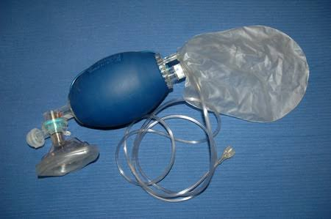
AMBU

Slide 21
Chest compressions along with AMBU – when HR<60 min even after ventilation for 30 secs.

Slide 22
Cord Care
The umbilical cord is clamped soon after delivery.
After stabilization and drying of the baby,
Using 2 clean ligatures and a new blade, after 2 ligatures are made,the cord is cut between the 2 ligatures.

Slide 23
Check the cut end of the cord for normal anatomy i.e. 2 arteries and a vein.
Normally with all the precautions, the cord dries and falls off in 5-10 days.

Slide 24
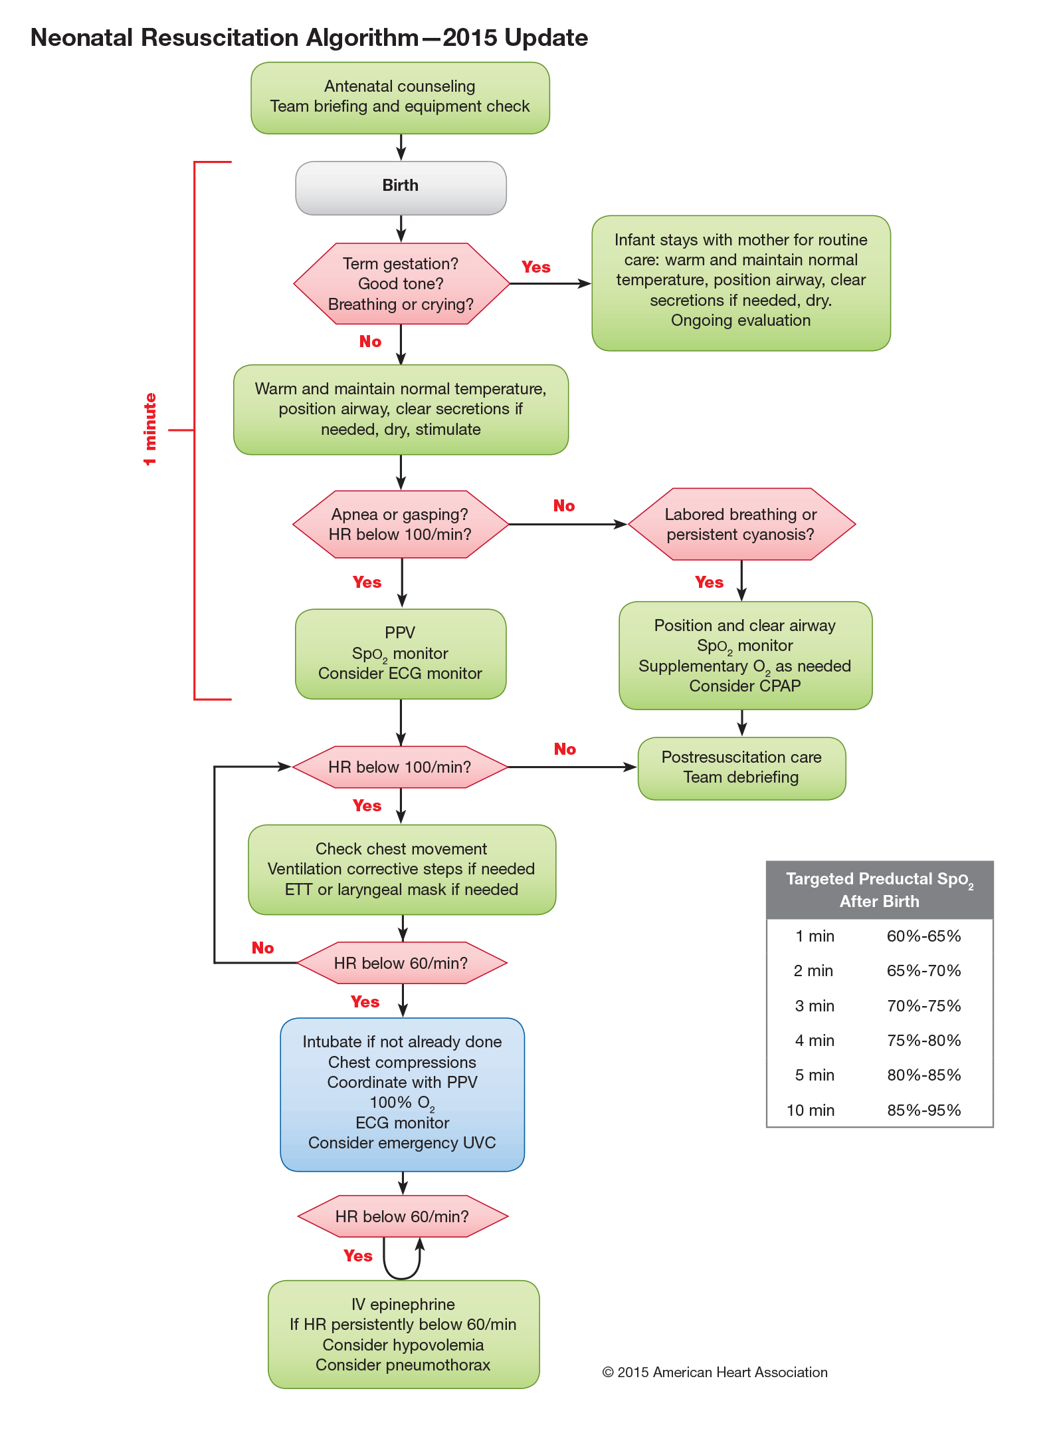

Slide 25
APGAR SCORE
SIGN | 0 | 1 | 2
Heart rate | Absent | Slow (<100/min) | Normal (>100/min)
Respirations | Absent | Weak cry | Good strong cry
Muscle tone | Flaccid | Some flexion | Active movements
Reflex irritability | No | grimace | Cough or sneeze
Color | Blue/ pale | Body pink, extremities blue | Completely pink

Slide 26
Immediately after birth, the APGAR scores are assigned at 1 and 5 minutes. If the score is <7, it is assigned every 5 minutes until 20 minutes.
The scores may be falsely low in very pre-terms, maternal drug intake, congenital heart disease and CNS malformations.
Hence, low APGAR should not be equated to Asphyxia.

Slide 27
I have come from an extremely warm, clean, quiet and comfortable abode.
Protect me at birth from microbes and cold.
I am wet and naked, dry me, cover me, place me under a heater.
I don’t know how to smile, let me announce my arrival by a cry.
Don’t hurt me but gently clean my windpipe to let me cry.
Don’t give me injections but give me a breath to save my life.
I have been swimming all through in the womb, don’t be in a hurry to bathe me in the labor room.
Thankyou

