Slide 1

CONTENTS
INTRODUCTION
SHISHUPARICHARYA
  JAATAMATRA SHISHU PARICHARYA
  NAVAJAATA SHISHU PARICHARYA
RESEARCH WORKS
PROCEDURES DONE IN OUR HOSPITAL
TRADITIONAL PRACTISES
CONCLUSION

Slide 2


INTRODUCTION
Newborn-Child upto 28days of life
Normal neonates-gestational age between 37- 41 weeks.
Neonatal mortality is highest during first 24hours,overall 65%.
The current NMR is 39/1000(India) live births.

Slide 3
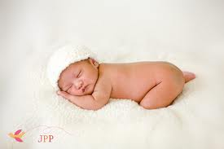
TERMS:
JAATAMATRA (Jata +Matra)
Jata refers to baby immediately after birth (A.H).
सध्य एव उत्भूतम् जातमात्रम्।
SADHYOJATA - सध्य एव जातः इति सध्योजात।
NAVAJATA
SHISHU- प्राक् अन्नप्राशनात् शिशुः।

Slide 4
CLASSIFICATION
CHARAKA | SUSRUTHA | VAGBHATA
PRANAPRATYAGAMANA | MUKAHAVISHODANA | ULBA PARIMARJANA
SNANA | PICHUDHARANA | PRANAPRATYAGAMANA
MUKHAVISHODANA | NALACHEDANA | NALACHEDANA
GARBHODAKAVAMANA | JAATAKARMA | SNANA
NALACHEDANA | SNANA | PICHUDHARANA
JATAKARMA |  | SUVARNAPRASHANA
RAKSHAKARMA |  | GARBHODAKA VAMANA
 |  | JAATAKARMA

Slide 5
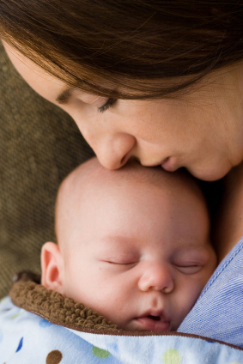

Slide 6
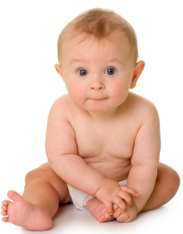

Slide 7
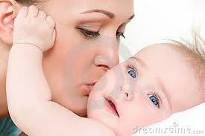
JAATAMATRA SISU PARICHARYA
ULBA PARIMARJANAM

Slide 8
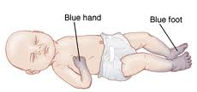
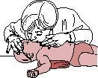
PRAANA PRATYAGAMANAM
PRAANA Life
Imp The efforts to establish a normal cardio-respiratory functioning from a compromised life threatening status
Why?? - During fetal stage functions of panchavaayu are entirely dependent on mother

Slide 9
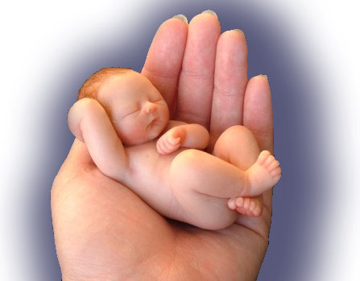

Slide 10
Cont...
Mukhakanthavishodhana (clearing the airway)
The throat, pharynx,tongue and lips, should be cleared by fingers of attender covered with clean cotton guaze.
Precaution (Purvakarma) -Nails should be trimmed and hands should be sterile.
(C.S.Sa 8/43)
Notes:
(C.S.Sa 8/43)

Slide 11
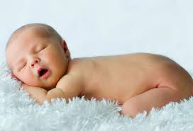
Cont...
BENEFITS:

Slide 12
Conti ..
Stimulus to baby:
शीतोदकेन उष्णोदकेन वा मुख परिषेकः।
(C.S.Sa 8/42)
अश्मनोः सम्घट्टनम् कर्णयोर्मूले।
IMP– स क्लेशविहतान् प्राणान् पुनरलभेत।
(C.S.Sa 8/42)

Slide 13
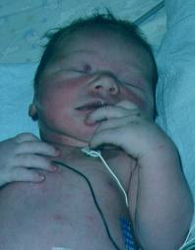
Cont...
3.Fanning with Krishnakaapalikasoorpa
क्रुष्णकपालिका शूर्पेण चैनमभिनिष्पुणीयुर्यध्यचेष्टः स्यात् यावत् प्राणानाम् प्रत्यागमनम्॥
Indicated in: Acheshta child
Duration: Till respiration attains
(C.S.Sa 8/42)
Materials used :
क्रुष्णकपालिका ईषिका नलमुन्जवमशादिभवा तत् क्रतः।
शूर्पःक्रष्णकपालिका शूर्पः......

Slide 14
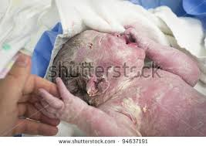
ULBASHODHANAM
During fetal period child is covered with a fine paste like substance called ULBA.
Equated to VERNIX CASEOSA.
Procedure
(A.H.U.1/1)
Soon after birth, baby should be smeared with ghee mixed with saindhava.

Slide 15
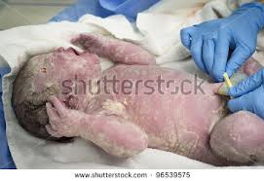
CONT...
Ghritha acts like an insulator & thus give sufficient protection from hypothermia.
Saindhava with stambha, bhandha, sanghata, vidhmapana and sukshma properties removes the ULBA which is slimy & sticky.
This is not practised nowadays.

Slide 16
GARBHODAKA VAMANAM
Garbhodaka is compared with Amniotic fluid.
paste of ghrita and saindhava given for licking.
Imp -Diseases like ulbakam can arise.
(A.H.U.1/10)

Slide 17
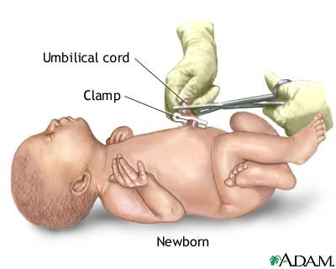
NAABHINALA CHEDANA VIDHI
WHEN TO CUT?
Baby gets devoid of prasoothiklesha.
Attains proper respiratory & cardiovascular functions.
MATERIALS REQUIRED

Slide 18
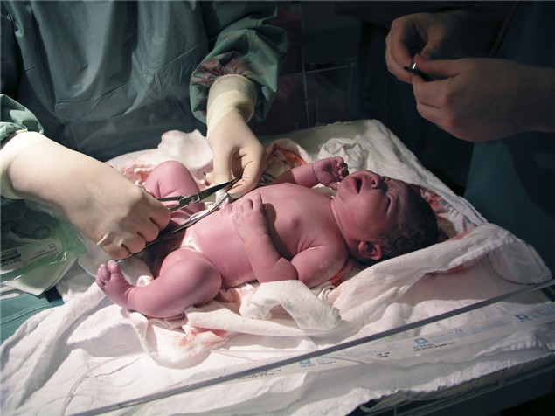
P PROCEDURE
SL.NO: | ACHARYA | DISTANCE
1. | Charaka | measure the cord 8 angulas from the umbilicus hold with two fingers and cut with Ardha-dharashastra
 | Susrutha | Tie at 8 angula distance & cut
2. | Vagbhata (A.H) | Cut at 4 Angula
3. | Vagbhata (A.S) | Cut at 4 Angula

Slide 19
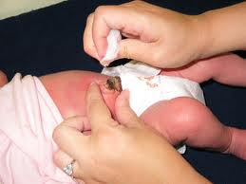
Conti ...
After the seperation of umbilical cord the stump has to be smeared with Kushta taila.
Benefits:

Slide 20
NAVAJAATA SISU PARICHARYA
Includes procedures in addition to the Jaatamatra sisu paricharya namely:
SL. NO: | PROCEDURE
1. | TAILA PARISHEKAM
2. | SNAANAM
3. | PICHU DHARANAM
4. | UDAKA KUMBHA STHAAPANAM
5. | PRASANAM
6. | STANYAPANA
7. | SAMSKARAS
8. | RAKSHOGHNA KARMA

Slide 21
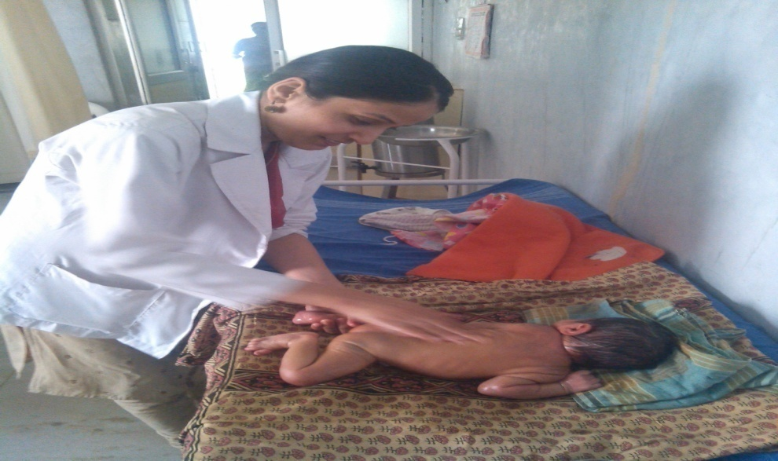
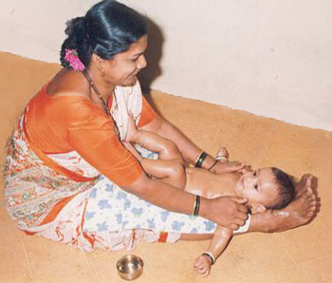
TAILA PARISHEKA
Most apt procedure which can be adopted here is Parisheka or AbhyangaWith Bala thaila.
Benifits-Removes prasotikelsa & mitigates vata.
(A.H.U.1/10)

Slide 22
THE EFFECTS OF INFANT MASSAGE ON WEIGHT,
HEIGHT, AND MOTHER-INFANT INTERACTION
AUTHOR -Hae-Kyung Lee, RN, PhD
SOURCE- Journal of Korean Academy of Nursing Vol. 36, No. 8
STUDY- to test the effects of infant massage on weight and height of infant and mother-infant interaction with normal infants over a period of 4 weeks.
RESULT
Facilitates the mother-infant interaction
Promotes building up the emotional tie between the mother and her infant.

Slide 23
SNAANAM
Commonly practised since ancient days & till recent past.
Now-a-days, snana is not done immediately after birth, due to the fear of hypothermia.
Benefits of ushnodaka snana:
Notes:
Benefits

Slide 24
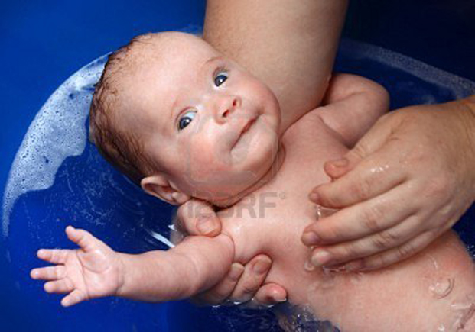
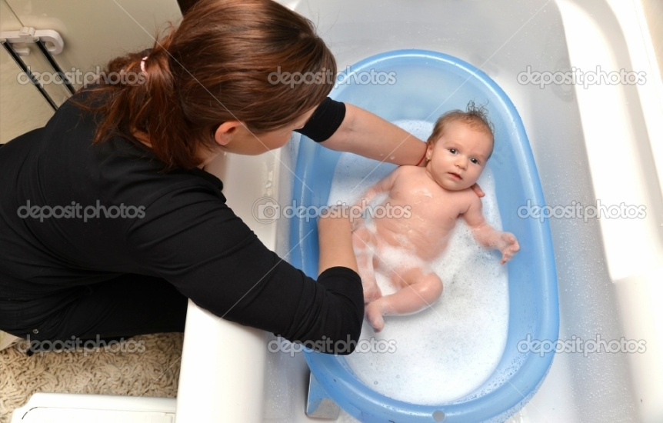
Baby has to be bathed in luke warm kwatha of:
ksheerivrikshas or
Eladigana or
Panchvalkala or
leaves of kapitha or
Sarvagandha dravyas or
with hot water made by dipping heated metal bars of gold or silver.
..................स्नापयेदनु ।
क्षीरिव्र्क्षकषायेण सर्वगन्धोदकेन वा।
कोष्णेन तप्तरजततपनीयनिमज्जनै।
(A.H.U.1/10)

Slide 25
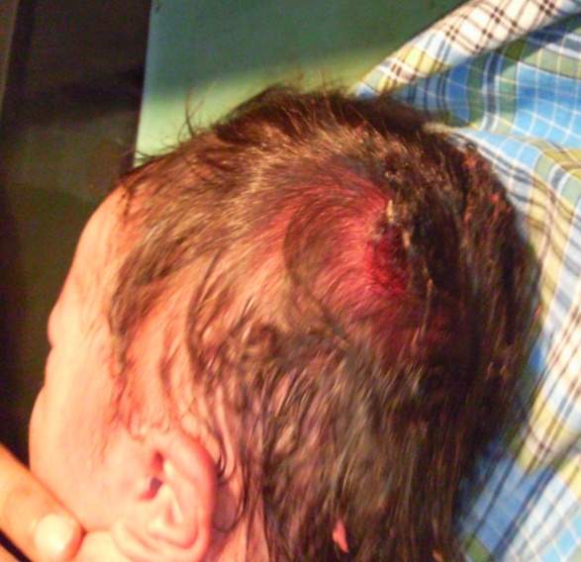
PICHUDHARANAM
Pichu is the simplest & effective procedure one among Moordhataila.
Procedure:
शिरसि स्नेहपिचुना........
(A.H.U.1/10)
Benefits:

Slide 26
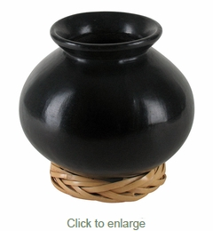
UDAKA KUMBHA STHAAPANAM
Hot Water pot (earthen pot) processed with mantras should be kept near the child’s head.
Acc to vaghbata,
keep hot water pot at both sides of room entrance

Slide 27
BENEFITS

Slide 28
JAATAKARMA SAMSKARA
Birth ceremony / care of new born.
Charaka explains Jaatakarma as:

Slide 29
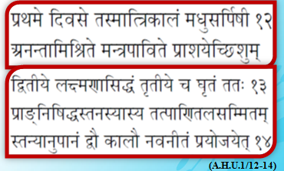
PRASANAM
The quantity which can be grasped by the tip of middle finger of attender and made to lick is termed as PRAASA.
DRUGS & METHOD OF ADMINISTRATION

Slide 30
CONT...

Slide 31
BENEFITS

Slide 32
RESPONSE OF THE NEWBORN TO MADHU-GHRITA
DR. KAMATH M. SETHUKUMAR, 1981, GUIDE
DR. SHASTRY C.H.S -KB-IPGT&RA, GAU, JAMNAGAR
STUDY: Madhu+Ghrita in equal quantities was administered for 7 days to newborn.
GROUPING:Two groups(control & trial)
FOLLOW UP: 3 Months
RESULT:
Significant rise in anthropometrical measurements
Rise of Sr.T.Protein and globulin levels of treated babies.
Action in triggering the response of immunological system in newborn.

Slide 33
EFFECT OF MADHU-GHRITA AND SWARNA-VACHA-MADHU-GHRITA ON NEONATES
AMRUTA S GAIKWAD, 2011-KB-IPGT&RA, GAU, JAMNAGAR
STUDY: Assess the efficacy of Madhu-Ghrita and Swarnavachayukta Madhu-Ghrita on Neonates.
GROUPING:GROUP A(Control), B & C
DOSE:5 drops in a single dose.– at morning
DURATION: 4 Weeks
RESULT:
Immunity increased
Episodes of reccurrent URTI reduced
Achieved appropriate developmental milestones

Slide 34
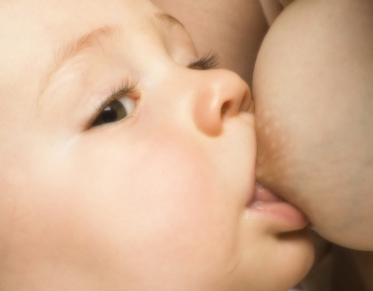

STANYAPANAM
Acc. to Acharya Charaka Breast feeding should be started from the first day .
Special care has to be taken not only in maintaining the quality of stanya but also in the techniques of feeding.
(Su.Ni.10/28)
Notes:
(Su.Ni.10/28)

Slide 35
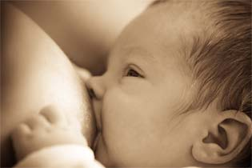
Cont...
Techniques of breast feeding
ततः प्रशस्तायाम् तिथौ शिरःस्नातमहतवाससमुदड्मुखम्
शिशुमुपवेशय धात्रीम् प्राड्मुखीम् चोपवेशय द्क्षिणम् स्तनम्
धौतमीष्त्परिस्रुतमभिमज्य मन्त्रेणानेन पाययेत्॥
(SU.SA.10/25)
Preparation of child:
Baby has to be bathed & dressed with new clothes.
Baby should be facing north.
Preparation of mother:
Mother should face towards east.
Little milk should be expressed out before feeding the baby.
Initially right breast has to be given for feeding along with enchantment of mantras.

Slide 36
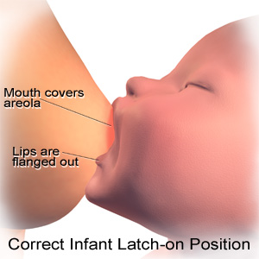

Points to be taken care
The baby should be hold in comfortable position.
Head & neck should be facing the breast & should be supported in a straight line with his body.
Both nipple and areola should remain inside the mouth of baby.

Slide 37
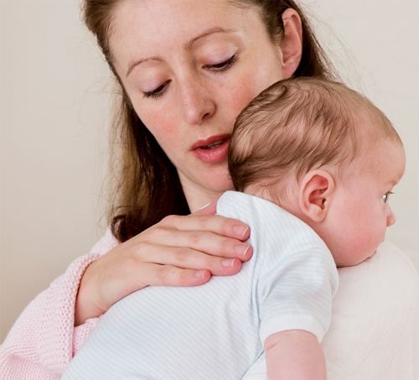
Cont….
Burping:
All infants swallow some air while sucking.
Holding infant erect over mother’s shoulder making him sit up on the mother’s lap & rubbing the shoulder helps in expelling wind.
If not done:
Abdominal cramps or regurgitation of milk

Slide 38
Cont...
Benefits of Stanyapana
Helps child and mother bonding
Light for digestion
Prevents jaundice
Helps in thermo regulation.
Boost immune system.
Highly nutritious to the child.

Slide 39
BREAST MILK AS THE GOLD STANDARD FOR PROTECTIVE NUTRIENTS
Author -Walker A
Source-Department of Nutrition, Harvard Medical School and Harvard School of Public Health, Boston, MA, USA. allan_walker@hms.harvard.edu
Result:
composition of breast milk changes according to the newborns needs for passive protection.
substances in breast milk actively stimulate development of the newborn's host defenses to provide continued mucosal protection after breastfeeding is terminated.
components of breast milk can act individually or in concert to contain the neonatal immature anti-inflammatory response.

Slide 40
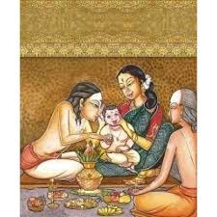
NAMAKARANA SAMSKARA
Time:
Notes:
Naming Ceremony

Slide 41
Cont...
Character of names:
Two names are given:

Slide 42
Preparation of the Baby
Mother & baby should take bath in water mixed with sarvagandha drugs.
Wear light & clean cloth & ornaments.
Should worship god & receive blessings from brahmanas
Baby made to sit over pad of cloths with head towards east or north.
Father should call name in child 's ear for three times.

Slide 43
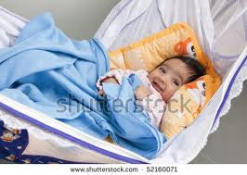
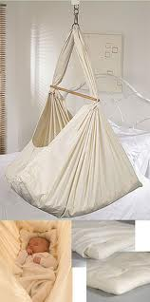
DOLASAYANA SAMSKARA
Child who is found to be physically doing well can be transferred to cradle
Time (Dharmasindhusara):
Benefits:
Sleeps comfortably with swinging movements
Notes:
Benefits:
Sleeps comfortably with swinging movements

Slide 44
RAKSHOGHNA KARMA
General protective & curative measures.
Aims:

Slide 45
RAKSHOGHNAKARMAS DEALT IN KAUMARABHRITYA:
Pottali made of Rakshoghna drugs like Vacha, Kustha, Hingu, Sarshapa, Atasi,Lasuna, Guggulu etc
where it should be tied?
Over the upper part of door of room where mother & baby live
To the neck of mother & child
To the water pots & other vessels
To the cot where mother & infant sleep
Either side of the door

Slide 46
Conti....
2. Branches of Aadani, Khadira, Karkandu, Peelu & Parushaka should be scattered outside the room (Ch.Sa.8)
3. Fire should be lit inside room with the fuel of Tinduka Kashta (Ch.Sa.8)
4.Dhoopana should be done with Guggulu(A.S.U.1)
5.Oblations to fire god is done twice a day with rice particles (Ch.Sa.8)

Slide 47

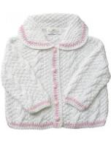
BED & CLOTHS OF BABY
Should be:
Mrudu, Laghu, Shuchi
with fragrance
devoid of sweat
micro- organisms
urine and fecal matter (ch.sa.8)

Slide 48
ENVIRONMENTAL IMPACTS OF HOMAM- A CASE STUDY
AUTHOR -Narayana Rao.M 1 , Sukruti Duvvuri 2, Hari Ram Naik 3, Gopi Kiran.M 3 and Manu Srivatsav.G 4
SOURCE- 1JNTU, Hyderabad – 500085,2Sir MV Institute of Technology, Bangalore-560094, 3JNTU, Hyderabad – 500085, 4Amrita School of Engineering, Amrita University, Coimbatore – 641105
RESULT-
Most economical, purifies environmental pollution
Removes harmful radiation
Emissions are non toxic & beneficial to the environment
Zinc Oxide present in the emissions has a curative effect on skin diseases.

Slide 49
PROCEDURE FOLLOWING
IN OUR HOSPITAL

Slide 50
ROUTINE CARE AT THE TIME OF BIRTH

Slide 51
Examination of Newborn
1. APGAR score
2. Look for if any obvious external congenital abnormalities
3.Weight
4.Vitals when baby becomes stable
5.Reflex
After completion of examination;
baby should be wrapped with clean cloth
given to mother for feeding.

Slide 52
Routine care of Newborn
SL.NO: | ROUTINE CARE
1. | Keep baby clean & warm
2. | Exclusive breast feeding 2hourly followed by Burping
3. | Cord care
4. | Abhyanga with Balaashwagandha lakshadi thaila followed by snana
5. | Vaccination
6. | Kumarabharana leha
7. | Bonnison drops
8. | Opthacare drops

Slide 53
TRADITIONAL PRACTISES

Slide 54
1ST DAY | PRACTISE |  | SIGNIFICNCE
 | ABHYANGA | Egg white | For strength(rich in protein)
 |  | Tila Thaila | Good sleep
 | DHOOPANA | With Sambrani, rakthachandana & lasuna | Purification & maintenance of temperature
 | ANJANA | Home made anjana applied inside eyes & over eyebrows | Avoid drishti, beauty of eyes, shapening of eyebrows, growth of eyelashes

Slide 55
 | SKIN RASHES AFTER DELIVERY | Egg of hen (first one,white portion)+ coconut oil-for 3 days | Cloth tied over body of baby(1 hr) followed by bath with hot water
 |  | Small coconut without water | Rubbed wit rakthachandana & swethachandana & applied(1 week)
 | COUGH & COLD | Thulasi swarasa 2-3drops | Same paste applied over chest
 |  | Boil Nagakesara with breast milk | Apply on forehead
 | DIGESTION | Jatiphala, vacha +breast milk | Apply paste over tongue

Slide 56
CONCLUSION
Newborn care is very essential to reduce NMR.
Children are the building blocks of nation
Principles of Ayurveda have been modified suiting current needs

Slide 57

THANK YOU

Slide 58
?SIGNS OF HEALTHY NEWBORN
A loud cry immediately after birth along with proper cardiovascular functioning signifies establishment of praana pravritti.
मुख़म् नेत्रे शरीरम् च पाणिपादम् तथैव च।
सरक्तम् द्रुश्यते यस्य स वै स्वस्तौ भविष्यति॥
( Bhela Samhitha)

