Slide 1
Cource Learning Outcomes
Evaluate normal growth and development and its deviation in children.
Demonstrate knowledge and skills in assessing and intervening child health through Ayurveda with research updates

Slide 2
Teaching learning methods- lecture with power point presentation
Domain- Cognitive/comprehension and Cognition / Knowledge
Must to know / desirable to know / Nice to know- Must Know and Desire to know
Millers pyramid- Know

Slide 3
Aim of this lecture
Understand approach to evaluating a febrile child
Have knowledge of commonly used medications from the pediatric aspect
Identify a sick child and provide for timely treatment

Slide 4
Discussion ----------
Fever ---Mechanism ? Good Or Bad ?
Approach
Clues to the Cause of fever
Management of fever

Slide 5
What is fever?
Fever is a neurochemical response, common to many animals
Controlled in the human hypothalamus and mediated by numerous endogenous and exogenous chemicals
Notes:
Almost all animals have the capability to have a febrile response
Endogenous pyrogens include interleukins, PgE
Exogenous pyrogens include various chemicals and endotoxins

Slide 6
What is fever?
Nerves in the hypothalamus maintain a normal “set point” temperature, usually in a range around 37C (98.6F)
Set point varies in a circadian rhythm with lowest at around 4am and highest between 4-8pm
Notes:
Set point– temp below which body acts to generate heat, above which body acts to lose heat, integrating both central and peripheral sensory data

Slide 7
What’s “normal”?
Most common definitions are based on a study by Wunderlich in 1868
“Normal” 37C (98.6F)
“Upper limit of normal” 38C (100.4F)
Weaknesses: 1.Thermometry used,
2.Use of axillary temps

Slide 8

What
about
the
numbers?

Slide 9
FEVER
Defined as a rectal temp 100.4 or higher.
Relations b/n recta, oral & axillary temperature:-
Rectal 0.5 C > oral 0.5 C > axillary 0.5 C

Slide 10
Thermometry
Body temperature can be measured at several sites:-
1.Axilla
2.Oral cavity
3.Rectum
4.Ear canal (Tympanic membrane)
5.Temporal artery

Slide 11
Thermometry
Three types thermometers are available:-
1.Mercury
2.Electronic
3.Infrared

Slide 12
Thermometry
Mercury thermometer-
Cheaper
Suitable for home use
Take 2-4 minutes to measure temp
No need of calibration

Slide 13
Thermometry
Electronic Thermometer:-
1.Take lesser time (only 30 seconds)
2.Convenient to use
3.Need calibration so subject to
calibration errors

Slide 14
Thermometry
Infrared thermometer:-
1.Very quick
2.Closely approximate rectal temperature
3.Expensive

Slide 15
Thermometry
Gold standards are rectal for children and oral for older children and adults
Axillary temps are not reliable and may vary as much as 1°C from rectal
There is no reliable conversion factor for axillary vs rectal temps

Slide 16
Thermometry
Tympanic thermometry is not accurate and may be technique-dependent
Infrared temporal artery (TA) thermometry is better than tympanic thermometry
TA temperature is consistently lower than rectal temps.

Slide 17
TYPE OF FEVER
1.INTERMITTENT:- If temperature touches baseline
daily & present for few hours
2.CONTINUOUS:- If temperature does not fluctuate
more than 1 C & not touch the baseline
3.REMITTENT:- If temperature fluctuation is more
thane 1C.
4.HECTIC/SEPTIC:-If fluctuation is extremely wide
(usually >2C)
Cont…..

Slide 18
TYPE OF FEVER cont…..
5.QUOTIDIAN:- fever occurs daily
6.TERTIAN:- fever comes on alternate days
7.QUARTAN:- there is two days interval b/n
two attacks

Slide 19
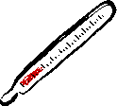
How
hot
is
“high”?

Slide 20
How hot is “high”?
Dubois, 1949
Human upper limit of fever 41 – 42C (105.8-107.6F)
Almost never exceeds 42C unless there’s a failure in thermoregulation

Slide 21
How hot is “high”?
McCarty and Dolan, 1976
40C (104F) may be the upper limit of fever in infants <12 weeks old
Remember that young infants can have infections with normal or lowered body temps

Slide 22
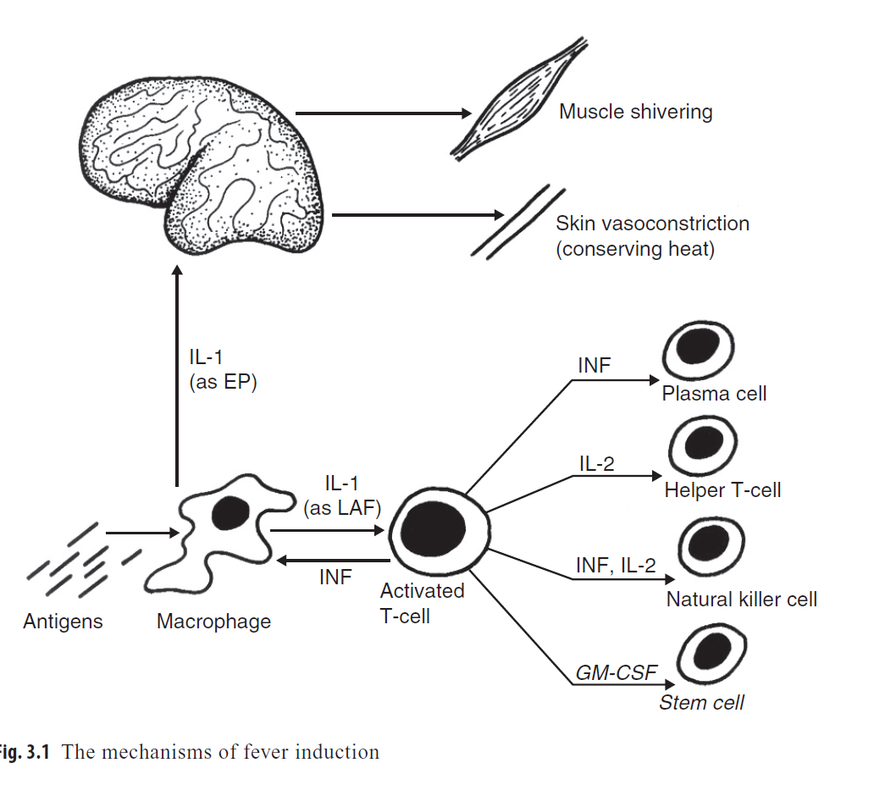
Molecular genesis of fever

Slide 23
FEVER
Studies have shown that fever helps the immune system fight infections.
Most children are not particularly uncomfortable with fever, particularly if it is lower than 39.5ºC (103ºF).

Slide 24
Fever Good ?
Increased WBC activity & movement to the site of infection
Fever Harmful? Increases energy & O2 consumption (cardiopulmonary stress)
Discomfort and associated pain Febrile Seizures
Increase insensible water loss

Slide 25
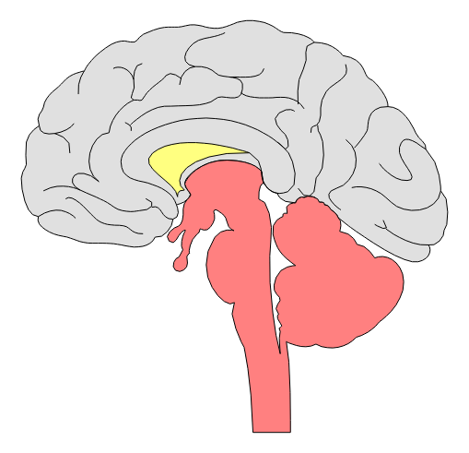
Fever can cause
damage…

Slide 26
FEVER
Sometimes fever is caused by a serious medical condition, such as:
1.Meningitis
2.Pneumonia
3.Bacterial infection of the blood.
These are true medical emergencies. The initial assessment and focused history findings will usually indicate that the child’s condition is urgent

Slide 27
FEVER
Fevers in a young infant is considered more urgent than fever in an older child.
Any infant aged three months or younger who has a rectal temperature of 100.4 degrees Fahrenheit or higher should have be evaluated

Slide 28
FEVER
Any child with fever who has decreased
ability to fight infection should be considered
potentially unstable.
Eg:- 1.Immunocompromise child
2.Child on steroids
3.Child with malignancy

Slide 29
FEVER
If fever is accompanied by:
1. Altered mental status
2. Respiratory distress
3. Signs of shock
4. Seizures
5. Bruise-like or spotty rash on the trunk
or extremities
6. A stiff neck
consider the child’s condition urgent.

Slide 30
Fact or fiction?
1. T> 105 may cause respiratory alkalosis and occasional electrolyte imbalances
2. T > 105.8 may cause cellular swelling and
damage in the brain, kidneys and liver
3. Animal studies suggest that a body temp of
>42C (107.6F) in humans may trigger enough
adverse effects on a cellular level to cause
death

Slide 31
ETIOPATHOGENESIS
Infections
Vaccines
Biologic agents
Tissue injuries
Malignancy
Drugs
Autoimmune diseases
Granulomatus diseases
Genetic disorder(familial Mediterranean fever)

Slide 32
Infectious
Systemic
Bacteremia, sepsis, meningitis, endocarditis
Respiratory
URI, sinusitis, otitis media, pharyngitis, pneumonia, bronchiolitis
Abdominal
Urinary tract infection, abscess (liver, kidney, pelvis)
Bone/joint infection
Hardware infection
Central line, VP shunt, G-tube

Slide 33
Inflammatory
Kawasaki disease
Juvenile inflammatory arthritis
Lupus
Inflammatory bowel disease
Henoch-Schonlein purpura
Notes:
Teacher’s Guide:

Slide 34
Fever
Approach
Clues to the Cause of fever
Management of fever

Slide 35
EVALUATION OF FEBRILE CHILD
Fever is a symptom NOT a disease; hence, evaluation for cause is important

Slide 36

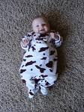
Similarities…..?

Slide 37
APPROCH….
“Kids are not adults ”
Think of the Common Causes
Detailed history & examination
SOS ---- Investigations
Start treatment as appropriate
Identify Serious fevers & refer them early

Slide 38
Kids are not adults !!
80-90% of all cases in children are respiratory and gastrointestinal!!!
Serious infection without high fever
Steroids and antipyretics change fever patterns dramatically
High risk of drug over dosing and side-effects
Febrile seizures !!!

Slide 39
HISTORY

Slide 40
HISTORY
Age—infants aged 3 months or younger have decreased ability to fight infection and should be evaluated if the temperature is 38ºC (100.4ºF) or higher
Headaches and emesis— the combination of fever, headaches, and emesis suggests meningitis, particularly if altered mental status is present as well.

Slide 41
HISTORY
Seizures—while febrile seizures are usually brief and do not harm the child, they may be a sign of meningitis.
Poisoning—ingestions involving aspirin, certain antidepressants, and other drugs can cause fever.

Slide 42
HISTORY
Heart disease or pulmonary problems—
children who have a history of heart disease or pulmonary problems may be unable to tolerate tachycardia and tachypnea associated with fever

Slide 43
HISTORY
Immunocompromise—
children with sickle-cell anemia, HIV, nephrotic syndrome, a history of recent chemotherapy, autoimmune disorders , or a history of splenectomy have decreased ability to fight infection.

Slide 44
HISTORY
Increased risk of local bacterial infection due to-
1.Hydrocephalus with a shunt
2.Congenital heart disease
3.Placement of a central intravenous catheter
4.Home peritoneal dialysis

Slide 45
Examination

Slide 46
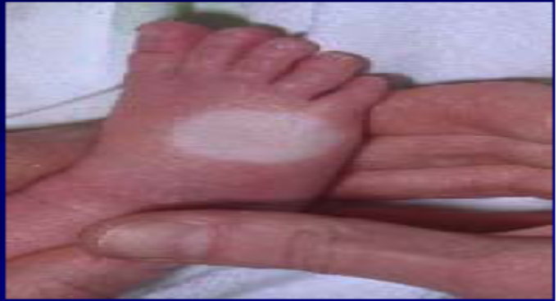
General appearance --- most imp ---? Toxic looking ? Level of alertness and responsiveness
Vitals signs ---HR, RR, BP & Temperature
Capillary refill time----State of hydration & perfusion
Oxygen saturation---Dusky tongue
--- s/o severe lung/ heart inv.( bad sign )
Head – to –toe 🡺Inspection + Palpation

Slide 47
“ Is this a serious fever ? ”
CNS --- Irritable or dull ---Convulsions
Cardiac--Cold extremities with poor pulses and increased CRT
RS--Breathing --Fast / labored ( nasal flare , retractions )
Dusky tongue
GI/ GU ---Decreased intake / urine output
Bleeding manifestations
Just sick-looking !!!!

Slide 48
Fever ---How ? good or evil ?
Approach
Clues to the Cause of fever---
Viral ? Bacterial? FWLS
Management of fever ---Sponging &
Anti-pyretics

Slide 49
Clues to the Cause of fever

Slide 50
Common Fevers in children
URTI
LRTI ---- Bronchiolitis
GI --------Gastroenteritis
UTI
Occult Bacteremia--- ex. Enteric
*** Malaria, Dengue , Leptospirosis***
Beware of Malingnancies esp. Leukemias

Slide 51
? Viral Infection
Many organs involved , esp. URTI
Contact with people with similar symptoms
Usually well-appearing, playful, and interact well
Lymphocytosis (or lymphocytopenia), and thrombocytopenia.
Normal CRP

Slide 52
Bacterial Infection
Often Localized
Toxic look
High fever with rigors
High WBC, CRP, Neutrophilia

Slide 53
Fever ---- without localising signs
Viral
Occult Bacteremias
UTI
Malignancies
Collagen Vascular diseases
Post – Vaccination
Drug related
-----------
Prolonged ---- “ PUO ”

Slide 54
Does Charting matter ??? Fever-- Mild up to 101---Moderate up to 104 Continuous --- Typhoid , Malignant Falciparum & Bacterial Intermittent --- Malaria , Lymphomas Hectic --- Pyogenic Remittent --- Most viral and bacterial infections

Slide 55
Usual labs --- tailor-made*** !!
CBC
Peripheral smear for band cell & toxic granules
Urine –R/M
Blood-culture
Urine-culture
C-reactive protein
X Ray
Malaria --- PS / Rapid Ag
Widal
Cont…….

Slide 56
Usual labs --- tailor-made*** !! Cont……
Dengue--- NS1 / IgM
Tuberculin test
USG
Rarely stools --- for parasitic infections
SOS – Lumbar Puncture --- CSF
Liver function test
Renal function test

Slide 57
Laboratory evaluation
What would you do if the patient has a high risk for sepsis?
Immunocompromised
Transplant recipient
Oncology patient
CBC with differential
Blood culture
Urinalysis and urine culture
Notes:
Teacher’s Guide:
For patients at high risk for sepsis (immunocompromised/transplant recipient/oncology patient), obtain:
CBC with differential
Blood culture
Urinalysis and urine culture

Slide 58
Laboratory evaluation
What would you do if the patient has hardware (VP shunt, tracheostomy, gastrostomy tube) or central line?
CBC with differential
Blood culture
CSF (tap VP shunt)
Notes:
Teacher’s Guide:
For patients with indwelling hardware:
Obtain CBC with differential and blood culture.
Consider obtaining CSF by tapping the VP shunt.

Slide 59
Laboratory evaluation
What would you do for an infant ≤ 3 months of age?
CBC with differential
Blood culture
Catheterized urinalysis and urine culture
Lumbar puncture
Notes:
Teacher’s Guide:
For infants ≤ 2 months of age obtain:
CBC with differential
Blood culture
Catheterized urinalysis and urine culture
Lumbar puncture

Slide 60

Fever Treatment

Slide 61
Should we even treat fever?
Animal studies suggest that the fever mechanism is a positive adaptive response
1.Triggers host immune responses
2.May stabilize cell membranes

Slide 62

(Why) should we treat fever?

Slide 63
Reasons to treat fever
Increased metabolic stress and oxygen demand:
1.Patients with poor cardiac reserve
2.Patients with poor pulmonary reserve
Lowering the “seizure threshold”

Slide 64
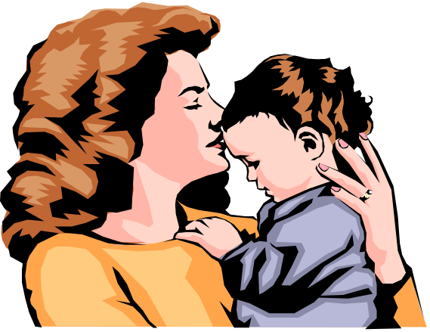
Reasons to treat fever
Patient comfort
Parent comfort

Slide 65

Danger!?

Slide 66
Fever can cause
damage…

Slide 67
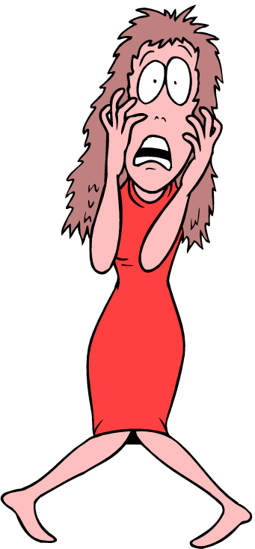
Febrile
Seizures

Slide 68
Treatment of fever (Sponging, Antipyretics, Antibiotics)
Light clothing
Blankets -- if shivering
Tepid sponging ---
with lukewarm water OR tap water
Air cooling
switch on fan

Slide 69
Antipyretics……………..
PCM --- | 10- 15mg/k/do— 4-5”/d **** | Liver necrosis , Hypoglycemia
Ibuprofen --- | 5-10mg/k/do SOS Max 3”/Day | Rash , Liver enzymes,Creat, Thrombo/ Pancytopenia
Mafenamic acid | ? | worse Ibuprofen
Nimesulide | ? | Banned for <12 years. Hepatic failure, Steven Johnson Syn.

Slide 70
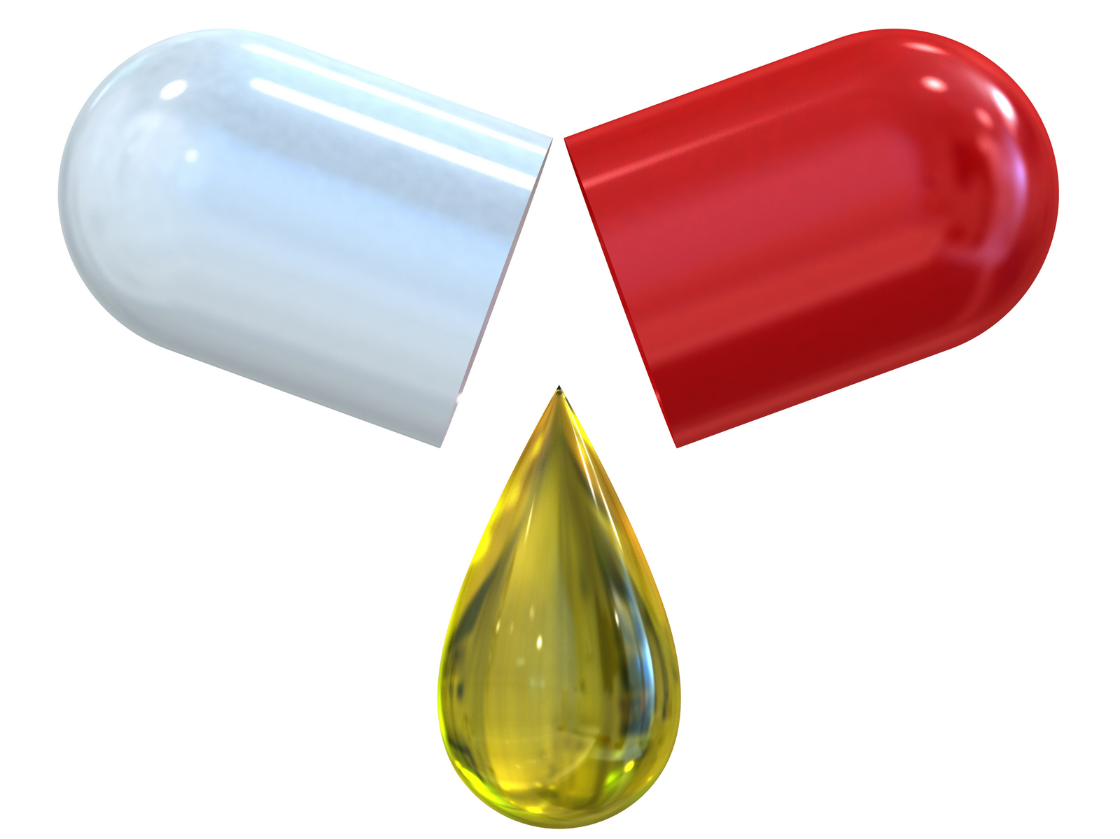
Antibiotics …………..?
If so , which ones to give ……….?

Slide 71
Commonly used Antibiotics...
Drug | Mg kg Day | Usual Freq. | S/E
Amoxi+Clav | 20-40 | 2” | LM*****, Rash
Azithro | 10 | 1” | 1”
Cefixime | 8-10 | 2” | 2”
Cefpodoxime | 8-10 | 2” | 2”
Cephalexin | 20-30 | 3” | 3”
Ciproflox | 10-15 | 2”

Slide 72
Drug | Mg kg Dose | Usual Freq. | Specific S/E
ceftriaxone – i.m / iv | 50 | 2” | Plt., Biliary
Cloxacillin | 25 | 3-4”
Oseltamavir | 2 | 2” | Hallucinations
Erythromycin | 10-30 | 3” | ECG
Metro | 20-50 | 3-4” | Metallic taste

Slide 73
Empirical choices
URTI / LRTI-- Amox+ Clavulinic acid Or Azithro Or
Cefpodoxime
Otitis Media --- Same
Gastro—Ciprofloxacin/oflox –Or-Septran +/- Metro
Genitourinary-------Amoxi+Clav ?? Ciproflox Or Septran or
cefpodoxime
Mild Cellulitis- Cephalexin Or Cloxacillin
Meningitis/ M-skeletal --- Vancocin-CP* + Ceftriaxone

Slide 74
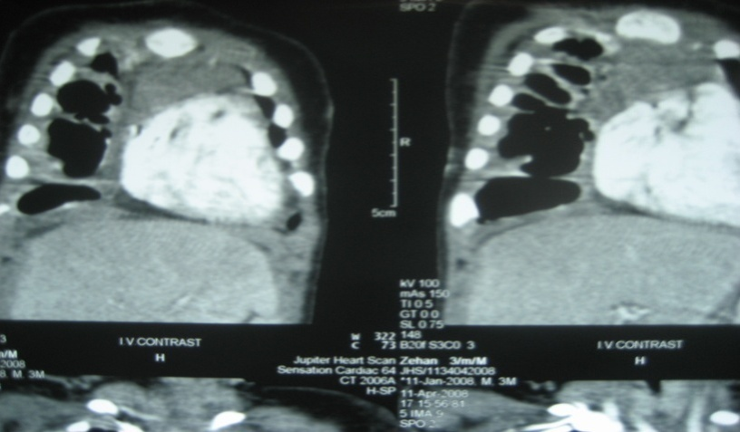
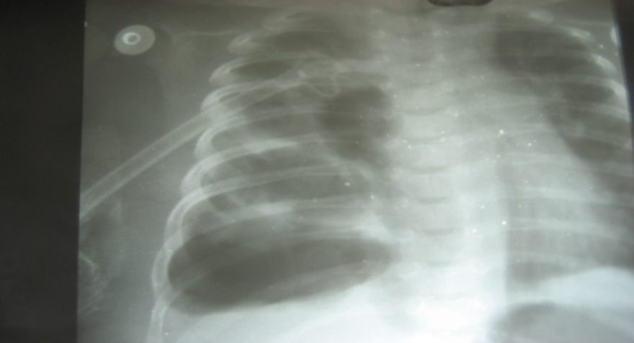
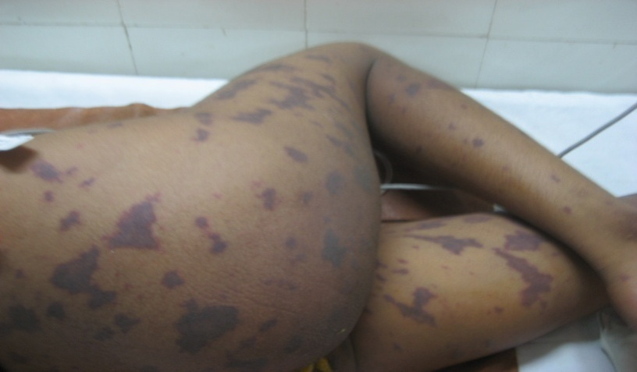
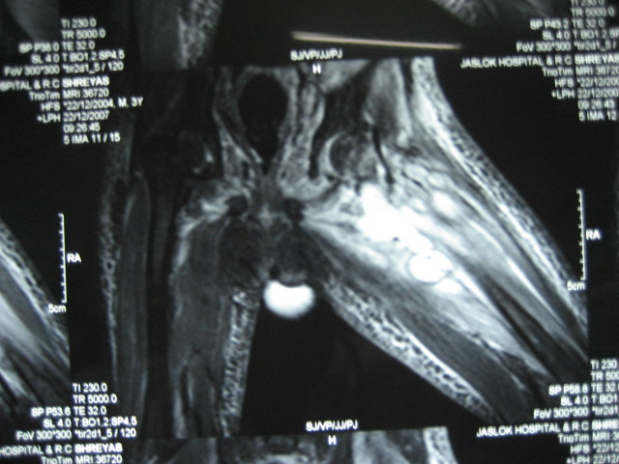
No role of oral drugs

Slide 75
Modify antibiotics after culture reports

Slide 76

An infection is more dangerous if it gives a high fever or if the fever doesn’t come down with treatment…

Slide 77
Hi temp = “bad” infection?
No studies have conclusively proven any correlation between height of temperature and outcome of an infection or disease outcome.
Notes:
Severity meaning the severity (degree and intensity) of symptoms

Slide 78
Hi temp = “bad” infection?
Several studies suggest that children with temperatures greater than 41°C (105.8°F) have a greater chance of having a serious bacterial illness.

Slide 79
Hi temp = “bad” infection?
Several studies suggest that fever of ≥ 40°C (104 °F) signals increased risk of serious bacterial illness for infants from birth to three months of age.

Slide 80
Poor response to tx = bad?
Failure of antipyretics to control fever has not been proven to correspond with severity of illness.
Improved general appearance after antipyretics may indicate a less severe illness.

Slide 81
SUMMARY
Since it is not always possible to distinguish a mild infection from a life-threatening condition, any child with fever should be properly evaluated.
In children with fever, the presence of additional risk factors for infection, such as sickle-cell anemia or HIV, is cause for evaluation, even if all assessment findings are normal.

Slide 82
Take home message
Fever—most common presenting symptom
Infections are the most common cause of fever in children
Thorough clinical examination is a must
Investigations need to be timely and tailor-made
Safe Antipyretics are usually safe
Ensure judicious and correct dose of antibiotics
Important to differentiate well from sick child for referral - - -
Is very often life-saving

Slide 83

Any Question ?

Slide 84

??????????

Slide 85
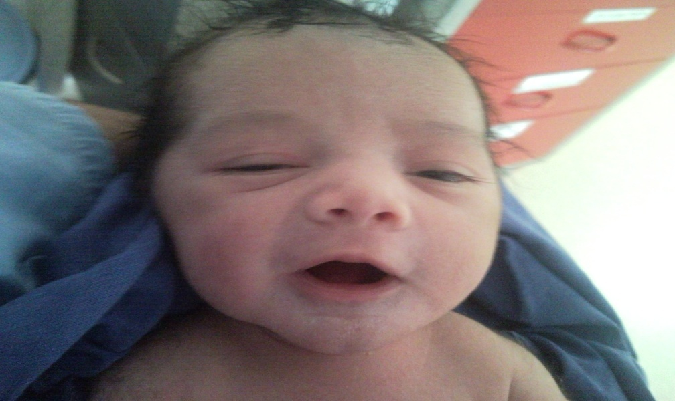
Thank You.

Slide 86
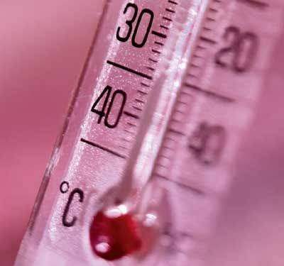
Case 1
18 month old boy
Fever 103-104 --- 3-4 times a day
In between-------- 100-101 F
“Decreased oral intake ---- Good urine output ”
On Examination ---
No localization
No Organomegaly , skin or M-sk involvement
Fever WLS----- ? Viral / Bacterial/ Non-infectious

Slide 87
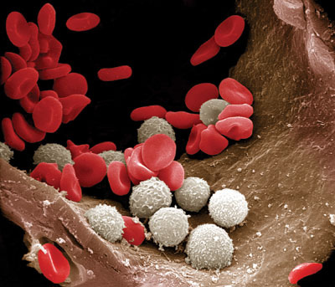
TLC--- 17000
70%Polys
Platelets normal
CRP ---- 1.8 (> 0.6 )
Lepto / Dengue / RMAg ---- Negative

Slide 88

Fever without localizing signs!!
UTI
Occult Pneumonia
Occult Bacteremia
Viremia
Non- Infectious --- CRP Positive --- Unlikely

Slide 89
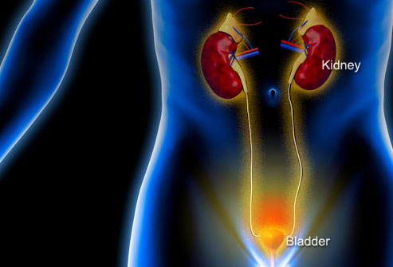
Urine ----- 8-10 pus cells
UTI ?
Leucocyte esterase +
Nitrites --- ++
Next step ???

Slide 90
Where is the culprit ???
?

Slide 91

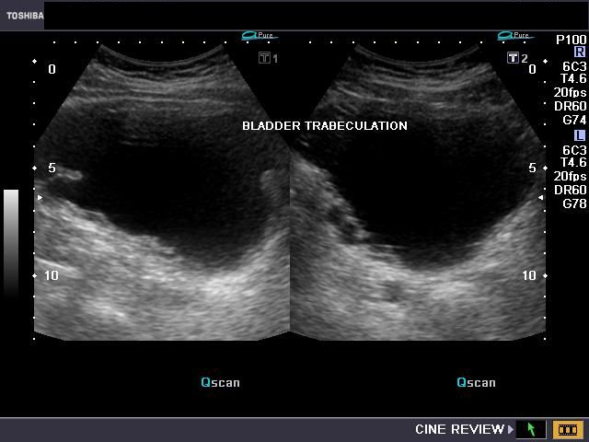
USG--- KUB
Posterior urethral valves

Slide 92
Underwent Fulguration of the PU valve f/b prolonged antibiotic course
Is on regular follow-up

Slide 93
Case- 2
11 yr old boy
Fever 99-101 for the last 10-15 days--- on different antibiotics
No localizing signs
Pallor
Spleen --- 1 cm palpable
? Malaria

Slide 94
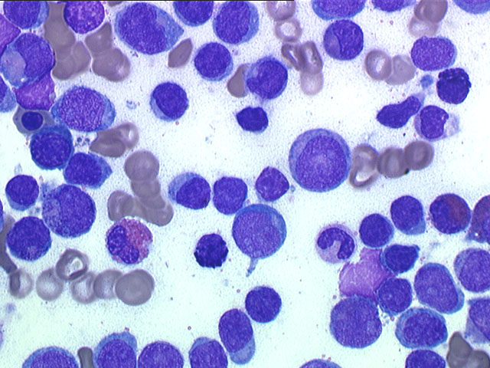
RMAg ---- negative
Hgb 8
Plt 1.2 lacs
TLC --- 50000
Diagnosis ???

Slide 95
Acute lymphatic leukemia
Fever with pallor , increased counts and
HS megaly ---Likely malignancy
Very important not to give steroids --- single dose of Hydrocort can change the picture
Referred to Pediatric hematologist for further care ………….

Slide 96
Case 3
13 yr old boy
1 day high grade fever with rash
Treated as Viral by quack
3RD generation Cephalosporins
Fever and rash worsened over the next 24 hours
Shown to a GP

Slide 97

1.He was noted to have poor pulses and few petechiae
2. Clinical diagnosis Dengue shock syndrome was made
3.Immediately referred

Slide 98
Came collapsed
Cyanosed and with Bradycardia + Feeble pulses
Intubated + Short run of CPR
Intravenous access impossible
Vague intra-osseous access
Decided to go with a Central line --- drugs as well as for sampling

Slide 99
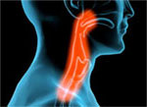
Case- 4
2 yr old girl
Immunised for age
C/O cough , cold , fever for 1 day
Difficulty swallowing food
O/E---Congested throat – no exudates
? Viral ? Bacterial **

Slide 100

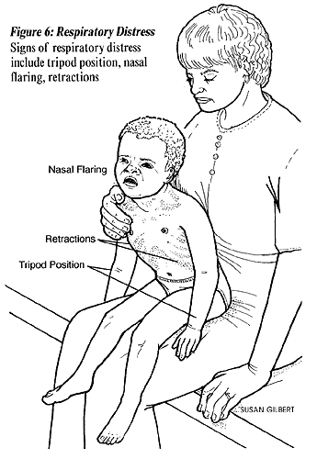
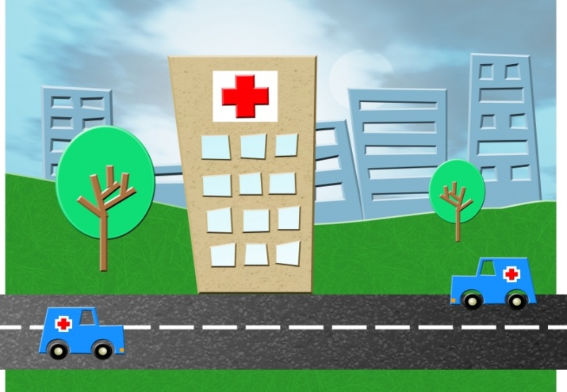
Started on antibiotics -- fever persisted
By day 3 ,
Increased work of breathing and
very poor oral intake
? Bronchiolitis /? Pneumonia
0/E – Bilateral crepts and minimal wheezing
Admitted to Hospital

Slide 101
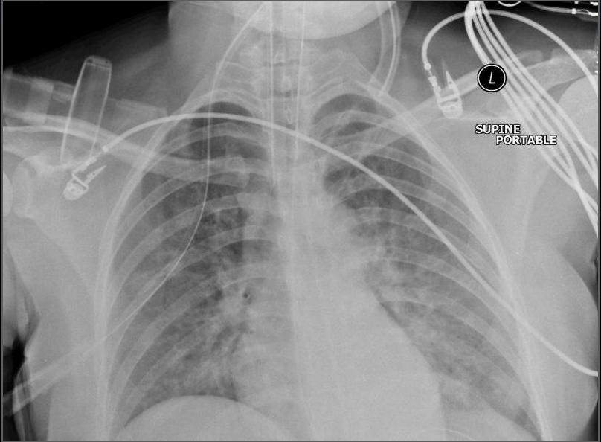
XRC ---- s/o bilateral Pneumonia
Started on Oxygen and Ceftriaxone
However, increased work of breathing
Was electively intubated ---- for next 4 days
Uneventful recovery thereafter

Slide 102
Repeat pneumonia
After 3 months ---again required ventilatory support
Repeat Pneumonias in children---?
Aspirations in CP and Down`s
Foreign Body --- Nuts, Peas etc. in younger children
Tracheo-esophageal fistula
Congenital Malformations of the lung
Immunodeficiency
Cystic fibrosis

Slide 103
Case--- 5
1 yr old boy
Partially top fed
c/o diarrheal illness with some blood in stools
Excessive crying – intermittently

Slide 104
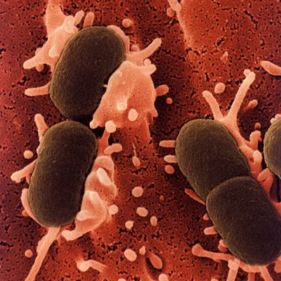
Viral v/s bacterial
Started on Norflox + Metro
Increasing crying episodes
Referred to us

Slide 105

O/E --- abdominal lump
?? Intussusception

Slide 106
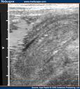

USG

Slide 107
GI Complaints
GastroEnteritis -- Vomiting is usual + Diarrhea
Intussuception --- Child draws up legs while crying , abdominal mass, cherry red stools
Appendicitis --Pain precedes vomiting.
Older children ---- 5-15

Slide 108
This particular child was first given reduction enema
------but then needed definitive surgery

Slide 109

Thank you

