Slide 1
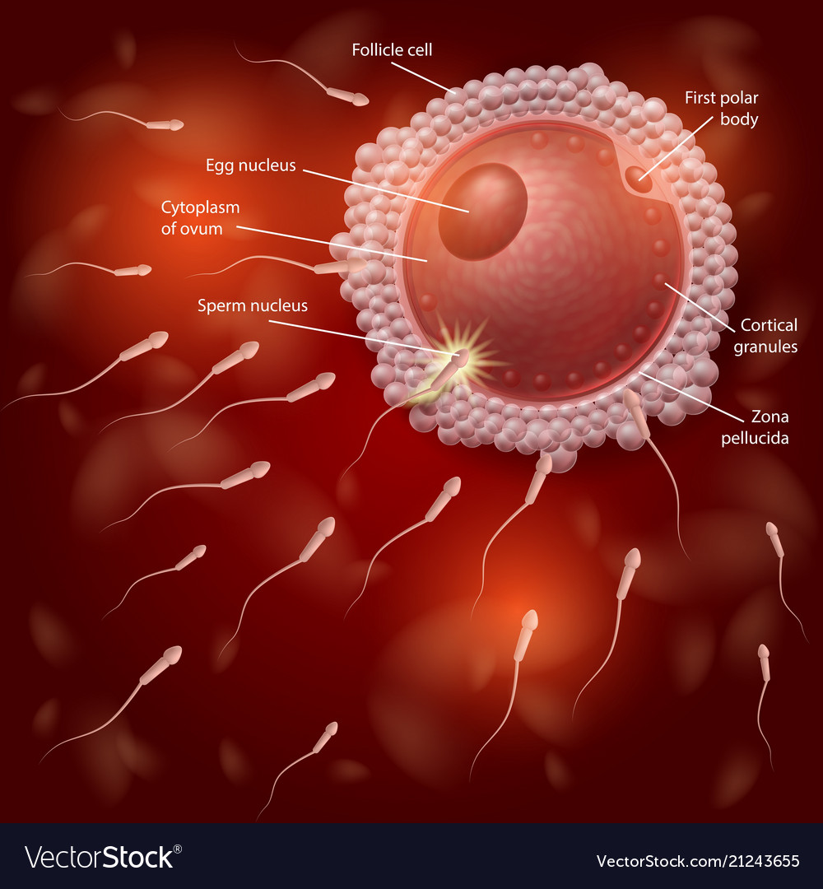
Fetal development
Dr. Jyoti Kumari Jangir
Assistant Professor
MD (Kaumarbhritya)

Slide 2
Teaching learning methods- lecture with power point presentation
Domain- Cognitive/comprehension and Cognition / Knowledge
Must to know / desirable to know / Nice to know- Must Know and Desire to know
Millers pyramid- Know

Slide 3
Cource Learning Outcomes
Evaluate normal growth and development and its deviation in children.
Demonstrate knowledge and skills in assessing and intervening child health through Ayurveda with research updates

Slide 4
Key points
Fertilization
Cleavage
Morula stage
Blastocyst stage
Implantation

Slide 5
Cont…
Fertilizin and Antifertilizin are specific proteins. Antifertilizin present on the surface of sperm and fertilizin is scereted by the ovum. Firtilizin and Antifertilizin of same species attract each other; this results in the aggretion of sperms arround the ovum; this phenomenon helps to understand why random fertilization does not occur in between two different species.
About 200-500 millions of sperms are introduced into the vagina during coitus, only 1% of them (4-5 million) reach inside the cervix and few hundred reach secondary oocyte in the fallopian tube, other expel outside and die. Prostaglandin present in semen probably stimulate uterine motility during coitus and help in the movement of sperm through uterus into the fallopian tube. Sperm takes 5-10 min following ejaculation to go to the fallopian tube and ovum gets fertilized

Slide 6
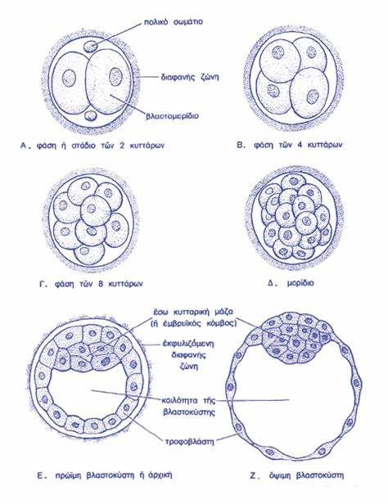
Cleavage
Early mitotic division of the zygote resulting into smaller cells immediately following fertilization is called cleavage. The resulting cells are known as blastomeres.
During cleavage the dividing cells are remained within the zona pellucida. Although cleavage increases the number of cells but not increases the size of zygote. The progressively smaller cells produced by the cleavage are called blastomeres.
A few days after fertilization (3 to 4 days) successive cleavages produce a solid mass of cells, still surrounded by the zona pelucida is called Morula (means Mulberry, a fruit), which is about the same size as the original zygote.

Slide 7
Implantation
Definition- Attachment, penetration and embedment of blastocyst inside the endometrium, which occur at about 6th or 7th day after the fertilization is called implantation.
Morula enters into the uterine cavity on 3rd or 4th day after fertilization.
Then it becomes blastocyst. The blastocyst remain free within the uterine cavity for about 2 days before attachment to the uterine wall.
After 6 days of fertilization the blastocyst loosely attaches to the endometrium.
During implantation, the inner cell mass of the blastocyst remains towards endometrium.

Slide 8
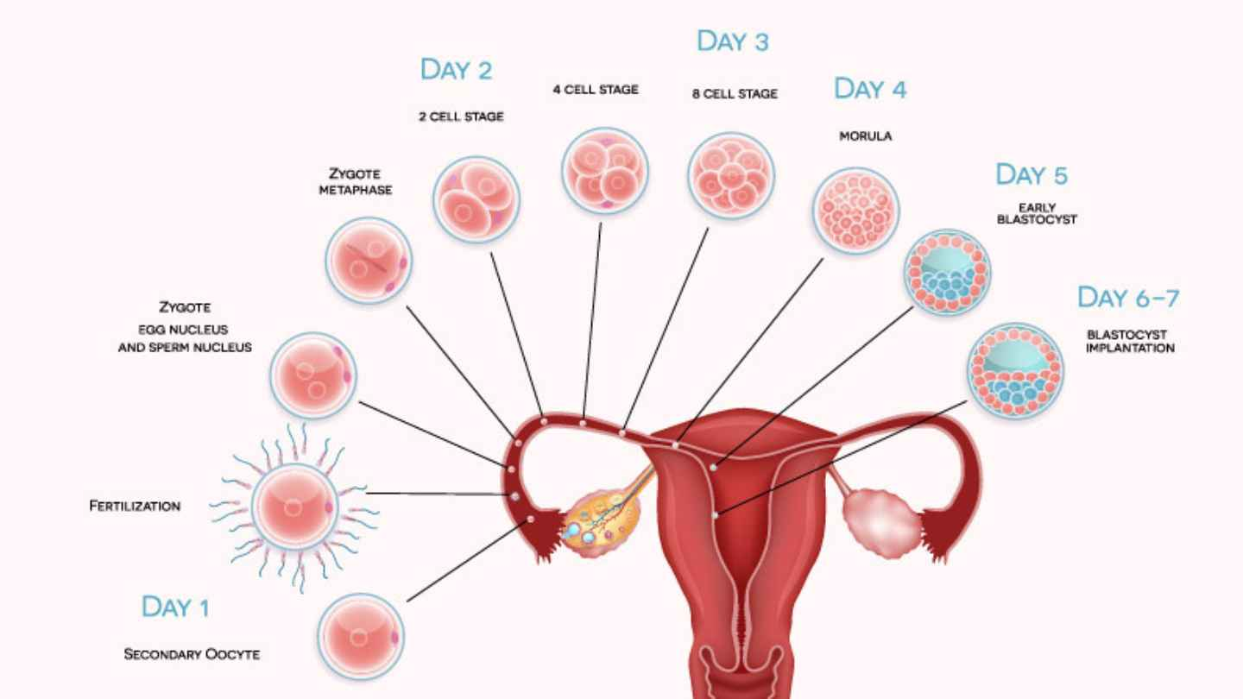
CONT…
'O’ DAY Fertilization 1 DAY 2 cells stage 2 DAY 4 cells stage 3 DAY 08 cells stage 4 DAY 16x cells stage
5 DAY EARLY BLASTOCYST
6-7 DAY IMPLANTATION

Slide 9
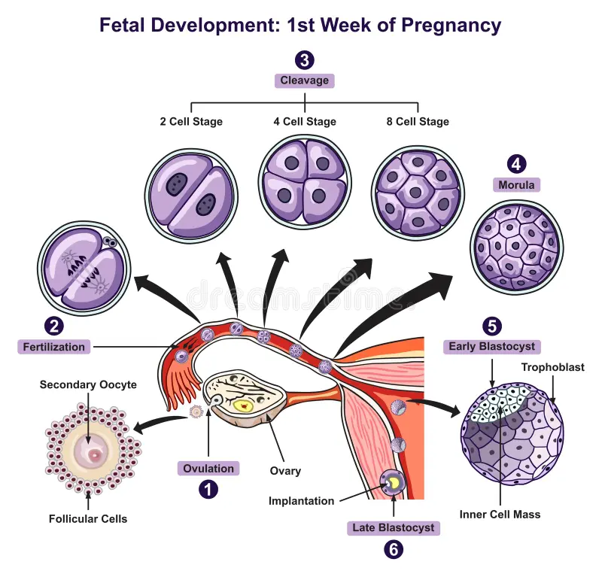

Slide 10
formation of placenta
After implantation the endometrium is modified and the endometrium of the pregnant uterus is called decidua. The word 'decidua' means a structure that falls off or shed after certain stage of development. It is so named because much of it shed during parturition (delivery). After the implantation, the different portions of decidua are named as follows-
1. Decidua Vera / Decidua Parietalis - The portion of decidua lining the uterine cavity outside the site of implantation is called decidua vera.
2. Decidua capsularis - Thin superficial endometrial layer covering the fertilized ovum is called decidua capsularis.
3. Decidua basalis - The portion of decidua lies in contact with the base of blastocyst is called decidua basalis.

Slide 11
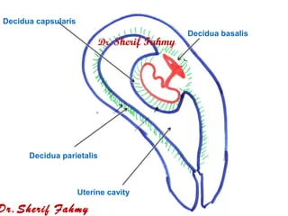

Slide 12
Cont…
The space between decidua capsularis and decidua vera is called decidual space.
As embryo grows towards uterine cavity, the decidual space becomes gradually reduced and it is completely absent by 4th month.
At term these two layers become atrophied due to pressure. The decidua basalis becomes extensively developed and become maternal portion of placenta.
At the site of implantation, the endometrial glands enlarge and endometrium becomes more vascularized. The decidua basalis provides large amount of glycogen & lipids for the developing embryo.

Slide 13
Cont…
On 8th day, the trophoblast is differentiated into two layers
Inner cellular layer is called as cytotrophoblast
Outer multi-nucleated syncytium called syncytiotrophobalst.
The syncytiotrophoblast secretes enzymes that digest and liquifies the endometrium by which blastocyst penetrate into the endometrium.
By 9th day blastocyst completely embed in the endometrium.

Slide 14
Cont…
The trophoblast secretes an important hormone known as HCG (human chorionic gonadotrophin). This hormone stimulates corpus luteum to produce progesterone and estrogen to maintain the pregnancy till the formation of placenta.
Peak secretion of HCG occurs at about 9th week of pregnancy. As syncytiotrophoblast penetrates into the endometrium, it keeps some area of endometrium within itself like island, these small spaces are called as lacunae. These lacunae contain maternal blood from which fetus draws its nutrition. The endometrial capillaries around the embryo become dilated and are called sinusoids.

Slide 15
Cont…
The trophoblast performs 3 important functions :
Invasion of the endometrium.
Provides nutrition to the embryo
Produces hormones for the maintenance of pregnancy
A new type of cells are visible below the cytotrophoblast on 9th day which are termed as embryonic mesoblast or primary Mesenchyme (mesodermal cells) or extraembryonic mesoderm. The origin of the these cells is still unknown.

Slide 16
These mesoblast produce mesodermal cells.
Mesodermal cells cover yolksac, amnion and inner lining of cytotrophoblast.
These mesodermal cells are known as extra embryonic mesoderm (as these cell do not take part in formation of organs of embryo). Now the large cavity within the extra embryonic mesoderm is called extra embryonic coelom.
The extra embryonic mesoderm together with the two layers of trophoblast (i.e. cytotrophoblast and syncytiotrophoblast) constitutes the chorion. The chorion becomes the principal fetal part of placenta.

Slide 17
Cont..
After 9th day, the chorion have finger like projections, known as primary chorionic villi, which give up branches and give rise to secondary and tertiary villi.
Extra-embryonic mesodermal cells enter into the central core of chorionic villi and are differentiated into blood cells and blood vessels.
This extra-embryonic circulatory system establishes connection with intra embryonic circulatory system through the body stalk or umbilical cord. The chorionic villi develop towards the myometrium & forms the placenta, but those lie towards the uterine cavity get atrophied due to pressure.

Slide 18
FORMATION OF PLACENTA (summary)
At about 8 days after fertilization the trophoblast is differentiated into 2 layers. (i) cytotrophoblast, (ii) syncytiotrophoblast
The cytotrophoblast consists of well defined cells, where as syncytiotrophoblast has multiple nucleus with common cytoplasm.
Syncytiotophoblast secretes enzymes which can digest and liquify the endometrium that enable the blastocyst to enter into the uterine wall. In this way the blastocyst gets burried in the endometrium.
As syncytiotrophoblast expands, small spaces containing maternal blood are formed within it which are known as lacunae.
Extra embryonic mesoderm and two layers of trophoblast such as cytotrophoblast and syncytiotrophoblast together form chorion.

Slide 19
Cont…
Chorion and decidua basalis together form placenta. Placenta has both fetal and maternal origin; chorion belongs to fetal part and decidua basalis belongs to maternal part.
During embryonic life the chorion develops finger like projections into the decidua basalis. They are called as chorionic villi. The chorionic villi continue to grow untill they get bathed in maternal blood, present in intervillous space (lacunae), where exchange of materials (nutrition & gases) occur between mother and fetus.

Slide 20
Cont..
Maternal blood enters the intervillous space of the placenta through spiral arteries, branches of the uterine artery.
It bathes the chorionic villi and flows peripherally to the marginal sinuses which leads to the uterine veins.
The development of placenta is accomplished by the end of 3rd month of pregnancy.

Slide 21
STRUCTURE OF PLACENTA-
It is almost circular disc flat cake when fully formed. The matured placenta has 15-18 cm diameter, 23 mm thickness & about wt. of 500 gm.
It has 2 surface maternal & fetal. Maternal surface is directly attached with endometrium. The fetal surface is covered with amnion which has white & shiny appearence.-
The maternal surface consists of about 20 distinct lobules are known as cotyledons. Each lobule consists of group of villi separated by a septum known as placental septum.
After delivery the cotyledons are inspected for their lost part to diagnose retained placenta in PPH (post partum hemorrhage) (clinical importance).

Slide 22
FUNCTION OF PLACENTA
Transportation- Through the plancenta, transportation of O2, water, electrolytes and nutrition occurs from mother to fetus and waste products like urea, uric and, co, & others, produced by fetus are excreted to the maternal blood.\
Barrier一It acts as a barrier & prevents many microorganism and harmful substances such as drugs to enter into the fetus from mother. However, most viruses (HIV) & some bacterias (tuberculosis) may cross the placental barrier to affect the fetus. Some drugs are contraindicated in pregnancy can cross the placenta to cause congenital anomalies. Usually maternal hormones cannot cross the plancenta but synthetic estrogens & progesterones can easily cross the placenta & affect the fetus.

Slide 23
Cont…
Storage - It stores nutrients such as carbohydrates, proteins, calcium, iron etc. which are released into the fetal circulation when are required.
Endocrine - It produces several hormones those are necessary in pregnancy.
Estrogens
Progesterone
HCG (up yo 4th month)
HCS ( human chorionic somatotropin) or HPL (Human placental lactogen).
Relaxin ( secreted by both ovary and placenta).
[Note- Function of HCL / HPL –
Stimulates development of breast for lactation.
It has anti insulin effect on mother as it increases blood glucose and amino acid level in the maternal blood to go to the fetal circulation.

Slide 24
Cont…
Immunity- Maternal antibodies against some infections such as measles, diptheria, tetanus, pertusis, etc. reach the fetus through placenta (passive immunity). To provide immunity against such diseases after birth upto some month. As maternal and fetal circulations are separated, i.e. no intermixing of blood, there is no chance of antigen & antibody reaction (for rejection of product of conception).
Treatment - It can be used as source of hormone or drugs or blood. Parts of placenta can be used for transplantation of skin in burn. Umbilical vein may be used in grafting of blood vessels, cord blood can be used as pleuripotent stem cells (blood mother cells) in transplantation of red bone marrow in blood cancer.

Slide 25
FORMATION OF UMBILICAL CORD
It is the connection between mother (placenta) and fetus or embryo. The umbilical cord is developed from connecting stalk.
By the end of 2nd week, the bilaminar embryonic disc becomes connected to the trophoblast by a band of extra-embryonic mesoderm is called as connecting stalk.
It becomes future umbilical cord, later a layer of amnion surrounds the entire umbilical cord and gives it a shining appearance. Anatomically umbilical cord is considered as fetal membrane.

Slide 26
Cont…
Structure
It consists of two arteries those carry deoxygenated blood from fetus to placenta and one vein that carries oxygenated blood from mother to fetus.
It is well supported by a mucus connective tissue called wharton's jelly.
Both wharton's jelly and blood vessels are derived from a fetal membrane called allantois.
Normally its diameter varies from 0.2 to 0.8 cm; its length also varies from 30-100 cm (average 55 cm). The length below 30 cm is considered as abnormal.

Slide 27
Cont…
The vessels in the cord are twisted and folded which creates nodules on the surface. Sometimes it looks as a knot and is known as false knot. Two arteries have smaller diameter than vein. Actually there are two veins, but the right umbilical vein disappears during early fetal development, leaving only one umbilical vein (left)
The vessels in the umbilical cord are twisted or spiralled. The twisting or spiralling may be clockwise (dextral) or anticlock wise (sinistral) but the anticlock wise twisting is more common

Slide 28
GASTRULATION AND DEVELOPMENT OF INNER CELL MASS
Definition: The various movements of cells occur in the inner cell mass leading to the formation of 3 primary germ layers is referred to as gastrulation.
At about 14th day following fertilization the cells of inner cell mass are arranged like a disc in 3 layers e.g. the upper ectoderm, middle mesoderm and lower endoderm and the disc is referred to as embryonic disc.
These are the embryonic tissues from which all tissues and organs of body develop. It is very difficult to understand how these 3 layers develop into all the organs of the body. Different organs, developed from different layers are described below.

Slide 29
Cont…
Ectoderm | Mesoderm | Endoderm
Nervous system | Dermis | Lining of GI tract (except oral cavity and anal canal)
Epidermis | Urogenital system | Liver
Lens of eye | Peritoneum | Pancreas
Hairs | Glands | Thyroid
Oral cavity | All connective tissue | Respiratory system
Anal canal | Areolar Adipose White fibrous Ligament Tendon Bone Cartilage Lymph | Urinary bladder and urethra
 |  | Vagina, vestibule
 |  | Bartholian’s gland

Slide 30
FORMATION OF EMBRYONIC OR FETAL MEMBRANES
Embryonic membrane are formed during early embryonic development. These membranes lie outside the embryo or fetus and perform dual functions, protection and nourishment. The embryonic membrane are :
(a) Amnion, (b) Yolk sac, (c) Chorion, (d) Allantois

Slide 31
Development of Amnion –
Cells of inner cell mass are differentiated into two layers after 8 days of fertilization.(i) Epiblast (primitive ectoderm)(i1) Hypoblast (primitive endoderm)
These two layers are together known as bilaminar embryonic disc. A small cavity appears within the epiblast, which gradually enlarges, is known as amniotic cavity.
As amniotic cavity enlarges, a thin protective membrane develops from the epiblast is called as amnion. As the embryo grows, the amnion gradually surrounds the entire embryo and is filled with a fluid called as amniotic fluid.

Slide 32
Devlopment of Yolk sac –
The cells of the hypoblast form a cavity or sac, which is called as yolk sac. It is lined with the cells of endoderm.
In many lower species it provides exclusive nutrients to the embryo; but the human embryo derives its nutrition from the maternal endometrium.
In human, the blood is formed from the yolk sac during embryonic period.
Some cells of the yolk sac also differentiate into primary germ cells which in future become Spermatogonia in male. As fetus grows it becomes a non-functional part of the umbilical cord

Slide 33
Chorion –
It is derived from the trophoblast and extra embryonic mesoderm.
It becomes the principal part of the placenta.
It is described in the slide of "formation of placenta“
Allantois –
It is a vascularised membrane and serves as an early site of blood formation.
Later its blood vessels connect mother and fetus in the placenta also becomes a non-functional part of umbilical cord.

Slide 34
AMNIOTIC FLUID
Definition: The faintly alkaline watery fluid present in the amniotic sac in which embryo or fetus grows is called amniotic fluid.
Origin : The exact (precise) origin of amniotic fluid is still unknown; but following assumption (hypothesis) may be considered -

Slide 35
When a fluid is secreted through membrane it is known as transudation. Amniotic fluid is secreted through membranes from both maternal and fetal circulation. From maternal circulation the secretion comes through placenta and uterine wall and from fetal circulation the secretion comes through umbilical cord.
Contribution from fetal urine.
Secretion from tracheo-bronchial tree.
Through the fetal skin before 20th week (because after 20 weeks it becomes impermeable due to deposition of keratin).

Slide 36


