Slide 1
Cource Learning Outcomes
Evaluate normal growth and development and its deviation in children.
Demonstrate knowledge and skills in assessing and intervening child health through Ayurveda with research updates

Slide 2
Teaching learning methods- lecture with power point presentation
Domain- Cognitive/comprehension and Cognition / Knowledge
Must to know / desirable to know / Nice to know- Must Know and Desire to know
Millers pyramid- Know

Slide 3
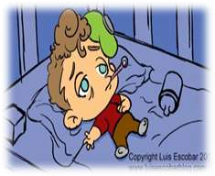
Diarrhea
Defined as change in consistency and frequency of stools, i.e. liquid or watery stools, that occur >3 times a day.
However it is the consistency of the stools rather than the number that is more important.
If stools associated with blood it is termed as dysentery.
Frequent passage of normal stool is not
diarrhoea.

Slide 4
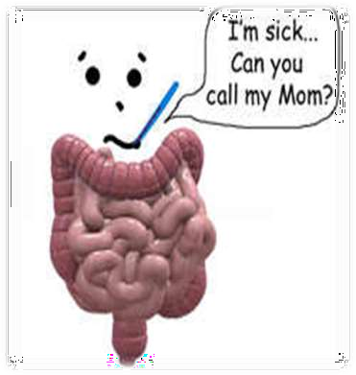
Classification
Diarrhoea is classified as
acute if <2 weeks,
persistent if 2–4 weeks,
chronic if >4 weeks

Slide 5
Magnitude of the problem: World
Diarrhoeal disease is the 2nd leading cause of death in children under 5 yrs of age.
Globally, there are about 3-5 Bn cases of diarrhoeal disease every yr.
Diarrhoeal disease kills 2 Mn children
every yr.
Diarrhea accounts for over 20% of all deaths in under 5 children.
It is both preventable and treatable.

Slide 6

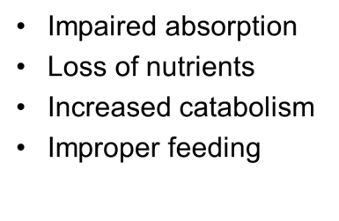
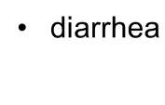
Consequences
Malnutrition
Dehydration

Slide 7
Risk Factors
Poor sanitation & personal hygiene
Contaminated food & drinking water
Low rates of BF & immunization
Malnutrition in younger children (2yr)
For prolonged episodes
Selective IgA deficiency
HIV infection
C.difficile infection (d/t antibiotic usage)

Slide 8
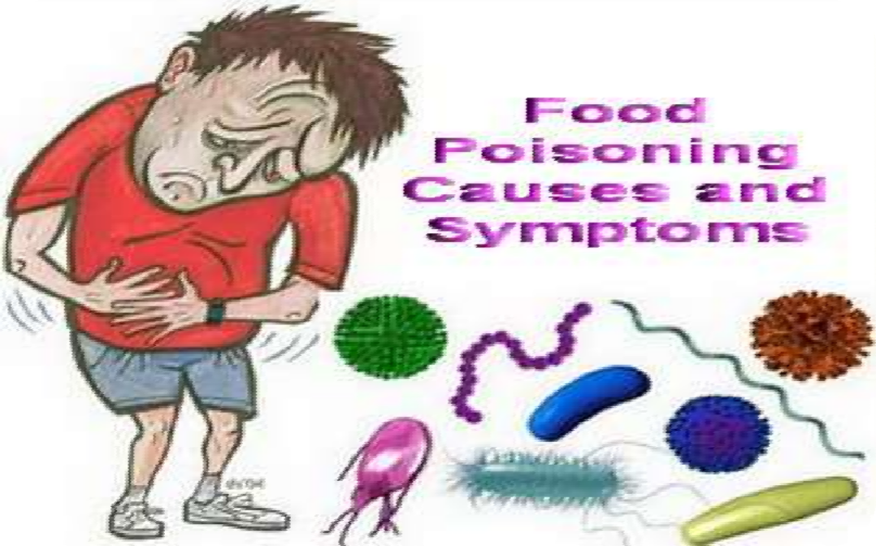
Etiology
Viral: 70-80% of infectious diarrhea in developed countries
Bacterial: 10-20% of infectious diarrhea but responsible for most cases of severe diarrhea
Protozoan: less than 10%

Slide 9
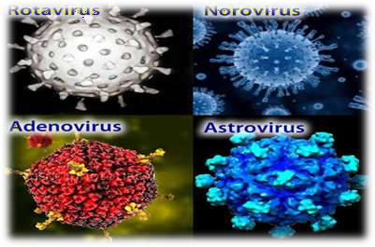
Viral Diarrhea
Rotavirus
Norovirus (Norwalk-like)
Enteric Adenovirus (serotypes 40 & 41)
Astrovirus

Slide 10
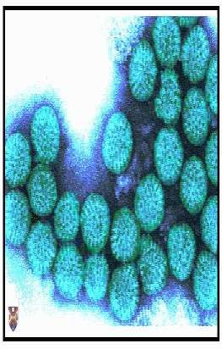
Summary of Viral Diarrhea
Most likely cause of infectious diarrhea
Rotavirus and Norovirus are most common
Symptoms usually include low grade fever, nausea and vomiting, abdominal cramps, and watery diarrhea lasting up to 1 week
Viral shedding can occur for weeks after symptoms resolve
Feco-oral transmis

Slide 11
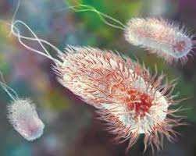
Bacterial Diarrhea
Escherichia coli (EHEC,ETEC)
Shigella
Vibrio cholera (serogroups O1 &O139)
Salmonella
Campylobacter

Slide 12
Summary of Bacterial Diarrhea
Can affect all age groups
Fecal-oral transmission, often through contaminated food & water
Typical symptoms include bloody diarrhea,
severe cramping, and malaise
Antibiotic treatment not always necessary

Slide 13

Parasitic
Giardia lamblia
Cryptosporidium parvum
Entamoeba histolytica
Cyclospora cayetanensis
Isospora belli

Slide 14
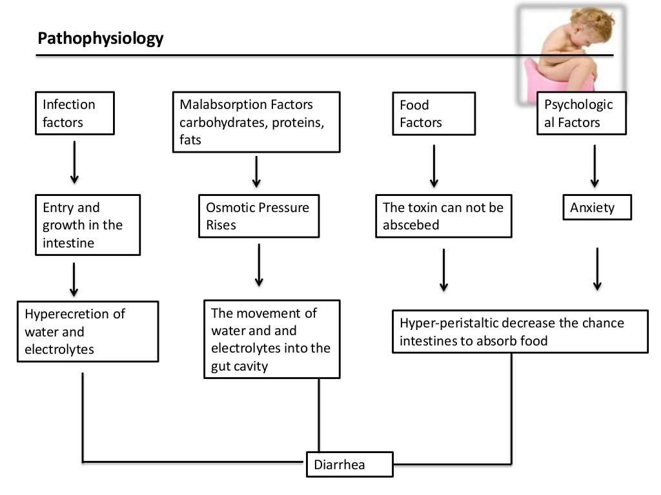

Slide 15
Clinical Features
Mild
Slightly irritable & thirsty
Moderate
More irritable, pinched look, depressed fontanelle, sunken eyes, dry tongue, distended abd. urine output at longer intervals
Extreme case
Moribund look, weak and thready pulse, low blood pressure, reduced urine output

Slide 16
Assessment of Child
Type of diarrhea
Look for dehydration
Assess for malnutrition
Rule out systemic infection
Assess feeding

Slide 17
History
Onset, duration and no.of stools per day
Blood in stools
No. of episodes of vomiting
Associated symptoms
Oral intake
Drugs or other local remedies taken
Immunization history

Slide 18
Physical Examination
Vitals, vitals, vitals!
Abdominal exam
Presence of occult blood
Signs of dehydration

Slide 19
Laboratory Evaluation
Can be managed effectively without lab investigations
Stool microscopy in selected situations like
cholera (darting motion) giardiasis (trophozoites)
Stool culture to decide on antibiotic
therapy in patients with shigella dysentery

Slide 20

Principles of Management
4 Major components:
Rehydration and maintaining hydration
Ensuring adequate feeding
Oral supplementation of Zn
Early recognition of danger signs and
treatment of complications

Slide 21
INTRODUCTION:
Dehydration resulting from acute diarrheal illness is one of the most significant causes of morbidity and mortality in the population.
In some cases, it accounts for more than 50% of the deaths during the initial stages of a humanitarian emergency.
Worldwide, over 3 million children under 5 years die from
dehydration every year. (WHO)
The use of oral rehydration therapy (ORT) has markedly reduced the morbidity and mortality associated with dehydration caused by diarrheal illness regardless of the etiology.

Slide 22
DEFINITION:
Dehydration is a condition that can occur with excess loss of water and other body fluids. Dehydration results from decreased intake, increased output (renal, gastrointestinal or insensible losses), a shift of fluid (eg, ascites, effusions), or capillary leak of fluid (eg, burns and sepsis).

Slide 23


CLASSIFICATION OF DEHYDRATION SEVERITY BY
WHO
NO DEHYDRATION | SOME DEHYDRATION | SEVERE DEHYDRATION
Not enough signs to | Two or more of the following | Two or more of the
classify as some or severe dehydration | signs: restlessness, irritability sunken eyes drinks eagerly, thirsty skin pinch goes back slowly | following signs: lethargy/unconsciousness sunken eyes unable to drink or drinks
 |  | poorly skin pinch goes back very
 |  | slowly (≥2 seconds)
National Collaborating Centre for Women's and Children's Health (UK). Diarrhoea and Vomiting Caused by Gastroenteritis: Diagnosis, Assessment and Management in Children Younger than 5 Years. London: RCOG Press; 2009 Apr. (NICE Clinical Guidelines, No. 84.) 4, Assessing dehydration and shock.

Slide 24
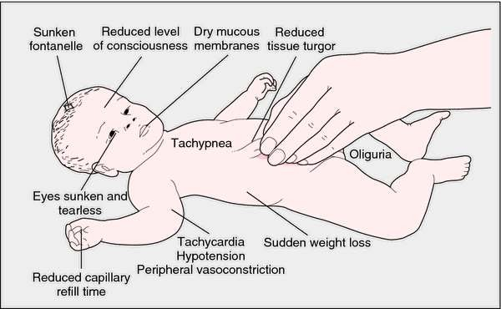

Slide 25


Degree of Dehydration
Factors | Mild Older Child 3% (30ml/kg) Infant 5% (50ml/kg) | Moderate Older Child 6% (60ml/kg) Infant 10% (100ml/kg) | Severe Older Child 9% (90ml/kg) Infant 15% (150ml/kg)
General Condition | Well, alert | Restless, thirsty, irritable | Drowsy, cold extremities, lethargic
Eyes | Normal | Sunken | Very sunken, dry
Anterior fontanelle | Normal | depressed | Very depressed
Tears | Present | Absent | Absent
Mouth + tongue | Moist | Sticky | Dry
Skin turgor | Slightly decrease | Decreased (1-2 sec) | Very decreased (>2sec)
Thirst | Normal | Drinks eagerly, thirsty | Unable to drink or drinks poorly
Pulse (N=110-120 beat/min) | Slightly increase | Rapid, weak | Rapid, sometime impalpable
BP (N=90/60 mm Hg) | Normal | Deceased | Deceased, may be unrecordable
Respiratory rate | Slightly increased | Increased | Deep, rapid
Urine output | Normal | Reduced | Markedly reduced
Treatment | Plan A | Plan B | Plan C

Slide 26
Management of Dehydration
General Principles:
Supply Maintenance Requirements
Correct volume and electrolyte deficit
Replace ongoing abnormal losses

Slide 27
Ongoing Losses
Regardless of the degree of dehydration, give additional 10ml/ kg of ORS for each additional diarrheal stool.

Slide 28
Severe Dehydration
Management of severe dehydration requires IV fluids.
Choice of fluid: Normal saline(NS) or Ringer
Lactate (RL)
Fluid selection and rate should be dictated by
The type of dehydration
The serum Na
Clinical findings
Aggressive IV NS bolus remains the mainstay of early intervention in all subtypes

Slide 29
Monitoring Therapy
Vital signs:
Pulse
Blood pressure
Intake and output:
Fluid balance
Urine output
Physical examination
Weight
Clinical signs of depletion or overload
Electrolytes

Slide 30

WHO TREATMENT PLANS

Slide 31
Plan A
(No Dehydration)
Oral rehydration therapy to prevent Dehydration Age ORT fluids to give Amount of ORS to after each loose stool provide for use at home
< 24 months | 50 - 100 ml | 500 ml/ day
2 – 10 years | 100 – 200 ml | 1000 ml/ day
> 10 years | Ad lib | 2000 ml/ day
Give Supplemental Zinc (10-20 mg) to the child, everyday for 10 to 14 days

Slide 32
Plan B (Some Dehydration)
Daily fluid requirement:
– Up to 10 kg = 100 ml/ kg
10 – 20 kg = 50 ml/ kg
> 20 kg = 20 ml/ kg
Deficit replacement:
75 ml/ kg ORS to be given over 4 hours
Replace losses:
ORS should be administered in volumes equal to diarrheal losses. Maximum of 10 ml/ kg per stool.
Give Supplemental Zinc (20 mg) to the child, everyday for 10 to 14 days

Slide 33
Plan C (Severe Dehydration)
Treated with 20 mL/ kg IV of isotonic crystalloid over 10 to 15 minutes. Repeat as necessary.
Monitor pulse strength, capillary refill time, mental
status, urine output and electrolytes.
After resuscitation: A total of 100 ml/ kg of fluid given over 3 hours in children > 12 months and over 6 hours in children < 12 months.
Assess the patient every 3 hours accordingly repeat Plan C or shift to Plan B
Age | 30 ml/ kg | 70 ml/ kg
< 12 months | 1 hour | 5 hour
> 12 months
30 min
2 ½ hour

Slide 34
ORS
STANDARD WHO ORS
LOW OSMOLARITY ORS
Constituent | g/ L | Osmole / ion | mmol/ L
Sodium chloride | 3.5 | Sodium | 90
Constituent | g/L | Osmole/ion | mmol/L
Sodium chloride | 2.6 | Sodium | 75
Glucose
13.5
Glucose
75
Glucose Potassium | 20 1.5 | Glucose Potassium | 111 20 |  | Potassium chloride | 1.5 | Potassium | 20
chloride Trisodium | 2.9 | Citrate | 10 |  | Trisodium citrate | 2.9 | Citrate | 10
citrate
Chloride 65
Chloride 80
Total Osmolarity
245
Total Osmolarity
311

Slide 35
Other types of ORS
Zinc fortified ORS
ORS fortified with amino acids.
Home made ORS
– 4g salt + 40g sugar in 1 L of water

Slide 36
Contraindications to ORT
Ileus or intestinal obstruction
Unable to tolerate (Persistent vomiting)

Slide 37
Home available fluids
Acceptable Home available Fluids
Fluids that contain Salt (Preferable)
ORS, Salted drinks (Salted rice water/ salted yogurt drink), vegetable or chicken soup with salt
Fluids that do not contain salt (Acceptable)
Plain water, water in which cereal has been cooked, unsalted soup, yogurt drinks without salt, green coconut water, weak unsweetened tea, unsweetened fresh fruit juice
Unsuitable home available fluids
Commercial carbonated beverages,
commercial fruit juices, sweetened tea.

Slide 38
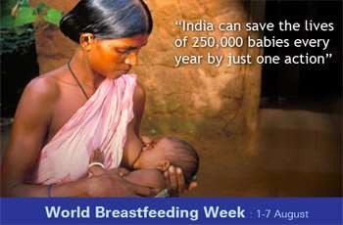
Early Refeeding
Luminal contents help promote growth of new enterocytes and facilitate mucosal repair
Can shorten duration of the disease
Lactose restriction is not necessary except in severe disease

Slide 39
Oral Zn Supplementation
3-6 months 10mg daily x 2 weeks.
>6 months 20mg daily x 2 weeks.

Slide 40
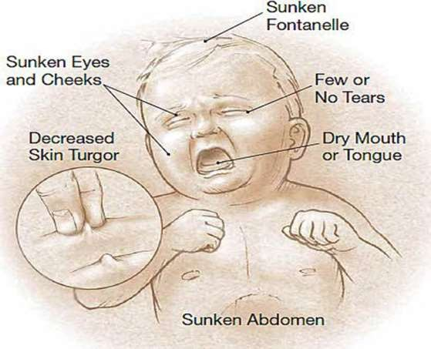
Danger signs

Slide 41
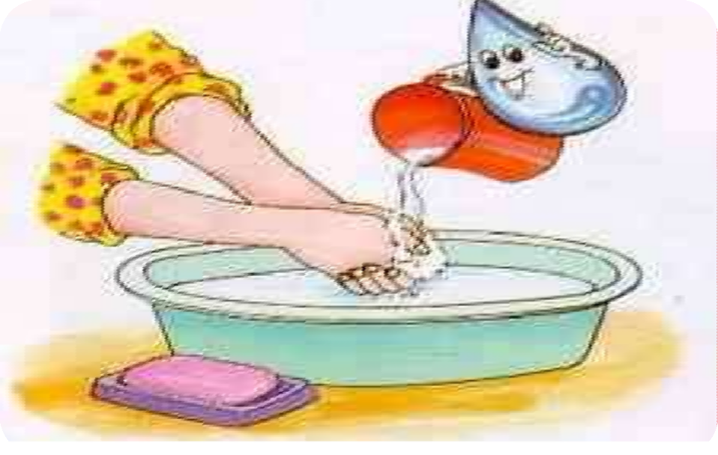
Prevention
Keep your hands clean
Boiling water
Wash fruits and vegetables
Refrigerate and cover food
Eat well-cooked foods

Slide 42
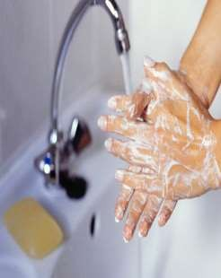


Contd…
Rotavirus and measles vaccination
Early and exclusive breastfeeding
Vitamin A supplementation
Promotion of hand washing with soap
Improved drinking water supply and safe storage of household food & water
Community-wide sanitation promotion

Slide 43

बालातिसार
गुदेन् बहुद्रवसरणमतिसारः
Excess mala nirharan from guda that only known as अतिसार when it happen to bala that is known as बालातिसार

Slide 44
पुर्वरुप
ह्यन्नाभिपायूदरकुक्षितोदगत्रावसादानिलसन्निरोधाः |
विट्सङ्ग आध्मानमथविपाको भविष्यतस्तस्य पुरःसराणि || मा.नि.3/5
Pricking pain at heart,nabhi, guda, udara, and kukshi
अधोवायुअवरोध
अन्गशिथिलता
मलप्रवृति अभाव
आध्मान
Indigestion of food

Slide 45
प्रकार & its रूप
सामान्य अतिसार
वातातिसार
पैतिक अतिसार
कफज अतिसार
त्रिदोषज अतिसार
रक्तातिसार
ज्वरातिसार
आगन्तुज अतिसार
आमातिसार
प्कवातिसार
बालातिसार

Slide 46
वातातिसार
अरुणं फेनिलं रूक्षमल्पमल्पं मुहुर्मुहुः |
शक्रुदामं सरुक्शब्दं मरुतेनातिसार्यते || मा.नि.
Stool comes out with sound and pain which is अरुणं in colour with foam and रूक्ष in nature which comes out frequently within small amount.

Slide 47
पैतिक अतिसार
पित्तात्पीतं निलमालोहितं वा तृष्णामुर्छादाहपाकोपपन्नम् | मा.नि.
In पैतिक अतिसार stool is of yellowish-green in colour or reddish colour patient suffers with associated symptoms like
तृष्णा
मूर्छा
सर्वान्गदाह
गुदपाक

Slide 48
कफज अतिसार
शुक्लं सान्द्रं शलेषमणा श्लेष्मयुक्तं विस्त्रं शीतं ह्यष्टरोमा मनुष्यः | मा.नि.
In कफज अतिसार stool is whitish coloured associated with thick in consistency , कफयुक्त , दुर्गन्धि and शीत
Patient suffers from रोमहर्ष

Slide 49
त्रिदोषज अतिसार
वराहस्नेहमाम्साम्बुसद्रुशं सर्वरुपिणम् |
क्रुछसाध्यमतिसारं विधाद्दोशत्रयोद्भवम् || मा.नि.
In त्रिदोषज अतिसार stool looks like fate of pig, or water mixed with mamsa (मांसधोवन )
This type of अतिसार is कृच्छसाध्य

Slide 50
रक्तातिसार
पित्तकृन्ति यदाऽत्यर्थ द्रव्याण्यश्नाति पैतिके |
तदोपजयतेऽभिक्ष्णं रक्तातिसार उल्बणः || मा.नि.
When patient is suffering from पैतिक अतिसार and the if patient indulge with पैतिक आहार विहार then he suffers from very dangerous and difficult to treat रक्तातिसार
Stoll is looks like blood only or reddish-yellow in colour and there is symptoms of पैतिक अतिसार also visible in this type of patient

Slide 51
ज्वरातिसार
ज्वरातिसारयोरुक्तं निदानं यत् पृथक् पृथक् |
तत्स्याज्ज्वरातिसारस्य तेन नात्रोदितं पुनः || मा.नि.
There is diffract nidanas for jvara and atisara when patient indulge with both nidana then he suffers from ज्वरातिसार

Slide 52
आगन्तुज अतिसार
आगन्तु द्वावतिसारौ मानसौ भयशोकजौ |
ततयोलंक्षणं वायोर्यदतीसारलक्षनम् || च.चि.19/24
According to आचार्य चरक there is mainly two type of आगन्तुज अतिसार they are भयाज and शोकज
Bothe are associated with मानस भाव
लक्षण of all आगन्तुज अतिसार are same as वातज अतिसार

Slide 53
आमातिसार
आमाजिर्णोपद्रुताः क्षोभयन्तः कोष्ठं दोषाः संप्रदुष्टाः साभाक्तम् |
नानावर्ण नैकशः सारयन्ति क्रुच्छाज्जन्तो: षष्ठमेनं वदन्ति || सु.उ.40/16
In आमातिसार when pachana of anna does not accurse then doshas got elivated in kustha and it produce dusana to raktadi dhatu and mala and produce different coloured stool which is comes out with pain and repeatedly that is आमातिसार
आमातिसार is कृच्छसाध्य

Slide 54
प्कवातिसार
संस्रुष्ठमेभिर्दोषैस्तु न्यस्तमप्स्ववसीदति |
पुरीषं भृशदुर्गन्धि विच्छिन्नम् चामसंज्ञकम् ||
एतान्ये व तु लिङ्गानि विपरीतानि यस्य तु |
लाघवञ्च मनुष्यस्य तस्य पक्वं विनिर्दिशेत् ||
सु.उ.40/17-18
When there is no लक्षण of आममल seen and patient feel free after malanirharana that is known as प्कवातिसार
Here in प्कवातिसार लक्षण are same as amatisara but only difference is in stool there will be no aam.

Slide 55
बालातिसार
क्षिरदोशजन्य | बालग्रह | व्यधिजन्य | अन्य कारनजन्य
पैतिक क्षिरदोष त्रिदोषज वैवर्ण्य पारिगर्भिक | नागमैष पितृग्रह शकुनिग्रह पुतना ग्रह शितपुतना ग्रह अन्धपुतना रेवतिग्रह सुश्करेवति ग्रह | विभिन्न व्यधि उपद्रव उत्फ़्फ़ुल्लिका क्रुमि तालुकन्तक | म्रुतिकाभक्शन जन्य त्रास जन्य दन्तोद्भेद जन्य

Slide 56
सामान्य सम्प्राप्ति
सम्शम्यपां धातुरग्निं प्रवृध्दः शक्रुन्मिश्रो वयुनाऽधः प्रणुन्नः
सरत्यतिवातिसरं तमाहुर्व्याधिं धोरं षड्विधं तं वदन्ति || मा .नि.3/4
When increase jaliya dhatu decreased pachakangni and got mixed up with mala whith the help of prakupita vayu it comes out from guda marga this type of bhyankar vyadhi known as atisara

Slide 57
चिकित्सा
चिकित्सा सिद्धान्त
निदान परिवर्जन
in सामावस्था - first दीपन पाचन with बालचतुर्भद्र , लवन्भास्कर चूर्ण ,
in निरामवस्था - गङ्गाधर चूर्ण , कर्पूर रस etc
लघुसंशोधन
पोषक युष is use full as पानक

Slide 58
औषधि विवेचन
in रावणकृत कुमर्तन्त्र there is many योग are explained
बिल्वं च पुष्पाणि च धातकिनां जलं सलोध्रं गजपिप्पली च |
क्वथोടवलेहो मधुना विमिश्रो बालेषु योज्यः कटीधारितेषु ||
We can use kwath or avaleha of bilva, dhataki pushpa, sugandhbala,lodra and gajapipali for katidharana in Balatisara.
काकोली गजकृष्णा च लोध्रमेषं समांशतः |
क्वथो मध्यान्वितः पितो बलातिसार हन्मतः||
Take equal part of kakoli, gajakrushna, and lodhra, make kwath of it and use with honey for the treatment of Balatisara

Slide 59
लाजा सैन्धवमांरास्थिचुर्णमेषां समांशतः |
हन्ति छर्दिमतिसारं मधुना सह भक्षितम् ||
Take laja , saindhava and aamaraasthi make churna and use with honey for chardi and atisara in children
आम्रबिजं तथा लोध्रं धात्रिफलरसं तथा |
पीत्वा महिषतक्रेण बालातिसारनाशनम् ||
Amrabija, lodhra and dhataki rasa is helpful with mahish takra in balatisara
समङ्गाधातकीलोध्रसारिवाभिः श्रुतं जलम् |
दुर्धरेडपि शिशोर्देयमतिसारे समक्षिकम् || यो.र.बा.रो.चि.पृ.441
Manjistha, dhataki, lodhra, and sariva take all in equal quentite and make kwath out of it use it ith madhu for all type of balatisara

Slide 60
घनक्रुष्णारुणाश्रुन्गिचुर्णं क्षौद्रेण संयुतम् |
शिशोर्ज्वरातिसारघ्नं कासं श्वासं वमिं हरेत् || यो.र.बा.रो.चि.पृ.441
Nagmotha ,karkatshrungi, pipali, atisha mixed all in equal quantite make churna out of it and use it with honey for removal of jwaratisara, kasha,swasha, vamana(in bhiajya ratnavali it is known as balachaturbhadrachurana)
चूर्ण - धातक्यादि चूर्ण , बालचातुरभद्र चूर्ण , लवङ्गचतुःसम चूर्ण , दाडिमचतुःसम चूर्ण
क्वाथ -धातक्यदि , कर्करादि
घृत - चाङ्गेरी घृत
लेह- बालकुटजावलेह, लवङ्गचतुःसम अवलेह , धातक्यादि अवलेह
रस- महागन्धक रस , कर्पुररस , बालार्क रस,
क्षार - चिञ्चा क्षार

Slide 61
