Slide 1
INTRODUCTION
One among kshudra roga.
Mentioned by sushrutha in Kshudraroga nidana,Nidanasthana 13th chapter.
Adhisthana is Guda.
Dosa is Kapha-Raktha.
Age group: Infant

Slide 2
SYNONYMS
Matrka dosa
Prstaru
Gudakuttakam
Anaamika

Slide 3
Acc. To Su.S. Ni;
शक्र्न्मूत्रसमायुक्ते अधोते अपाने शिशोर्भवेत्।
स्विन्नस्यास्नाप्यमानस्य कण्डू रक्तक्फ़ोद्भवा॥
कण्डूयनात्ततः क्षिप्रम् स्फ़ोटाः स्राव्श्च जायते।
एकीभूतम् व्रणघोरम् तम् विद्दादहिपूतनम्॥
(su.ni.13/57)

Slide 4
NIDANA
UNHYGIENIC CONDITIONS :
Absence of proper cleaning after defecation
& urination.
Negligence of bath after oversweating.

Slide 5
SAMPRAPTHI
Nidana → Kapha- Raktha Kopa → Kandu→
Kshipra Sphota with Srava → Join to form
Vrana.

Slide 6
CLINICAL FEATURES
Kandu
Sphota
Srava
Vrana

Slide 7
CHIKITSA (Acc. to Su.S.Chi )
धात्र्याः स्तन्यम् शोधयित्वा बाले साध्या अहिपूतना।
पटोलपत्रत्रिफ़लारसान्जनविपाचितम्॥
पीतम् घ्रतम् नाशयति क्र्च्छामाप्यहिपूतनाम्।
त्रिफ़लाकोलख़दिरकषायम् व्रणरोपणम्॥
कासीसरोचनातुत्थहरितालरसान्जनैः।
लेपो अम्लपिष्टो बदरीत्वगवा सैन्धवसम्युता॥
कपालतुत्थजम् चूर्णम् चूर्णकाले प्रयोजयेत्।
(su.chi.20/57)

Slide 8
TREATMENT
Dhathri stanya shodana by pittahara and
sleshmahara measures.
Internal administeration of ghrtha prepared
from Patola pathra, Triphala & Rasanjana.
Vrana ropana with Triphala, Kola & Khadira
kvatha.

Slide 9
CONTD…….
Lepa with Kasisa, Gorochana, Thutha,
Haritala & Rasanjana. or
Lepa with Badari tvak added with saindhava
& macerated with any sour juice.
Avachurnana with Kapala churna & Thutha
churna.

Slide 10
NAPKIN DERMATITIS
Also be called as :
Diaper Rash
Nappy Rash
Diaper Dermatitis

Slide 11
DEFINITION
It is an inflammatory disorder
characterized by the development of
erythema, papules & sometimes
vesiculation with scaling affecting the napkin or diaper area of usually infants.

Slide 12
ETIOLOGY
Very common
Some babies get sore bottom very easily,
others very rarely, but they all grow out of
it when they stop wearing nappies.

Slide 13
FACTORS ASSOCIATED WITH ETIOLOGY:
Irritant Contact Dermatitis: Urine & faeces
will cause a rash on any skin left in contact
for long enough.
Ammonia is formed and burns the skin.
Infection with bacteria & candida yeasts.

Slide 14
CONTD……
Other skin disorders like Psoriasis and
Atopic Dermatitis can affect the Napkin area.

Slide 15
CLINICAL EVALUATION
Disease is characterised by development of
erythema in its early stages.
Followed by formation of vesicles that
rupture to ooze out serous discharge.
Lesions resolve with scaling.

Slide 16
CONTD……..
Areas affected are: Convexities such as
Prominences of ;
Pubis
Thighs &
Buttocks

Slide 17
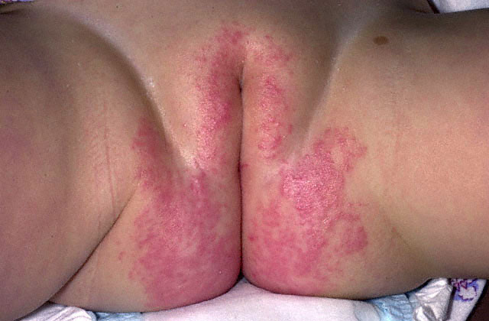
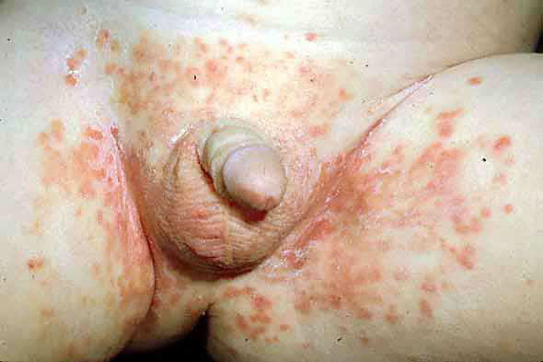

Slide 18
TREATMENT
Frequent diaper changes & short periods
without diapers are important adjunctive
treatment.
Area should be washed following a bowel
movement.
Washing should be done with warm water
only.

Slide 19
CONTD……
Air drying is useful.
Long standing diaper rash should be treated
with topical antifungal therapy such as nystatin cream, powder or ointment; clotrimazole 1% cream; miconazole 2% ointment etc.

Slide 20
TIPS TO PARENTS
INCLUDE:
Use disposable nappies.
If cloth nappies are used, make sure the
nappies are rinsed and dried well after
washing.

Slide 21
CONTD……
Change the nappies frequently.
Do not leave your baby in wet or dirty nappy.
Wash the babys bottom at every change.

Slide 22
CONTD.......
Use warm water to remove all urine & bowel
motions.
Pat dry frequently.
Moisturize dry skin at every nappy change.

Slide 23

THANK YOU

