Slide 1
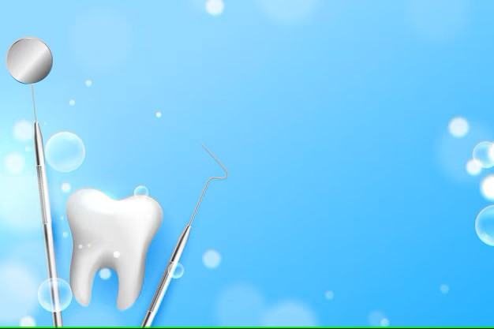
Danta Vijnana
Dr. Jyoti Kumari Jangir
Assistant Professor
MD (Kaumarbhritya)

Slide 2
Cource Learning Outcomes
Evaluate normal growth and development and its deviation in children.
Demonstrate knowledge and skills in assessing and intervening child health through Ayurveda with research updates

Slide 3
Teaching learning methods- lecture with power point presentation
Domain- Cognitive/comprehension and Cognition / Knowledge
Must to know / desirable to know / Nice to know- Must Know and Desire to know
Millers pyramid- Know

Slide 4
INTRODUCTION (Dentition in Ayurveda)
Charaka & Sushruta : No specific dentition details, but
  Sushruta: 15 Dantamula (gum) & 8 Dentational disorders
Teeth origin: From Pitruj Bhav (father) – Ch. Sh. 3/7, S. Sh. 3/33
Eruption: Starts at 4 months onwards– K.S. Su. 20/6
Vagbhata: Mentions Danta Roga & Dantamamsa Roga
Sharangdhar : explained 22 balrogas (out of them 4 are Dant rogas – Dantodbhed, Dantghata, Dant Shabda, Akaladanta)
Kashyapa: Pioneer in pediatric dentistry
  Separate chapter ‘Dantajanmika’ in Kashyapa Samhita

Slide 5
Dantotpatti Prakriya (Physiology of teeth eruption)
" तत्रास्थिमज्जानौ दन्तोत्पत्ति हेतु ।।” (अ.सं.उ. २/२१)
“तदा च तयोरसम्पूर्णवीर्यत्वात् पुनः कालान्तरेण दन्तानां पतनमापूर्यमाणधातुत्वाच्च पुनरुत्थानमत एव च वृद्धानां न पुनर्दन्तोत्पत्तिः । : ।।" (अ.स.उ. २/२१)
  Vagbhata: Teeth originate from Asthi & Majja Dhatu
  Due to incomplete strength, primary teeth fall off, and new teeth erupt
  Three stages of tooth eruption:
    Primary Dentition – Only milk teeth present
    Mixed Dentition – Both milk & permanent teeth
    Permanent Dentition – Only permanent teeth remain

Slide 6
Dantotpatti Kala (Period of dentition)
Vagbhata:
  8 months or later – Sign of long life
  4 months or earlier – Indicates shorter life span
Kashyapa:
  Explain detailed signs/symptoms of tooth eruption from 4th to 8th month
  Month-wise specific features described

Slide 7
Cont…
मासविशेषेण दन्तनिषेकस्य दोषा गुणाश्च
चतुर्थे तु मासि दन्ता निषिक्ता दुर्बला भवन्त्याशुक्षयिणश्चामयबहुलाश्च,
पञ्चमे स्पन्दनाश्च प्रहर्षिणश्चामयबहुलाश्च
षष्ठे प्रतीपाश्च मलग्राहिणश्च विवर्णाश्च घुणदन्ताश्च भवन्ति,
सप्तमे द्विपुटाः स्फोटिनश्च राजिमन्तश्च खण्डाश्च रूक्षाश्च विषमाश्चोन्नताश्च भवन्ति,
तथाऽष्टमे मासि सर्वगुणसंपन्ना भवन्ति । (का.सू. 20)

Slide 8
Cont…
Period Effect
4th month Weak, fall very easily and prone to disorders
5th month Shaky, tingling sensation, prone to disorders
6th month Irregular, deposition of waste, discolored and affected with caries
7th month Cracked having lines , broken dry, irregular and forwardly protruding
8th month Have all the qualities of a healthy tooth

Slide 9
Kashyapa had following concepts regarding dentation
“इहः खलु नृणां द्वात्रिंशद्दन्ताः, तत्राष्टौ सकृज्जाताः स्वरुढ दन्ता भवन्ति, अतः शेषा द्विजाः ।।'' (का.सू. २०/४)
Total number of teeth: 32
Out of these, 8 are ‘Sakrijjata’ – they appear only once and do not regrow.
The remaining 24 are ‘Dwija’ – they fall and re-erupt as permanent teeth.
"यावत्स्वेव च मासेसु दन्ता निषिच्यन्ते तावत्स्वहः सूद्भिद्यन्ते । "यावत्स्वेव च मासेषु जातस्य सत उद्भिद्यन्ते तावत्स्वेव च वर्षेषु पतिताः पुनरुद्भिद्यन्ते" ।। (का.सं.सू. २०/४)
Milk teeth (deciduous teeth) erupt in the same month after birth as the month in which their formation began during intrauterine life.
The month of eruption of milk teeth often corresponds to the year in which that tooth will fall and the permanent tooth will emerge.

Slide 10
Danta Swasthya
Chewing Sticks (Dataun) – with Dantshodhan churna
  Recommended daily and after meals for oral hygiene.
  Length of Dataun- 12 angul as thick as the little finger (Sushrut)
  Tastes preferred: Katu, Tikta and Kashaya.
Gandoosh Dharan: with Khadir, Triphala, Arjun etc. Sidhh kwath or Tila Tailam.
In Ayurveda dental health is personalized, based on one's Prakriti (body constitution) and influenced by nature and climate.

Slide 11
ऋतु | दोष प्रकोप | रस प्रधान दातौन
वर्षा | वात | मधुर - मधुक
शरद | पित्त | तिक्त - निम्ब कषाय - खदिर
हेमंत | कफ | कटु - करंज तिक्त - निम्ब कषाय - खदिर
Note:
Dantshodhan Churna (दंतशोधन चूर्ण)-
त्रिकटु, त्रिजात , तेजोवती चूर्ण, मधु, तैल, सैंधव

Slide 12
Dataun nished in balak
भक्षयेद्दन्तपवनं नास्थिरद्विजबन्धनः| तस्य तद् घट्टनात्क्रुद्धः कुर्याद्दन्तामयान्मरुत्||५७|| अ सं उत्तर अध्याय 1/57 Child should not use tooth-brush for cleaning teeth. As teeth are still loose and unstable, due to friction, vata may be vitiated. Vitiated Vata may produce many disorders of teeth.

Slide 13
दन्तधावन का निषेध
गला, तालु, ओष्ठ एवं जिह्वा के रोग, मुखपाक, श्वास, कास, हिक्का एवं वमन से ग्रसित, दुर्बल, अजीर्णावस्था में भोजन किये, मूर्च्छा एवं मद से पीड़ित, शिरःशूल से दुःखी, प्यासे, थके, मद्यपानी, अर्दित, कर्णशूल एवं दन्तरोगी को दातौन नहीं करनी चाहिए ।
दन्तधावन हेतु निषिद्ध वनस्पति, काण्ड
श्लेष्मातक, अरिष्ट (रीठा), विभीतक, धव, करीर, बिल्व, निर्गुण्डी, शिग्रु, तिल्वक, तिन्दुक, कोविदार, शमी, पीलू, पिप्पली, इंगुदी, गुग्गुलू, पारिभद्र, इमली, शाल्मली तथा शण इन वृक्षों के काष्ठ का तथा जिन वृक्षों का रस मधुर-अम्ल-लवण हों, शुष्क, सुषिर, पूति, पिच्छिल हो उनका प्रयोग न करें ।

Slide 14


