Slide 1
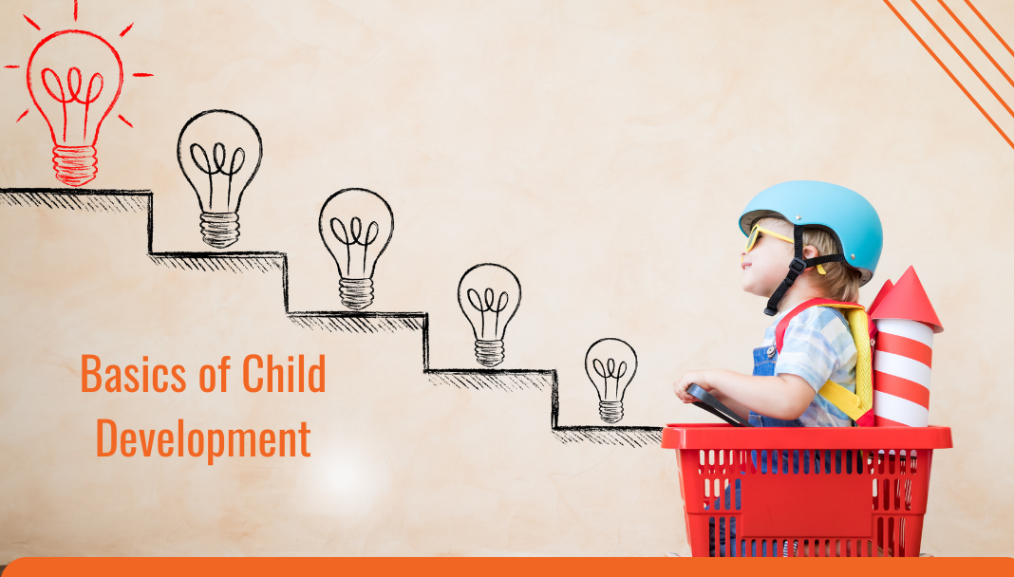
(Bala Samvardhana) Growth and Development
Dr. Jyoti Kumari Jangir
Assistant Professor
MD (Kaumarbhritya)

Slide 2
Cource Learning Outcomes
Evaluate normal growth and development and its deviation in children.
Demonstrate knowledge and skills in assessing and intervening child health through Ayurveda with research updates

Slide 3
Teaching learning methods- lecture with power point presentation
Domain- Cognitive/comprehension and Cognition / Knowledge
Must to know / desirable to know / Nice to know- Must Know and Desire to know
Millers pyramid- Know

Slide 4
INTRODUCTION
The process of growth and development starts before the baby born i.e. from conception in the mother's womb.
Growth and Development are closely interrelated.
Hence, factors affecting one also tend to have an impact on the other.
They are not interchangeable because they represent two different aspect of dynamics of change

Slide 5
What is Growth ?
Growth is the process of physical maturation resulting an increase in size of the body and various organ.
It occurs by multiplication of cells and an increase in intracellular substance.
It is Quantitative changes of the body which can be measured in Inches/Centimeters/pounds/kilograms.
Growth is progressive and measurable phenomenon.

Slide 6
What is Development ?
Development is the process of functional and physiological maturation of the Individual.
It is progressive increase in skill and capacity to function.
It is related to maturation and myelination of the nervous system.
It includes Psychological, Emotional and Social changes.
It is Qualitative aspect of maturation and difficult to measure.

Slide 7
Stages of Growth and Development
Stages of growth and development can be as:-
Prenatal period/intrauterine
Ovum:- O to 14 days after conception
Embryo:- 14 days to 9 weeks
Fetus:- 9 weeks to birth
Postnatal period / extra uterine life
Neonate:- from birth to 4 weeks of life
Infancy:- first year of life
Toddler:- 1 - 3 years

Slide 8
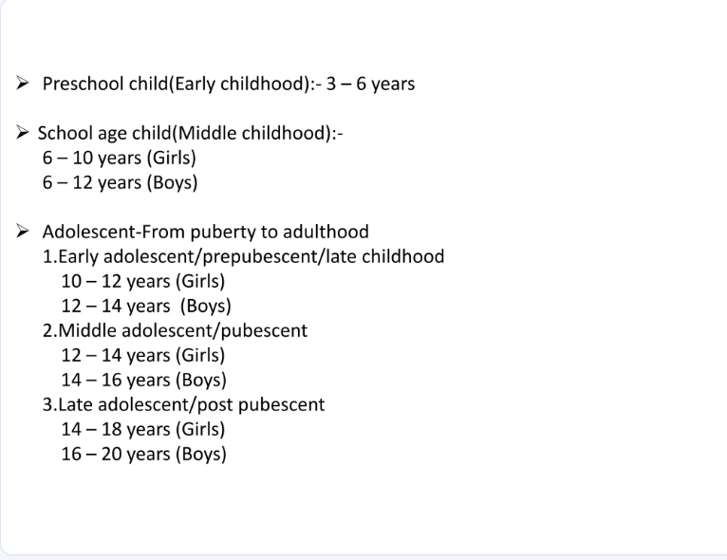

Slide 9
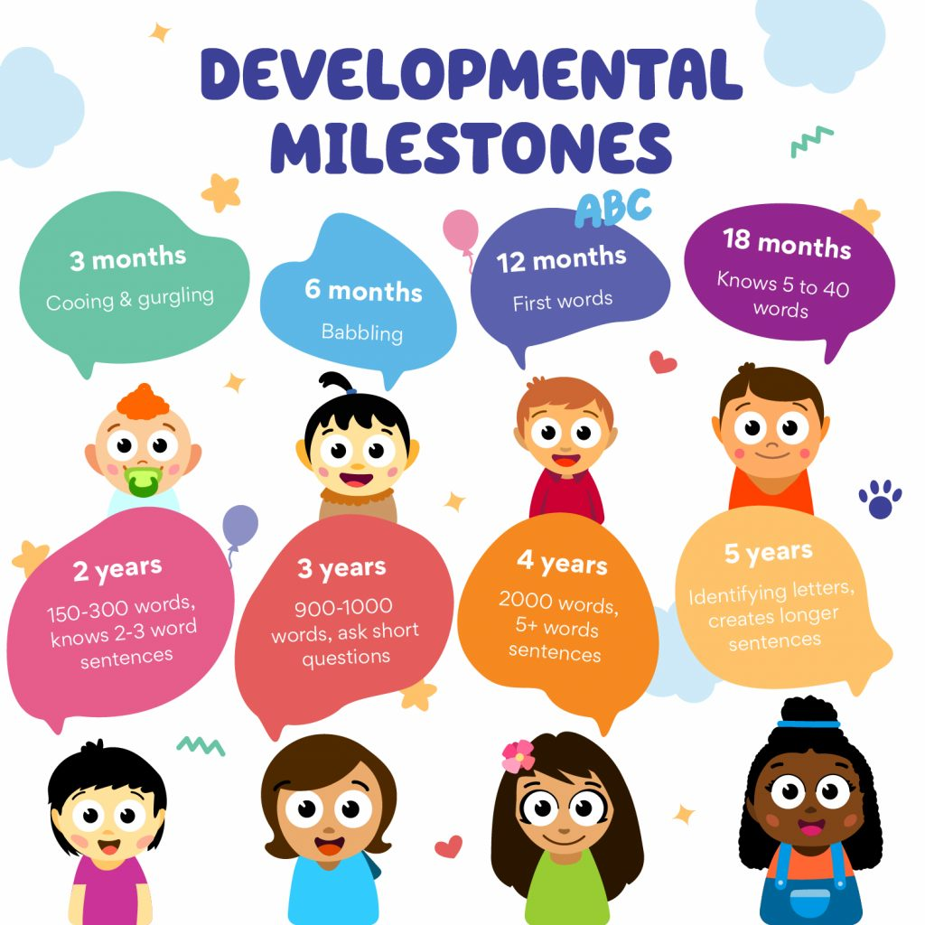

Slide 10



Slide 11
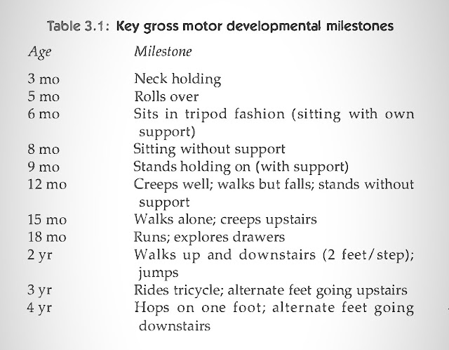

Slide 12
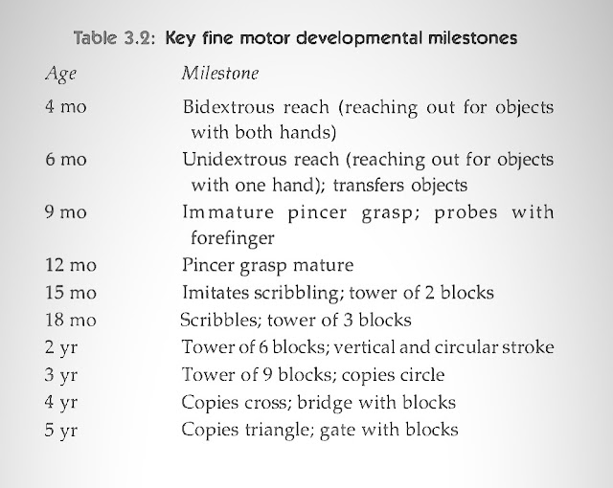

Slide 13
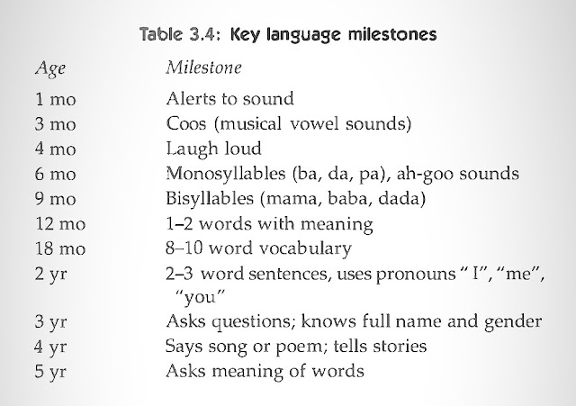

Slide 14
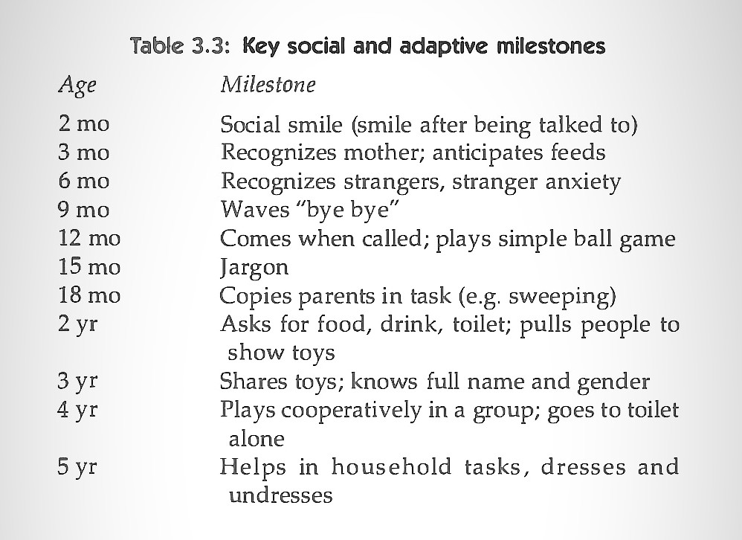

Slide 15

Developmental Assessment

Slide 16
Goal of Developmental Assessment
The goal of developmental assessment is not only to generate a diagnosis, but equally important to analyze the pattern of strengths and weaknesses in the child, family, and available developmental, educational, and social support systems, in order to direct treatment.
The maturation of central nervous system is characterized by coordination of motor activity and as infants grow they respond to their environment in a purposeful manner with the help of special senses (acoustic and auditory inputs), integrity of labyrinthine, vestibular and musculoskeletal systems.

Slide 17
Children achieve neuro-motor milestones of development at predictable ages within a narrow range of few weeks or months.
Development is dependent upon interaction between innate genetic potential and environmental factors like emotional security, love and attention, stimulating home environment, optimal nutrition, ethnic and cultural factors.
Neuro-motor retardation may occur due to gestational immaturity, perinatal hypoxia, birth trauma, metabolic disorders (inborn errors of metabolism), hypoglycemia, kernicterus, intrauterine infections, postnatal CNS infections, hypothyroidism, developmental and chromosomal disorders.

Slide 18
Some tools for developmental assessment
Gessel Development Tool
Amiel-Tison Method of Assessment
Vineland Social Maturity Scale (VSMS)
Bayley Scales of Infant Development
Brazelton Neonatal Behaviour Scale
Vojta Technique
Denver Developmental Screening Test (Denver-II)
Trivandrum Developmental Screening Chart.
Baroda Developmental Screening Chart.
Seguin Form Board

Slide 19
Self Help General (SHG) - performing general activities like head holding ETC
Self-help Eating (SHE) - This caters to the child's ability to handle her/his eating patterns and take care of her/his nutritional needs. The child gets more independent in terms of eating.
Self-help Dressing (SHD) - This category indicates the child's ability to cleanse and dress her/himself.
Self-direction (SD) - The adolescent period is specifically characterized by the desire of social freedom in personal conduct. This is clearly expressed in the handling of money, in looking after everyone's needs etc. Two series are apparent, that is, money and purchasing.

Slide 20
Occupation (OCC) - This may include playful activity in infancy, helping minor tasks, involve in self-exploratory tasks, and working for others.
Communication (COM) - This is related to the social use of language, literacy and other means of communication and how these help individuals to adapt better.
Locomotion (LOM) - Locomotion involves including going to the neighborhood and other places.
Socialization (SOC) - It involves social skills.

Slide 21
Developmental Screening
The American Academy of Pediatrics recommends that all children be screened for developmental delays and disabilities during regular well-child doctor visits at:
9 months
18 months
24 or 30 months
Additional screening might be needed if a child is at high risk for developmental problems due to preterm birth, low birth weight, or other reasons.

Slide 22
Developmental delay
Developmental Delay is when a child does not reach their developmental milestones at the expected times.
The significance of the delay is often only determined by observing the child's development over time.
Developmental delay occurs in up to 15% of children under 5 years of age. This includes delays in speech and language development, motor development, social-emotional development and cognitive development.
It is has been estimated that only about half of the children with developmental problems are detected before they begin school.

Slide 23
The developmental quotient (DQ) can be calculated as follows:
Developmental age
Chronological age
100

Slide 24
How to Assess a child for developmental screening
Should take in place in a room with appropriate for child.
With one or both parents, but no prompting and helping.
With chair and table.
Child's behavior and interaction with parents during history taking should be observed prior to physical examination.
Normal functioning of motor, vision and hearing should be assessed
Infant or child in a good temper.
Should not be hungry, tired, unwell, had convulsion prior, under influence of sedative or anti-epileptic drugs.

Slide 25
Accurate history of developmental milestones is often difficult to obtain due to poor observation and educational status of the mother.
Early events in the life of child's development may be forgotten by the parents. The milestones should be asked in a chronological order in a simple and lucid manners
The social smile must be differentiated from spontaneous smile which even newborn babies may exhibit during sleep or fantasy.
The mother should be asked whether the child interacts and plays with children of his age or likes the company of younger children.

Slide 26
The effects should be made to identify whether child is globally retarded or backward only in an individual or specific field e.g. delayed speech in a deaf child, delayed walking in a child with congenital dislocation of hips etc.
To understand how older children are growing and developing, we can look at how well they do in school, how good they are at playing games, and how they behave with others.

Slide 27
Developmental milestones serve as the basis of most standardized assessment and screening tools.
Two separate developmental assessment over time are more predictive than a single one.
Developmental monitoring not only should be aimed at identifying children who have low function, but at directing the focus of anticipatory guidance to help promote normal development.
In preterm babies corrected age (conceptional age) should be used as the chronological age especially during first year of life.

Slide 28
Apart from assessing the developmental milestones, the examiner should undertake a detailed neurological examination, evaluate the muscle tone and special senses (vision and hearing).
All high-risk infants must be subjected to detailed assessment of hearing and vision at the age of 6 months.

Slide 29
Developmental delay should be suspected if the child is not able to :
Lack of social smile by 2 months.
Absence of stable head control by 4 months.
Roll over by 6 months.
Inability to recognize the mother by 6 months.
Inability to sit when pulled to sit by 6 months and lack of independent sitting without support by 10 months.
Lack of creeping by 12 months.
Stand holding on by 10-12 months.

Slide 30
Interpretation of findings:
The global developmental delay in all the domains (motor, adaptive, social, language etc..) is suggestive of mental retardation.
Isolated delay in gross motor development may occur due to poor physical growth due to protein energy malnutrition.
Lack of environmental stimulation and poor interaction by parents may adversely affect neuromotor development.

Slide 31
Delay in an isolated sphere of motor development like walking may be due to congenital dislocation of hips.
Isolated delay in the development of speech is most commonly due to deafness.
Autistic children must be differentiated from children with mental retardation. Autistic children may have normal development upto certain age and then regress especially in their social and communication skills.

Slide 32
Developmental delay can be categorized into two main types: transient (temporary) and persistent (long-lasting). It can also be described as either isolated or specific (affecting one area), or global (affecting multiple areas of development)."
Transient developmental delay
Some children have a transient delay in their development.
For example, some extremely premature babies may show a delay in the area of sitting, crawling and walking but then progress on at a normal rate.
Other causes of transient delay may be related to physical illness and prolonged hospitalization, immaturity, family stress or lack of opportunities to learn.

Slide 33
Persistent developmental delay
When a delay continues over time, it is called persistent.
It often involves one or more areas of development (e.g., speech, movement, learning).
Persistent delays are often linked to developmental disabilities.

Slide 34
Isolated (Specific) Developmental Delay
Affects only one area of development.
Example: A child may have delayed speech but normal motor skills.
Early intervention can help address the specific delay.
Global Developmental Delay (GDD)
Affects multiple areas (2 or more) of development.
Delays can occur in speech, motor skills, cognitive abilities, and social interactions.
Often diagnosed in early childhood and may require multidisciplinary support

Slide 35
Management
Early Intervention Services (Birth to 3 Years)
From birth to 3 years, any child with a known disability, significant developmental delay, or a high-risk condition (like Down syndrome) has the right to receive early intervention services.
These services aim to help the child develop better skills in areas like movement, communication, and learning.

Slide 36

Types of Services may include:
Physical therapy – to improve movement and strength
Occupational therapy – to help with daily activities like eating or dressing
Speech and language therapy – to support communication skills
Special education/teaching, counseling, and family training – to help both the child and the family

Slide 37


