Slide 1
INTRODUCTION TO KAUMARBHRITYA
Dr. Jyoti Kumari Jangir
Assistant Professor
MD (Kaumarbhritya)

Slide 2
Cource Learning Outcomes
Evaluate normal growth and development and its deviation in children.
Demonstrate knowledge and skills in assessing and intervening child health through Ayurveda with research updates

Slide 3
Teaching learning methods- lecture with power point presentation
Domain- Cognitive/comprehension and Cognition / Knowledge
Must to know / desirable to know / Nice to know- Must Know and Desire to know
Millers pyramid- Know

Slide 4
Definitions of Kaumarbhritya
कौमारभृत्यं नाम कुमारभरणधात्रीक्षीरदोषसंशोधनार्थं दुष्टस्तन्यग्रहसमुत्थानाञ्च व्याधीनामुपशमनार्थं च । (सु.सु. 1/6)
Means –
Kaumarabhritya is one among the eight branches of Ayurveda and it deals in detail about Kumar Bharana which includes Poshana and Dharana i.e. nutrition as well as growth and developmental aspects of a child, Dhatri, different types of milk like breast milk, animal and its vitiation, defects as well as treatment.
It deals in detail regarding different Grahas, its vitiations and treatment.
It also deals with Stanya and Stanya Dusti with its treatment.

Slide 5
Definitions of Kaumarbhritya
कौमारभृत्यमिति कुमाराणाम् भृतिः धारणम् पोषणम् च तस्येदमिति कौमारभृत्यम् । (चक्रपाणि)
Means –
One which is concerned with Dharana i.e. holding, supporting or maintenance of optimal healthy status of growth and developmental aspect of the child.
One which deals with nutritional aspect of the child and which is required for all round development of the child.

Slide 6
Definitions of Kaumarbhritya
गर्भोपक्रमविज्ञानं सूतिकोपक्रमस्तथा ।
बालानां रोगशमनी क्रिया बालचिकित्सम्॥ (हा.सं.2/17)
Garbhopakrama- Kaumarabhritya explains topics related to Garbhopakrama as health status of fetus in antenatal period determines its future health status. This includes study of embryology, antenatal hazards, monthwise development of fetus, diet and regimen of a pregnant lady.

Slide 7
Definitions of Kaumarbhritya
Suthikopakrama- Sutika is post natal period, where baby is in contact with the Sutika mother and completely depends on her for breast milk. Stanya Dusti of different kinds and different systemic disorders of Sutika will have hazardous effect on the growing baby. Hence, for the welfare of the baby one should also take care of mother.
Bala Roga Shamani- Dealing exclusively with disorders of Bala, like different systemic disorders, Graha Roga, Kuposhanajanya Vyadhi etc.

Slide 8
Definitions of Kaumarbhritya
कौमारभृत्यं नाम कुमारभरणधात्रीक्षीरदोषसंशोधनार्थं दुष्टस्तन्यग्रहसमुत्थानाञ्च व्याधीनामुपशमनार्थं च । (सु.सु. 1/6)
Means –
Kaumarabhritya is one among the eight branches of Ayurveda and it deals in detail about Kumar Bharana which includes Poshana and Dharana i.e. nutrition as well as growth and developmental aspects of a child, Dhatri, different types of milk like breast milk, animal and its vitiation, defects as well as treatment.
It deals in detail regarding different Grahas, its vitiations and treatment.
It also deals with Stanya and Stanya Dusti with its treatment.

Slide 9
तत्र बालमपरिपक्वधातुमजातव्यञ्जनं सुकुमारमक्लेशसहमसंपूर्णबलं
श्लेष्मधातुप्रायमाषोडशवर्षम् ॥ (च.वि. 8/122)
Bala (बाल) is one, who is having immaturity of Dhatus, non-development of secondary sexual characteristics, delicate body tissues with inability to withstand stress and medicines. Bala is that stage of life, where strength of the body is not at its maximum level and with predominance of Kapha Dosha. This period extends till sixteen years of life.

Slide 10
Scope and importance of Kaumarbhritya
कौमारभृत्य का आधार ग्रंथ - काश्यप संहिता
काश्यप संहिता - प्रथम स्थान
आचार्य वाग्भट्ट- द्वितीय स्थान
आचार्य सुश्रुत- पंचम स्थान
आचार्य चरक- षष्ठम स्थान

Slide 11
Scope and importance of Kaumarbhritya
'कौमारभृत्यमष्टानां तन्त्राणामाद्यमुच्यते । आयुर्वेदस्य महतो देवानामिव हव्यपः। अनेन हि संवर्धितमितरे चिकित्सन्ति । बालस्य हृद्यमौषधम्मन्यत् । प्रमाणमन्यदन्य उपक्रमोऽन्ये च विशेषाः । (का.वि. 61) Kashyapa considered Kaumarabhritya as the main branch among eight branches of Ayurveda and explained it with first preference. Its importance has been compared with Agni Devata among the Devatas.

Slide 12
Scope and importance of Kaumarbhritya
Agni Devata (अग्निदेवता) receives all offerings given during, Homa (होम), Havana (हवन), which will be later carried to all other Devatas. So, in the absence of Agni rest of the Devatas can't get their offerings.
Hence, Agni acts as a mediator. Similarly all other medical branches will have a scope of getting patients if physicians of Kaumarabhritya looks after the baby, treats the disease of Bala, makes them grow and survive up to 16 years (Today's children are citizens of tommorrow).
Again, treatment of Bala is quite specific, as medicines should be Hridya in comparison to other medical fields. Meanwhile quantity, dose of medicine and certain treatment procedures are also different.

Slide 13
Scope and importance of Kaumarbhritya
लोकेस्मिंस्त्रयो दुष्करकारिणः । भिषग्धात्री च बालश्च त एव सुखःदुखिताः । परिज्ञानं विना वाताद्यौषधकल्पने शिशोः ।
भिषक्कौमारभृत्यस्तैः कारणैर्नित्यंदुःखितः । का.चि. धात्री चिकित्सित अध्याय Why physician of Kaumarabhritya is great? It has been told that, physician of Kaumarabhritya always stands different from other doctors due to challenges that he faces

Slide 14
Cont..
There are mainly three people in the world who performs their duty under stress. They are- 1. भिषक् (Physician of Kaumarabhritya). 2. धात्री or माता (one who looks after and takes care of the baby). 3. बालक (who is dependent on others).
and these three always experiences happiness and sadness (सुःख and दुःख).

Slide 15
Terminologies used in Kaumarbhritya
बालक
निरुक्ति- बल्यते बलते वा |बल संचलने (अमरकोष)
जिसमे बल का आधान हो, बल का संचालन हो
शिशु
निरुक्ति- अतिशय शयनेन इति शिशु । जो ज़्यादा सोता है ।
कुमार
निरुक्ति- कुमारयति क्रीड़यति । जो क्रीड़ा करता है

Slide 16
Cont..
नवजात
1st month of new born (birth to 28 days)
सद्योजात
First 24 hr after birth
जातमात्र
After birth till cutting of umblical cord

Slide 17
Cont…
Pediatrics word-American origin
Paediatrics word- British origin
Pais means child
Iatros means doctor or healer
Perinatal period – 28th week of gestation to 7 days after birth
Extended perinatal period – 22nd week of gestation to 7 days after birth

Slide 18
Cont…
Gestational age- the duration of gestation is measured from 1st day of last menstrual period and gestation period or age is expressed in completed weeks and days
Adequate for gestational age (AGA) - babies with birth weight of between 10th and 90th percentile for that gestational age
Small for gestational age (SGA) –babies with birth weight of less than 10th percentile for that gestational age
Large for gestational age (LGA) –babies with birth weight of more than 90th percentile for that gestational age

Slide 19
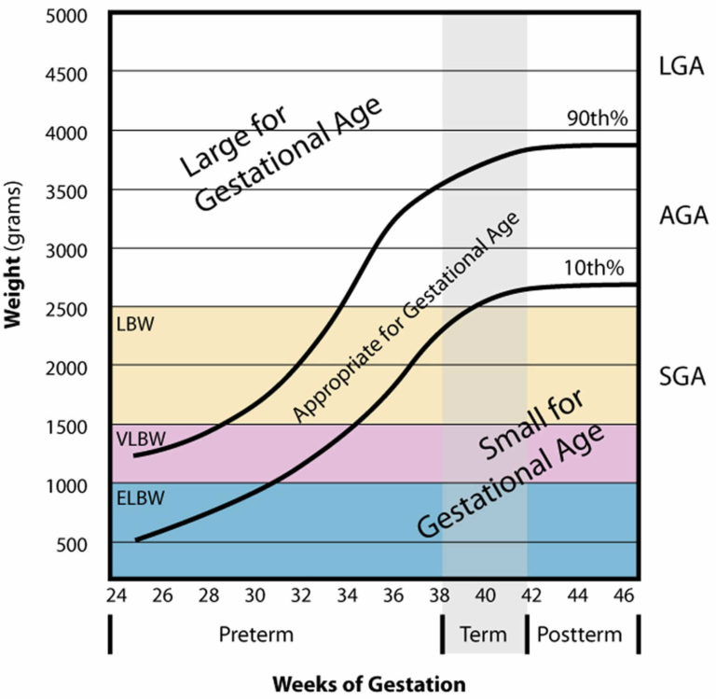

Slide 20
Cont…
Term baby – born between 37-41 week
Pre term baby – born before 37 week
Post term baby – born after 41 week

Slide 21
Cont…
Average weight of new born baby at birth in india - 2.9 kg (in range 2500-3500g)
Low birth weight (LBW)- birth weight less than 2500 g
High risk low birth weight - birth weight less than 2000 g
Very low birth weight (VLBW) – BIRTH WEIGHT LESS THAN 1500G
Extreme low birth weight (ELBW)- birth weight less than 1000g
Micro premie – birth weight less than 800 g

Slide 22
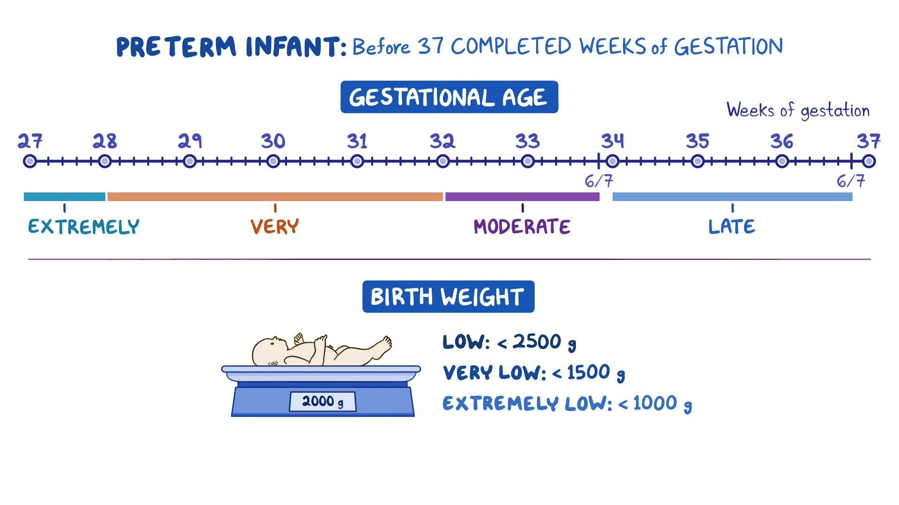

Slide 23
Cont…
Fetal death –
Intrauterine death of a fetus before delivery from the mother, regardless of the duration of pregnancy. Fetal deaths do not include induced terminations of pregnancy (abortions).
Classification-
Early fetal death- Death of fetus having birth weight of less than 500 g or gestation of less than 22 week or CHL of less than 25 cm
Intermediate fetal death – fetus having birth weight between 500 to 1000g 0r gestation between 22 to 28 week or CHL between 25 – 35 cm
Late fetal death or Still birth- Death of fetus having birth weight of 1000 g or more and gestation of 28 weeks or more or crown heel length (CHL) more than 35 cm

Slide 24
Cont…
Abortion: Intentional termination of a pregnancy, typically performed in the first trimester, and can be a legal medical procedure.
Miscarriage: Natural loss of a pregnancy, occurring spontaneously at any time during pregnancy, and is not a medical procedure.

Slide 25
Still birth - during pregnancy death of fetus after 20weeks of gestation
Still born – death of fetus at the time of birth or just prior to delivery baby is dead

Slide 26
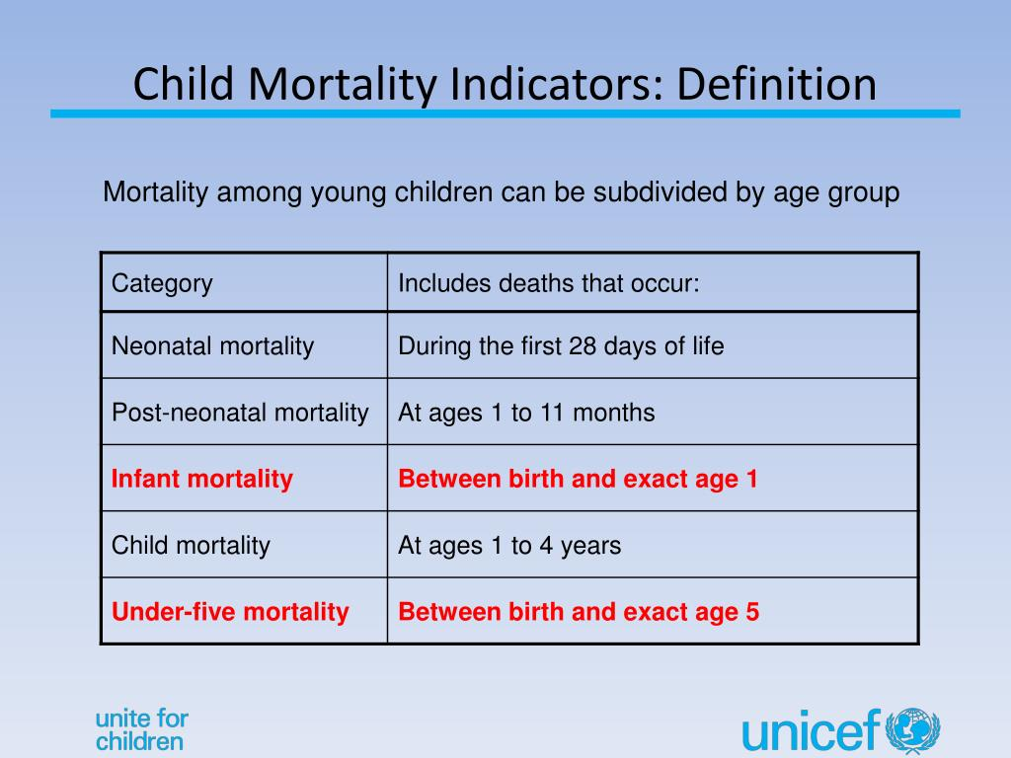

Slide 27


