Slide 1

Ambulatory
Breathing
Unit
Material
Silicon

Slide 2
Indications :
During resuscitation
Birth asphyxia
Respiratory distress
Apnoea
After surfactant therapy
Paralysis of resp. muscles

Slide 3
Contraindications:
Meconium aspiration
Diaphramatic hernia

Slide 4
Parts
Oxygen inlet
Air inlet (reservoir is attached here)
Self inflating silicon rubber bag
Pop-off valve
Fish-mouth valve
Expiratory valve

Slide 5
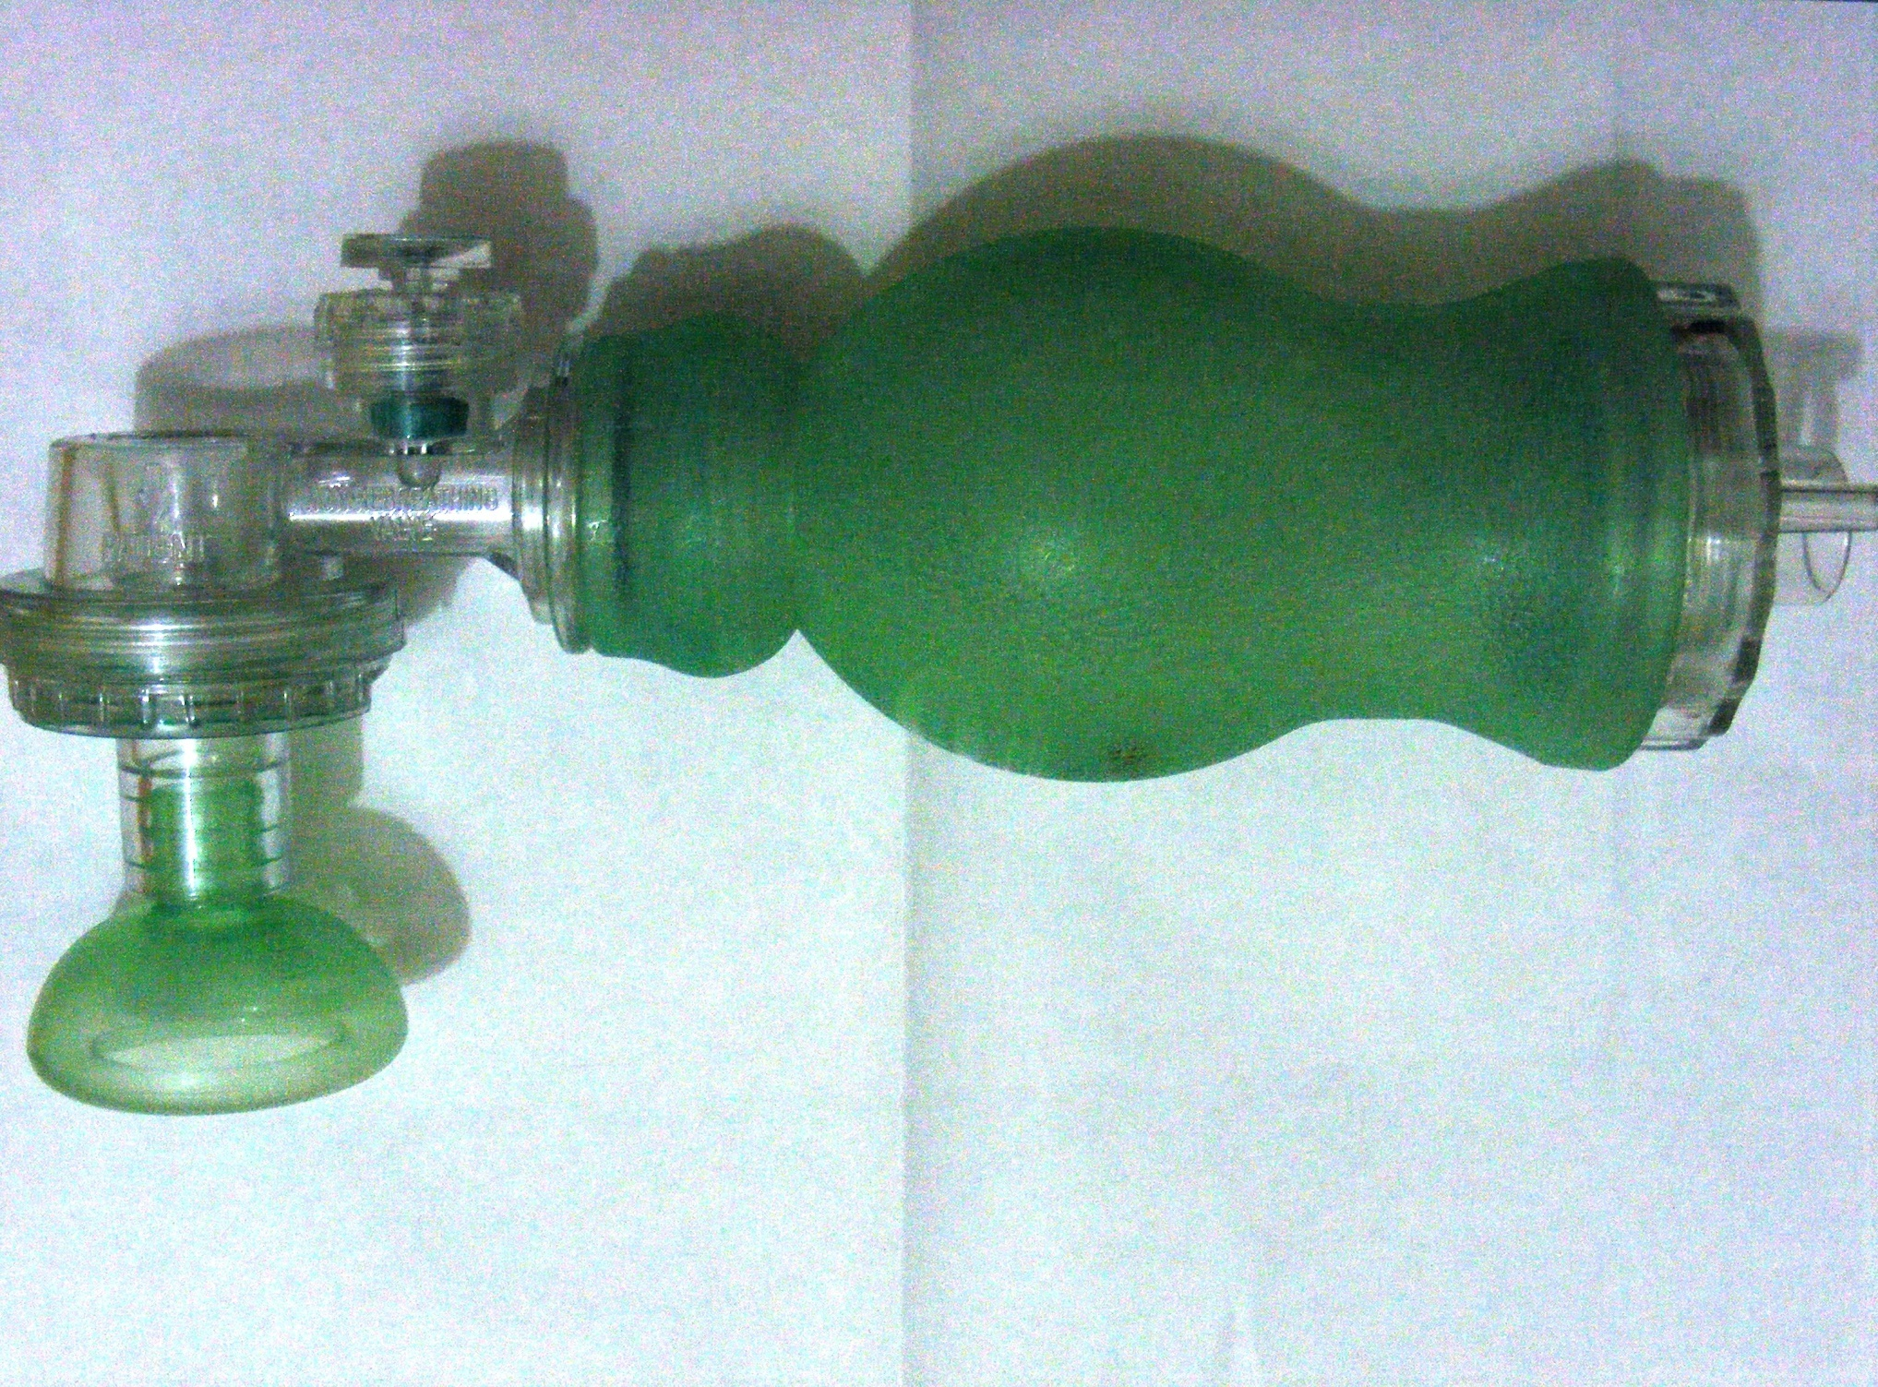

Slide 6
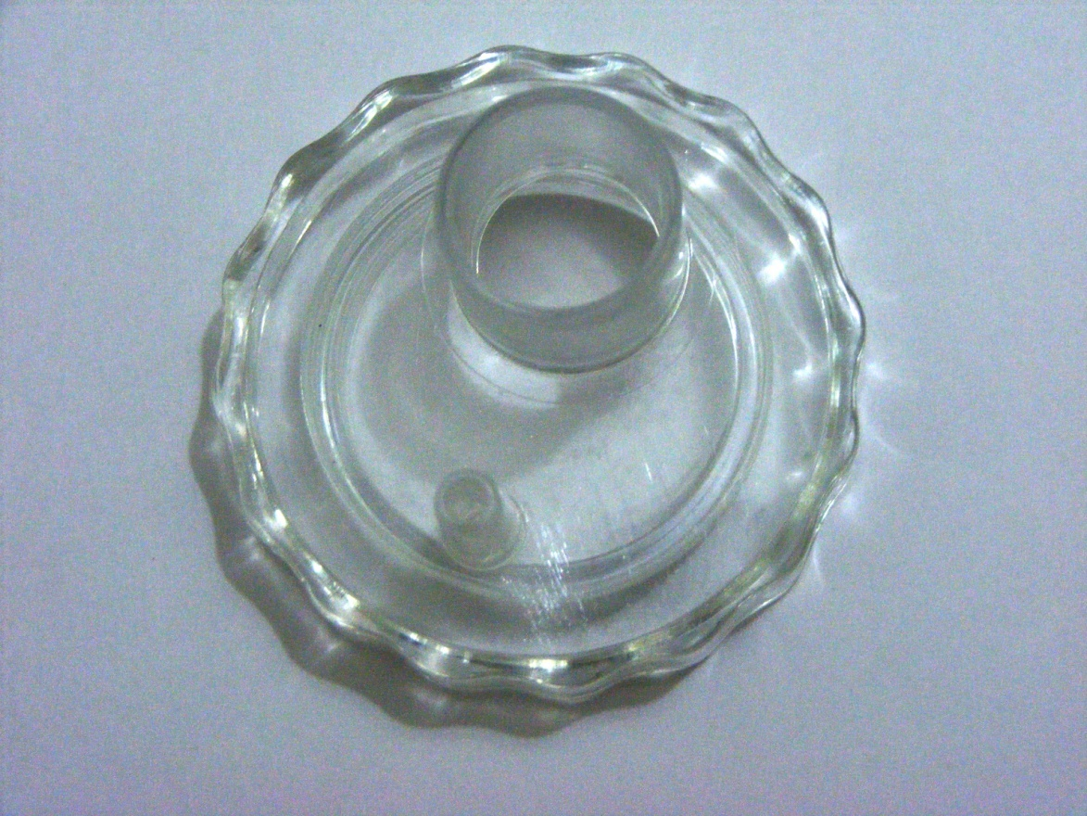
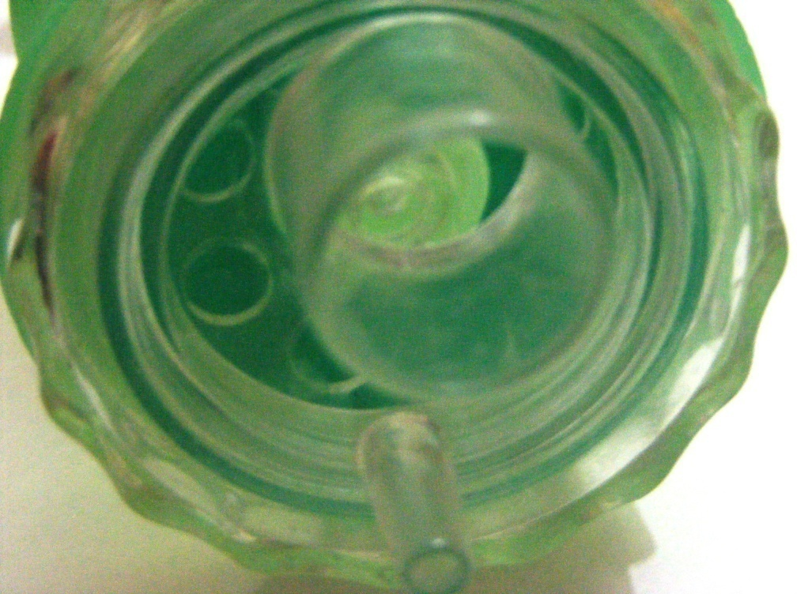
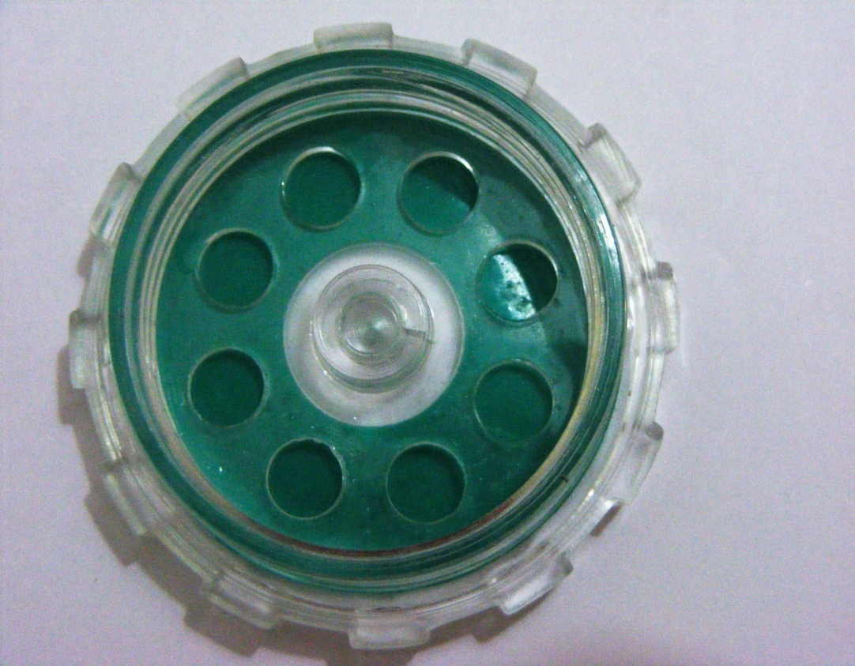

Slide 7
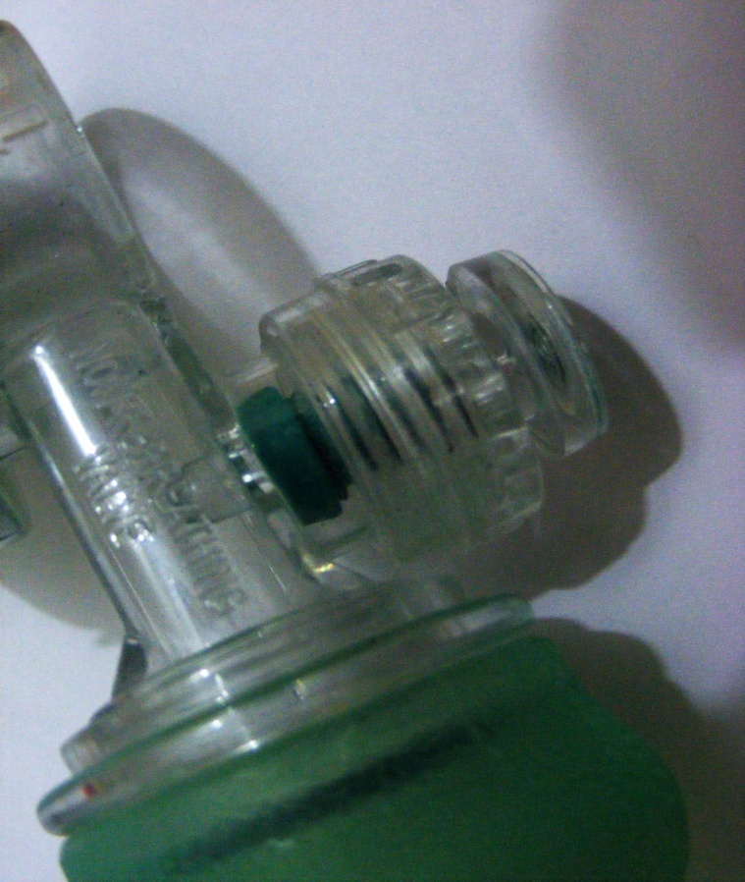
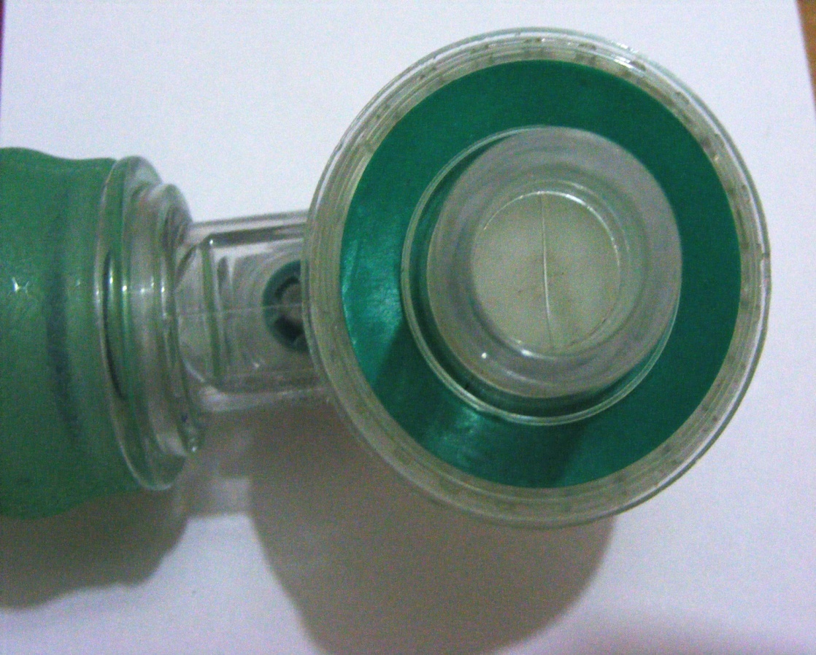
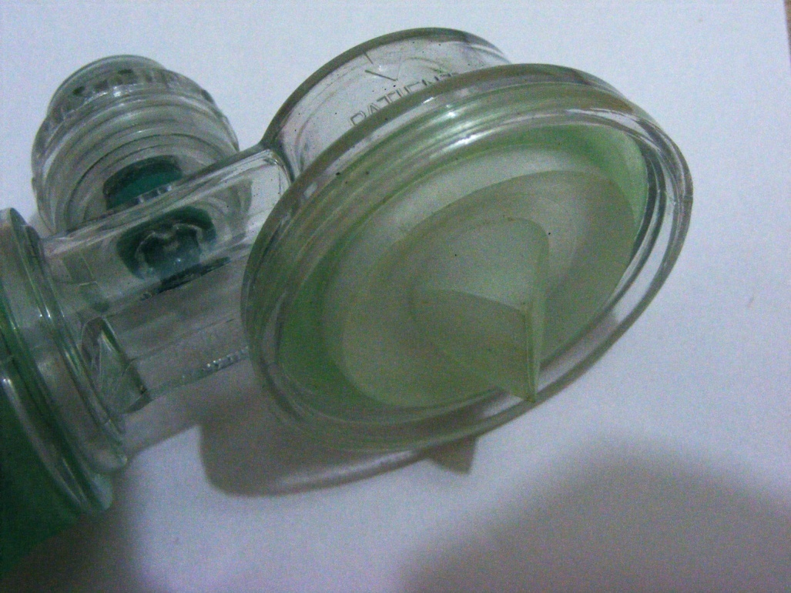

Slide 8
Reservoir
used to increase the O₂ concentration upto
90-98%
Prevents air from mixing with the oxygen in the bag
Molecular weight of CO₂ > O2

Slide 9
MASK
Round
Anotomically shaped
Cushioned (less traumatic, requires less pressure to maintain the seal)
Uncushioned
Size
Should cover
the nose upto the bridge,
Mouth
Tip of the chin
Should not cover the eyes
Seal is maintained by E-C clamp technique

Slide 10
Pop-off Valve
Usually pops-off at 30-40 cm of H2O
May be blocked to deliver first high pressure breath in HMD
It prevents barotrauma
Prevents the development of pneumothorax

Slide 11
Sterilization
Gluteraldehyde
Washed with soap water and dried
Autoclaved
Checked by blocking the outlet and pressing the bag, the pop-off valve should pop-off.

Slide 12
Check for adequate ventilation:
Adequate chest rise
Improvement in pts SpO2

Slide 13
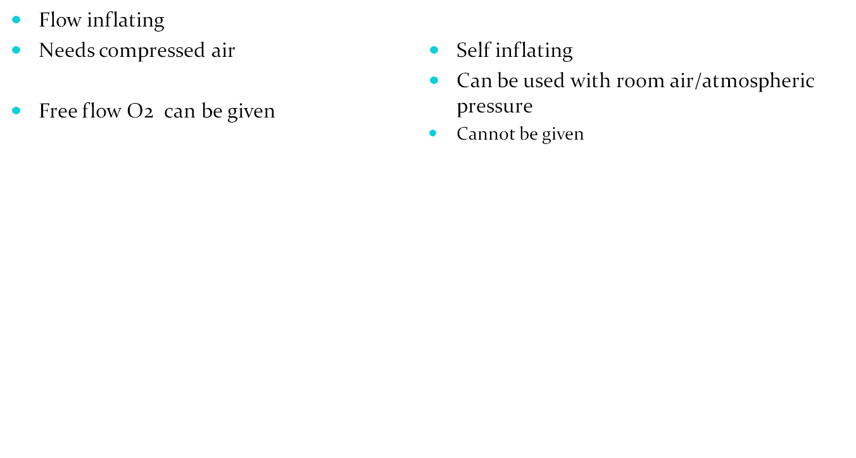
Diff bet anesthesia bag and ambu bag

Slide 14
Laryngoscope
Parts?
Types of blades?
Indications?
Method of use?
Size of blades?

Slide 15
Parts
Handle (also contains the batteries)
Blade
Two types of blades
Straight - miller
Curved – Macintosh (preferred in children >8yrs)

Slide 16
Size
Preterm & LBW - 0
Term neonates - 1
2 to 10 yrs - 2
> 10 yrs - 3
Indications
intubation
During resuscitation
Birth asphyxia
Respiratory distress
Apnoea
MSL
General anesthesia
Foreign body

Slide 17
Always check the bulb before intubating
Check batteries
Check for loose teeth

Slide 18
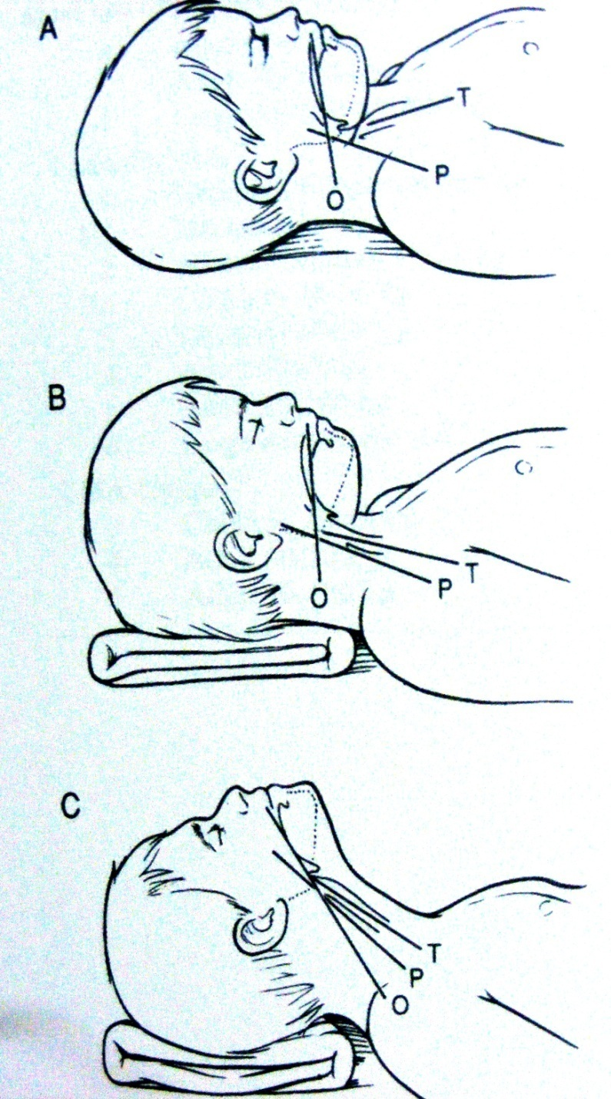
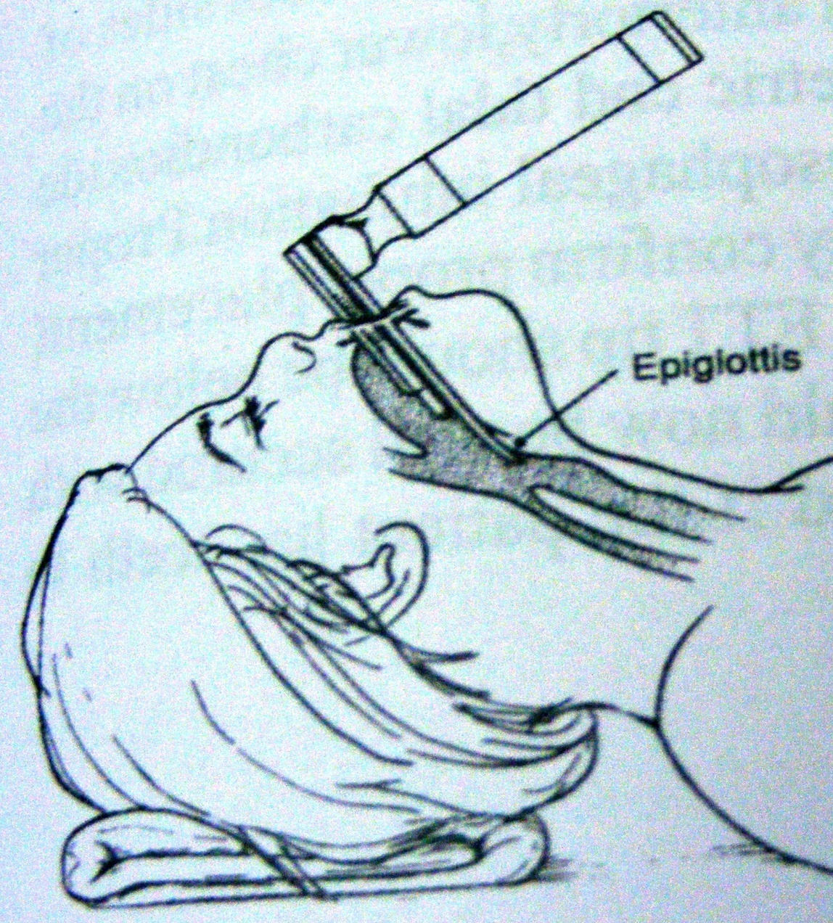

Slide 19
E.T. Tube
Material?
Types?
Size?
Length?
Indications?
contraindications?
Drugs?

Slide 20
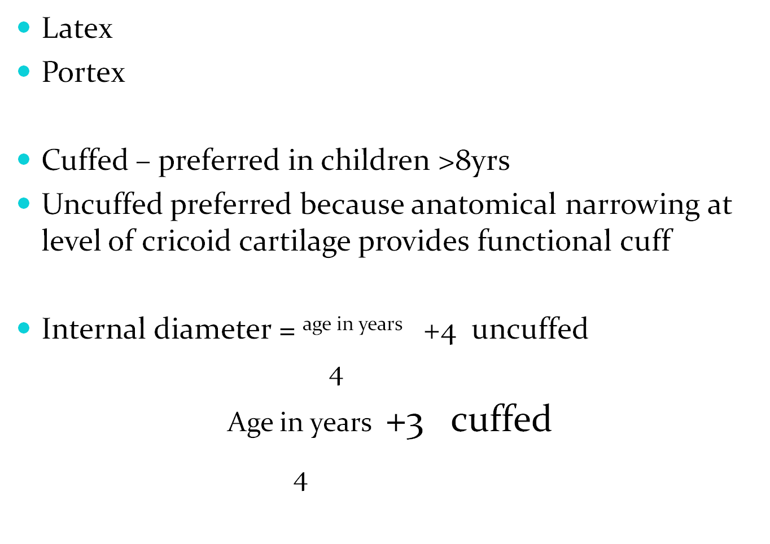

Slide 21
Preterm - 2 - 2.5
Term upto 2wks 3 - 3.5
2wks upto 6mths. 4 – 4.5
Lip to tip distance
6 + weight <44wks
3x ET tube size

Slide 22
Uses
Resuscitation
Mechanical ventilation
MSL
Respiratory distress
Life threatening croup
General anesthesia
Air way obstruction
Drugs
Adrenaline
Surfactant
Sodabicarb is never given.
Notes:
Seema

Slide 23
Confirmation of tube placement
Symmetrical chest rise
Equal breath sounds
Improved SpO2
Xray – tip should be at the T4 level.
DOPE

Slide 24
Oro-pharyngeal airway
Indications
Size

Slide 25
Non patent nostril and choane
Macroglossia
Difficult to maintain airway
Size measured from the angle of mouth to the angle of the jaw

Slide 26
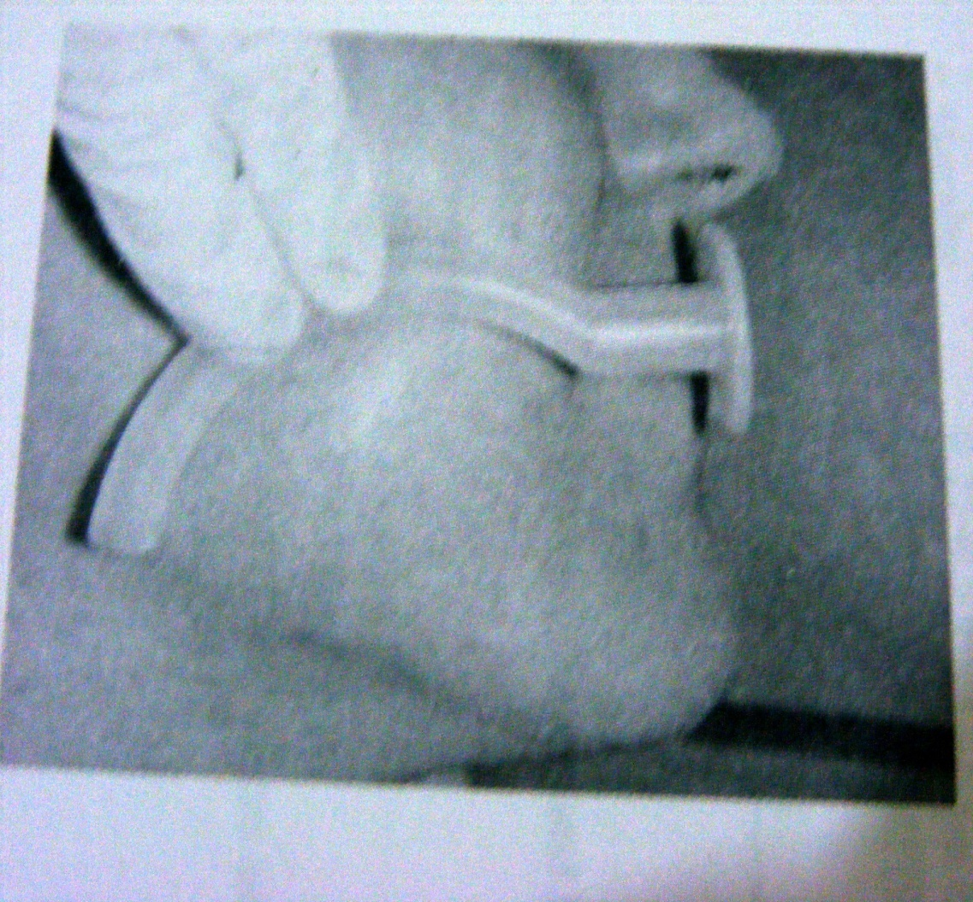
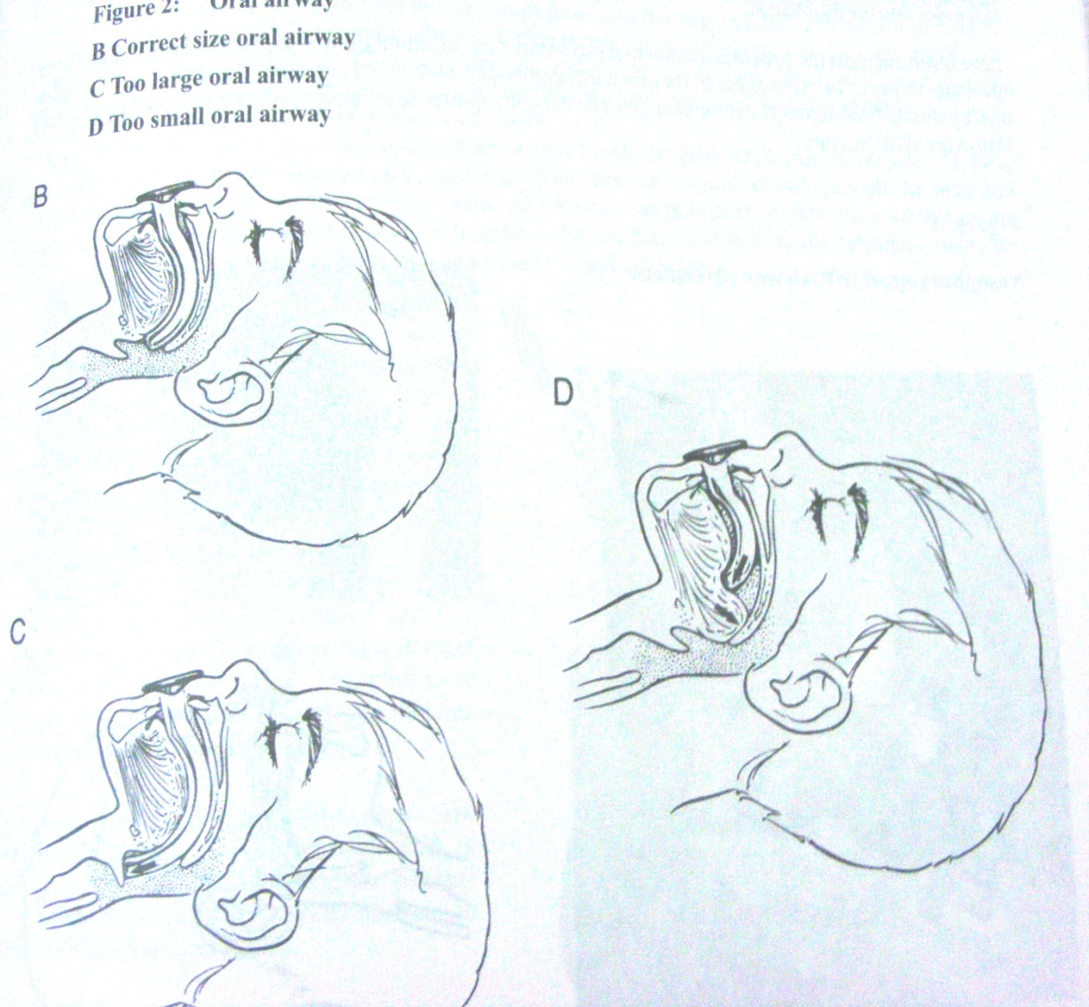

Slide 27
Feeding tube
Size
Use

Slide 28
Plastic tube with a blind end
Opening is present laterally proximal to the end
Outer end can be closed
Measured from tip of the nose to tragus to xiphisternum
Check proper placement before administering any fluids.

Slide 29
Use
Diagnostic
Gastric lavage for AFB
GI Bleeding
TOF
Chemical analysis of stomach contents
To R/o imperforate anus
Theraputic
Feeding
Medications
Gastric decompression
management of poisoning
Umbilical line
Other uses
O2 catheter
Tourniquet
Urinary catheter

Slide 30
Folley’s cath
1 year - 6-8
1-6yrs - 8-10
6-10 - 10
>10 - 12-14
Inserted by no touch technique
USES
relieve acute retention
To measure exact urine production
Collection of sterile urine sample
Bladder wash
Post op patients
Contraindications
Stricture
Local infection
Trauma
Difficult insertion

Slide 31
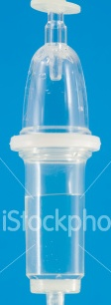
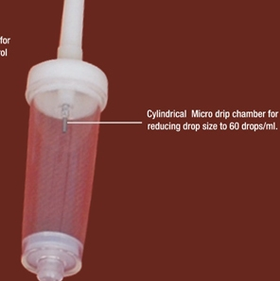

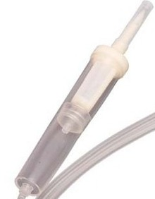
Macro-drip set | Macro-drip set | Macro-drip set | Macro-drip set
Macro-drip set | Macro-drip set | Macro-drip set | Macro-drip set
Macro-drip set | Macro-drip set | Macro-drip set | Macro-drip set
Macro-drip set | Macro-drip set | Macro-drip set | Macro-drip set

Slide 32
